Slide 1
Parametric insurance and smart mobility 2° May 2023 Tel Aviv Aida WorldConference
Simona Viciani (simona.viciani@unifi.it)
Associate professor Private Law

Slide 2
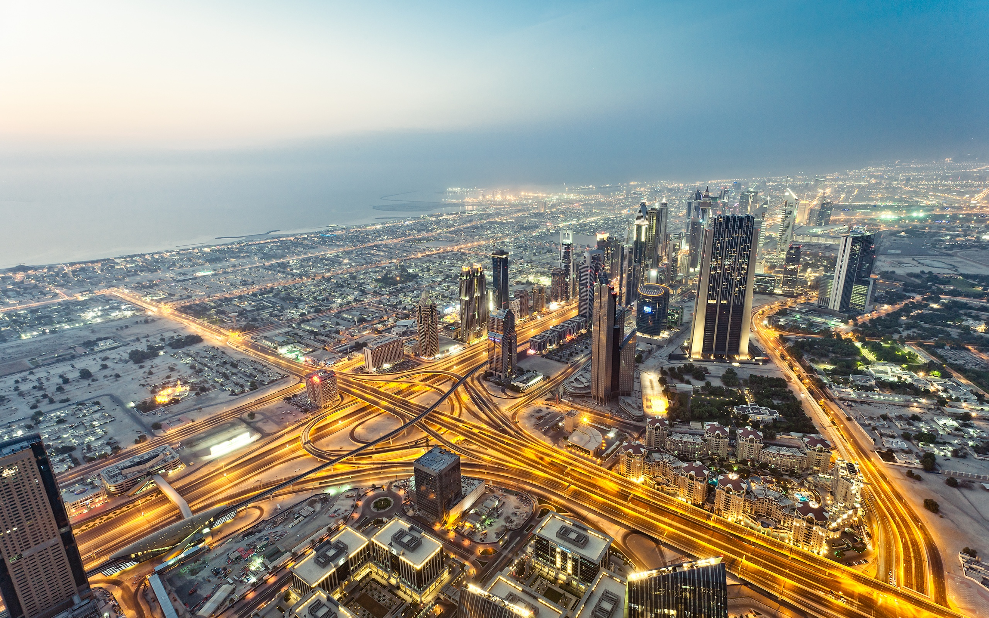
The IoT technologies are opening up towards the mobility of the future, in which connected vehicles will be even more protagonists and mobility will evolve very rapidly, with considerable benefits.
Questa foto di Autore sconosciuto è concesso in licenza da CC BY-NC-ND

Slide 3
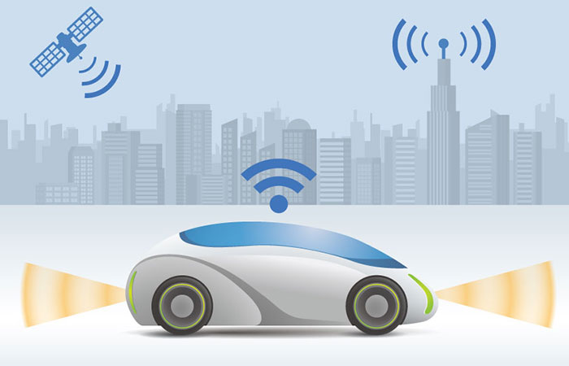
By smart car we mean the connection of cars to communicate real-time information to the consumer, connection between vehicles or between them and the surrounding infrastructure for the prevention and detection of accidents, as well as the offer of new insurance models and/or georeferenced traffic information.

Slide 4
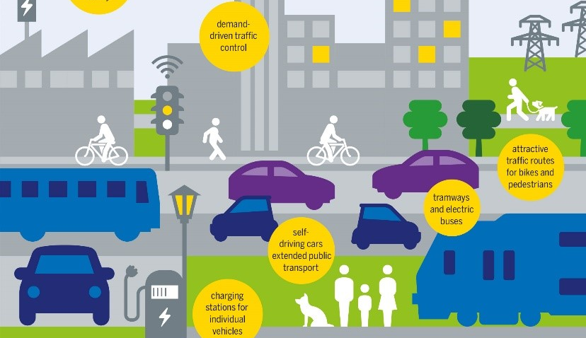
sustainable mobility
it will be possible to have an improvement in road traffic conditions, a reduction in environmental pollution and, above all, an extension of mobility also in favor of subjects for whom driving is a rule precluded as the elderly and disabled, transforming mobility into a real service.
Questa foto di Autore sconosciuto è concesso in licenza da CC BY-NC-ND

Slide 5
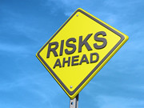
There are numerous risks associated with this type of mobility:
liability for road accidents
damage to third parties deriving from a technological anomaly
-the coexistence of traditional and autonomous vehicles
privacy protection
-cyber security
Questa foto di Autore sconosciuto è concesso in licenza da CC BY-ND

Slide 6
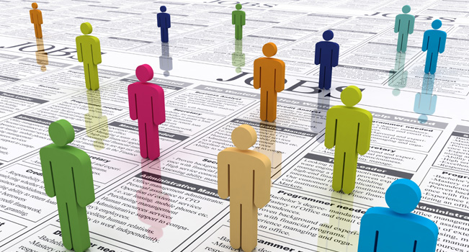
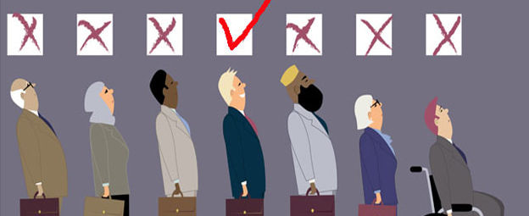
The key aspects of insurance on which is possible to evaluate the technological impact are:
1) The meaning and "ethical-juridical" validity of statistical discrimination, typical of insurance companies and the foundation of its regulatory peculiarities, in the light of the most recent scenarios of use of personal and non-personal data;
2) The functioning of insurance companies, which are increasingly challenged by the most recent phenomena of disintermediation and de-professionalisation, made particularly current by the technological developments of social networking and the use of robotic or artificial intelligence technologies.
Questa foto di Autore sconosciuto è concesso in licenza da CC BY-SA
Questa foto di Autore sconosciuto è concesso in licenza da CC BY-SA-NC

Slide 7
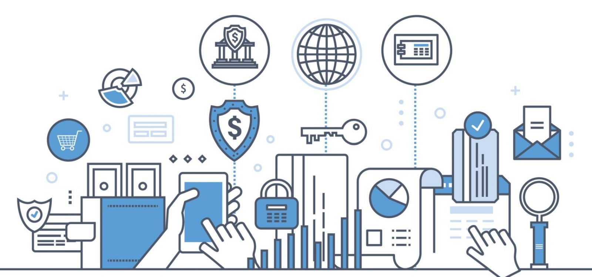
Among the main innovations in the insurance sector there are parametric policies: one of the most important Insurtech trends towards the use of big data and mobile technologies.

Slide 8
Parametric insurance is a valid offer for those types of risk for which traditional insurance solutions are not offered or are not economically sustainable for insurers. We are talking about risks, for which traditional coverage is not sustainable for policyholders.
In practice, parametric insurances are contracts in which the insurance benefit is triggered upon the achievement of a certain level of a variable or an index, in a pre-established period.

Slide 9
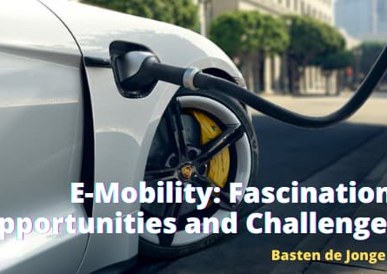
As far as e-mobility is concerned, we are facing a radical change for one of the fundamental sectors of the insurance market.
It is a question of evolving the most immutable product in the insurance world, on which much of the turnover of large companies is based, of redesigning risks and therefore pricing, as well as evolving distribution and customer profiling strategies

Slide 10
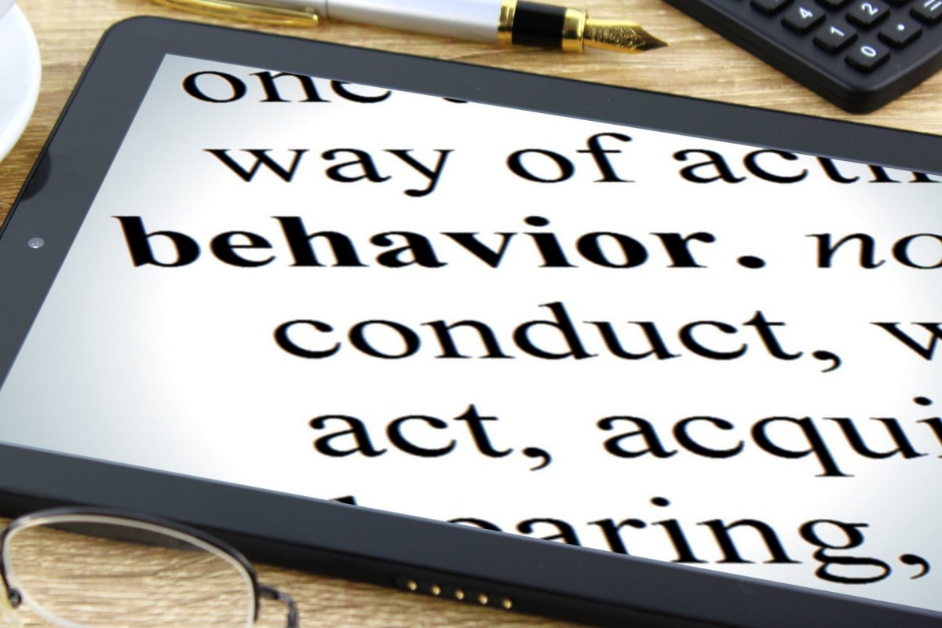
discriminatory practices will gradually decrease, thanks above all to embedded products, for example, we make data on our driving habits available to the manufacturer and the insurance company in a parametric way:
how many kilometers we travel
our driving style
for damage to property just the possible impact force could be evaluated taking into account the type and engine capacity of the car
on the basis of these data, the price of the policy that we will have to pay will be fixed.

Slide 11
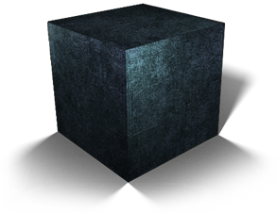
To date, black box , the device capable of assessing the driver's behavior and the actual responsibilities in the event of an accident, has already had a particular impact on the price of the policy.

Slide 12
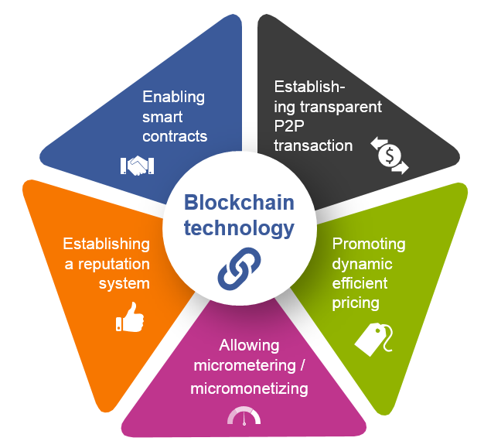
Furthermore, parametric insurance will find a valid ally in blockchain technology and smart contracts which will optimize the process of issuing and managing policies and will make settlement of damages to policyholders quick and certain.
In addition, third-party, certified and public sources (so-called "oracles") will be used, which will allow for the opening of the liquidation procedure and automatic reimbursement upon the occurrence of certain events.
In this way the consumer will no longer have to deal with all the bureaucratic steps for reporting the accident, for acknowledging the amount of the damage and the amount will be automatically credited.

Slide 13
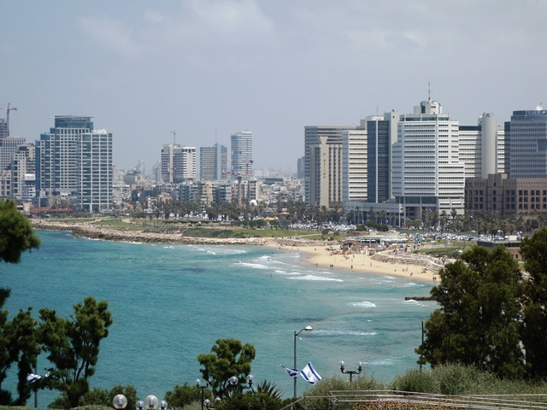
Thank you!
Questa foto di Autore sconosciuto è concesso in licenza da CC BY-SA

