Slide 2
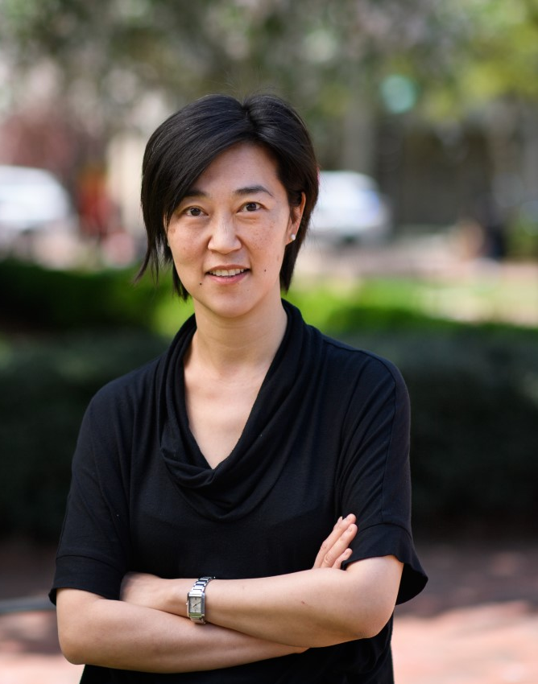
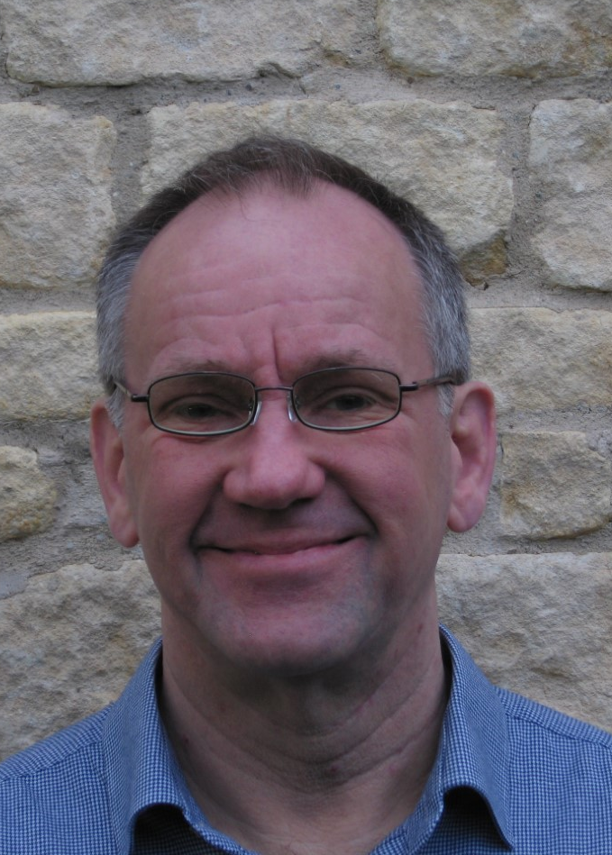
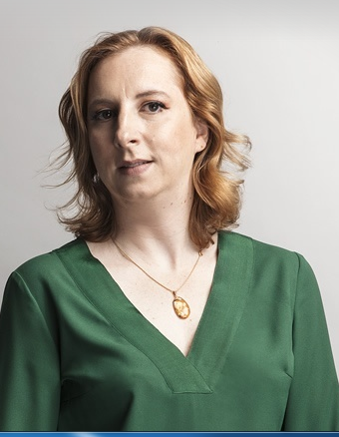
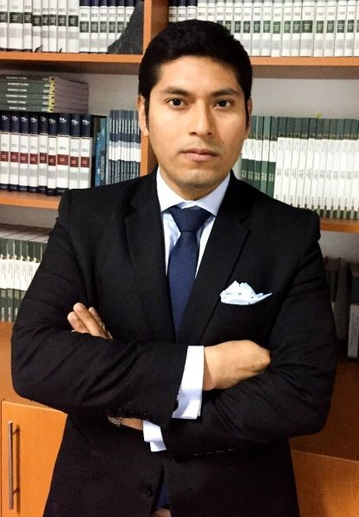
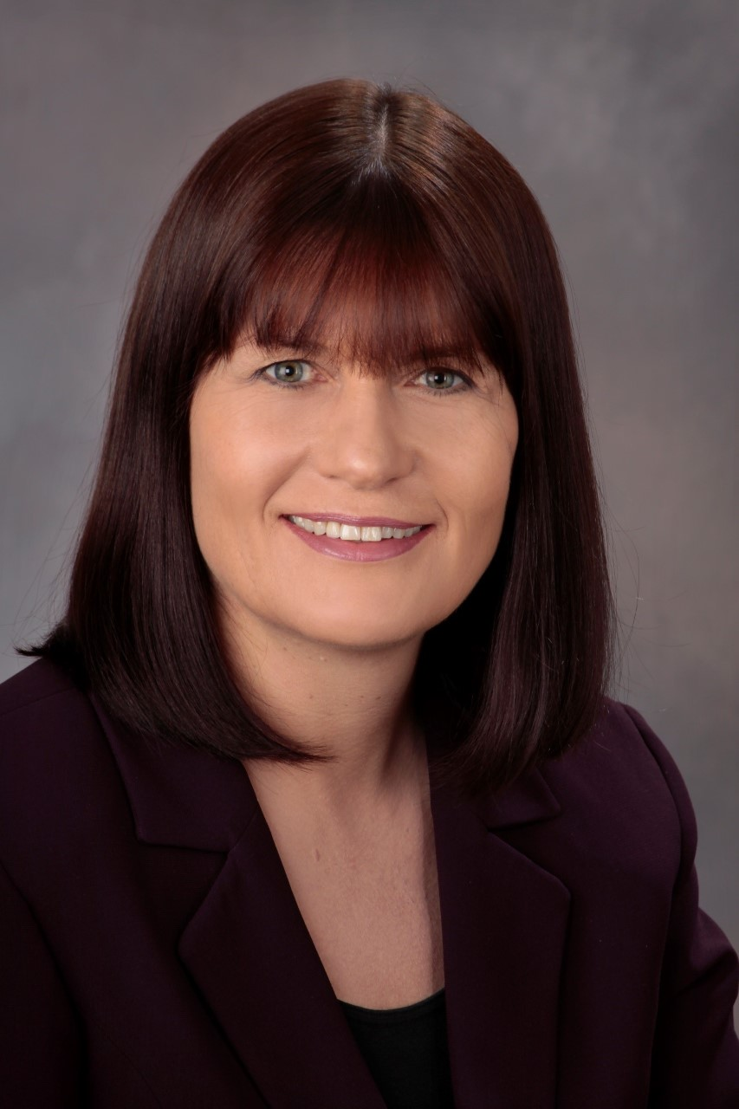
INSURANCE AND HUMAN RIGHTS
2nd session: Big Data and Discrimination in Insurance Panelists:
1st session: Insurance and ESG Panelists:
PROFESSOR CHRISTINA HO
STEPHEN TURNER
MARGARIDA LIMA REGO
CARLOS ACOSTA OLIVO
SAMANTHA HUNEBERG
BIRGIT KUSCHKE

Slide 4
Considering the Future of Insurance in ESG
Dr Stephen Turner
(University of Essex)

Slide 5
Considering Protection of the Environment and Human Rights
The relationship between human rights and the environment
ESG issues

Slide 6
Considering the Obligations of State Actors and Non-State Actors
National Constitutions
International Agreements
Corporate Law
International Investment Law
International Trade Law / WTO Law
Law of Multilateral Development Banks

Slide 7
Liability of Companies
Currently liability is not comprehensive
Especially when parent/subsidiary relationships are taken into account

Slide 8
Expectations of the International Community
Environment
Climate Change – Net Zero by 2050
Planetary Boundaries
Net zero harm related to biodiversity
Human Rights
Employment Rights
Modern Day Slavery
Health

Slide 9
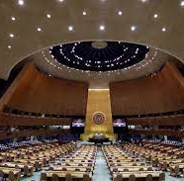
Renewed Systems of International Governance

Slide 10
Potential Movement to Higher Standards Internationally
International Agreements
Constitutional Law
Corporate Law – Directors’ Duties
International Trade Law
International Investment Law

Slide 11
A Central Role for Insurance
New regimes of responsibility (potential liability)
Compulsory Liability Insurance
Part of a Broader Range of Reforms in International Governance

