Slide 2
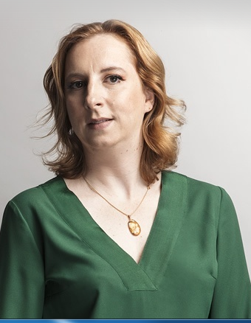
INSURANCE AND HUMAN RIGHTS
2nd session: Big Data and Discrimination in Insurance Panelists:
1st session: Insurance and ESG Panelists:
PROFESSOR CHRISTINA HO
STEPHEN TURNER
MARGARIDA LIMA REGO
CARLOS ACOSTA OLIVO
SAMANTHA HUNEBERG
BIRGIT KUSCHKE

Slide 4
BIG DATA AND DISCRIMINATION: A SOUTH AFRICAN PERSPECTIVE
DR SAMANTHA HUNEBERG
2 DECEMBER 2021

Slide 5
HOW CAN BIG DATA BE UTILISED IN THE INSURANCE INDUSTRY? BENEFITS VS PITFALLS? POSSIBILITY OF DISCRIMINATION AND EXCLUSION

Slide 6
THE BAD…
Possibility of exclusion?
May result in individual policyholders’ premiums being adversely impacted; thereby resulting in financial exclusion and ultimately exclusion altogether as a result of limited service provider offerings.
Ethical perspective? Fairness?
The use of AI increases the risk of consumers being manipulated and becoming subject to discriminatory treatment and arbitrary, non-transparent decisions.
Significant assumptions about consumers’ attributes, conditions and behaviour can be made using AI.
FAIRNESS
EXCLUSION
DISCRIMINATION
DATA PROTECTION

Slide 7
THE UGLY….
New data practices could allow firms to charge more individualised prices and lead to discriminatory price optimisation practices. Higher premiums for certain individuals.
Premiums should be set based on information that is directly pertinent to the pricing of insurance, including the risk and/or the cost of the individual policyholder.
Fairness of algorithms must be guaranteed to avoid potential bias in premium setting and general decision-making.
Insurers should avoid ‘labelling’ – should be based on factual evidence.
Each case should be judged on its own circumstances and merits.

Slide 8
THE GOOD….LEGISLATIVE MEASURES IN SA SUFFICIENT?
SA CONSTITUTION – S 9
SA EQUALITY COURTS - Equality courts are specialised courts
designated to hear matters relating
to unfair discrimination, hate speech and harassment.
THE PROMOTION OF EQUALITY AND UNFAIR DISCRIMINATION ACT 4 OF 2000 - extends the equality grounds to other general grounds causing or perpetuating systemic disadvantage, undermining human dignity or adversely affecting equal enjoyment of rights and freedoms.
SA appears to be progressive compared to other countries

Slide 9
SA CONSTITUTION – RIGHT TO EQUALITY (S 9)
Everyone is equal before the law and has the right to equal protection and benefit of the law.
Equality includes the full and equal enjoyment of all rights and freedoms. To promote the achievement of equality, legislative and other measures designed Chapter 2: Bill of Rights 6 to protect or advance persons, or categories of persons, disadvantaged by unfair discrimination may be taken.
The state may not unfairly discriminate directly or indirectly against anyone on one or more grounds, including race, gender, sex, pregnancy, marital status, ethnic or social origin, colour, sexual orientation, age, disability, religion, conscience, belief, culture, language and birth.
No person may unfairly discriminate directly or indirectly against anyone on one or more grounds in terms of subsection (3). National legislation must be enacted to prevent or prohibit unfair discrimination.
Discrimination on one or more of the grounds listed

Slide 10
CONCLUSION….
Ideally the aim of big data should, in line with fairness outcomes, be to enhance policyholder outcomes and improve societal welfare, however, with any innovation comes the potential for great risk.
Justification for insurers – discrimination vs differentiation
Algorithms in insurance must be constantly scrutinised by policymakers to ensure their high reliability and trustworthiness. The data that AI systems rely on when taking decisions about insurance consumers must be reliable and trustworthy.
Insurers will have to find a transparent way of gathering objectively determinable criteria relating to the risk insured.
If there are fair, objectively determinable reasons for differentiation, insurers must apply them fairly on a case-by-case basis.

