Slide 2
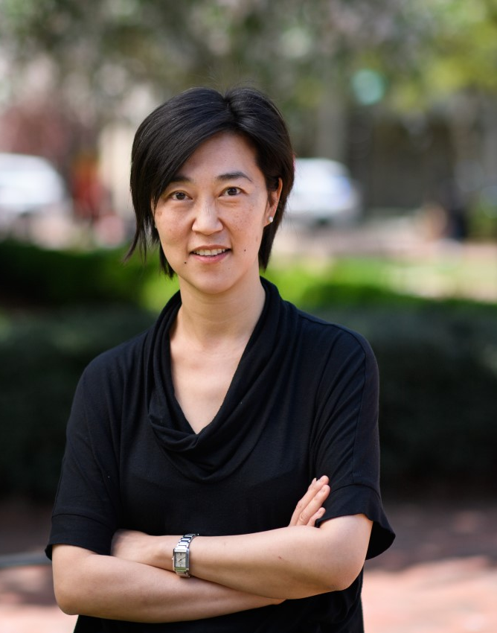
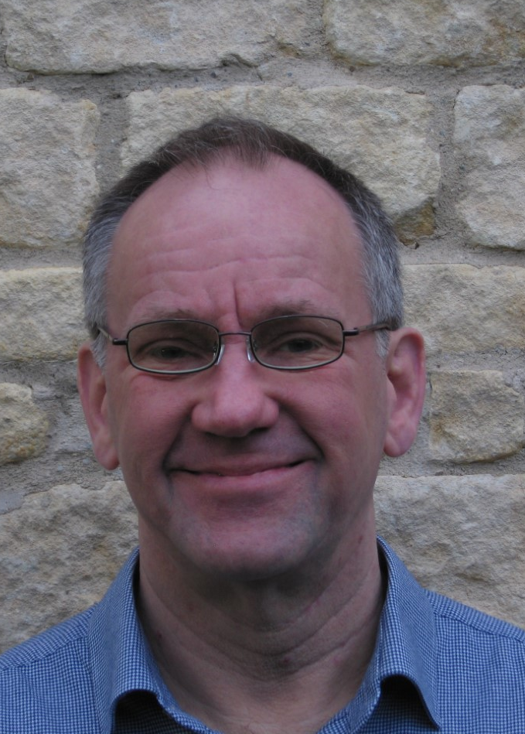
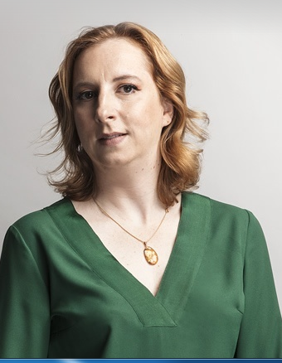
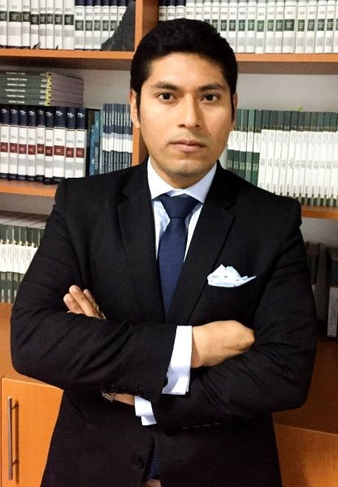
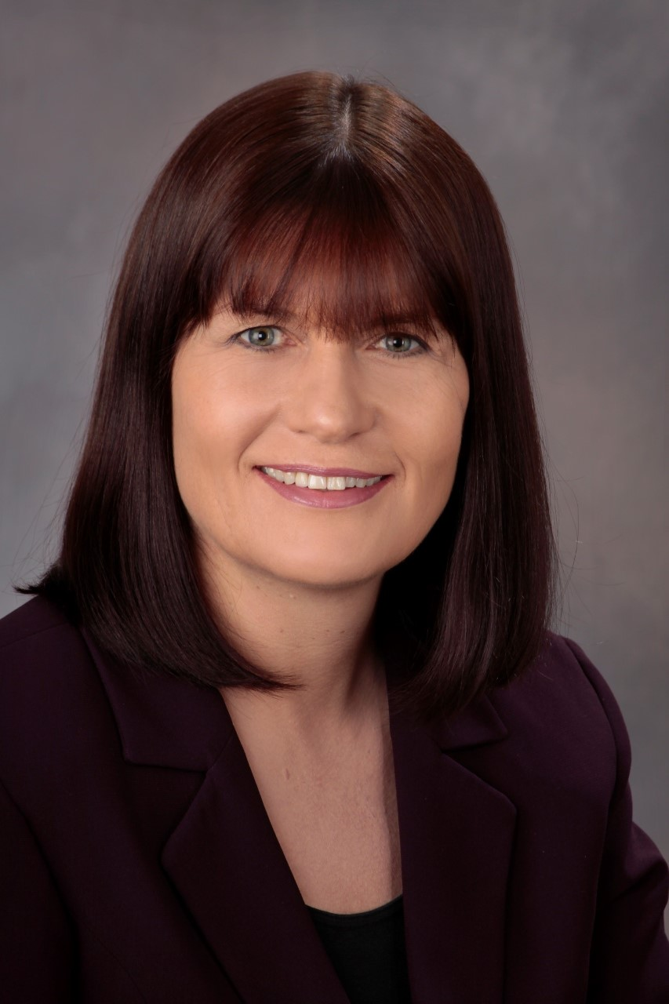
INSURANCE AND HUMAN RIGHTS
2nd session: Big Data and Discrimination in Insurance Panelists:
1st session: Insurance and ESG Panelists:
PROFESSOR CHRISTINA HO
STEPHEN TURNER
MARGARIDA LIMA REGO
CARLOS ACOSTA OLIVO
SAMANTHA HUNEBERG
BIRGIT KUSCHKE

Slide 4
Big data, human right and insurance
Prof. Carlos Acosta Olivo
LL.M. Derecho Privado Europeo
caacos03@ucm.es

Slide 5
Why is big data a trending topic?

Slide 6
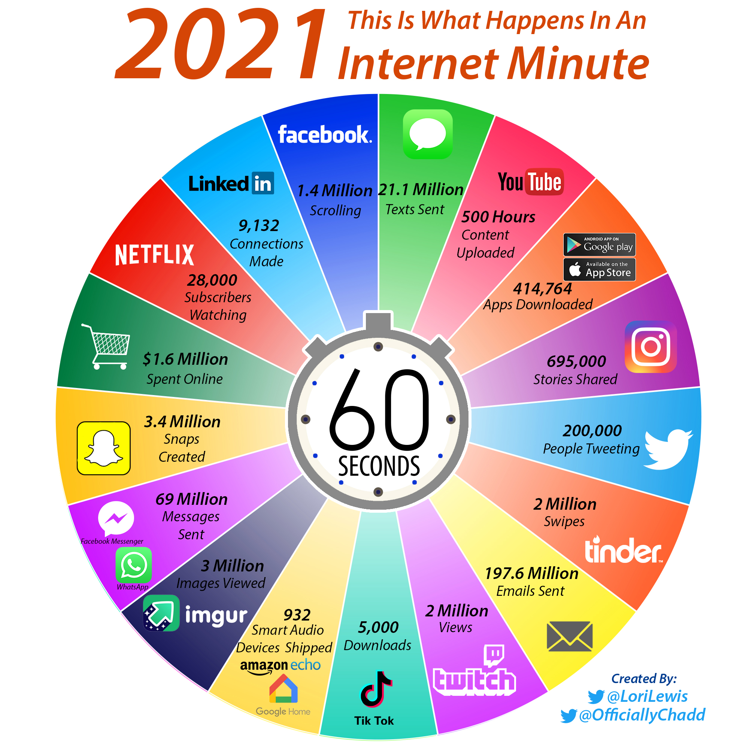
Every second counts

Slide 7
Technology as a data collection tool

Slide 9
The impact of big data on insurance
Insurance rate or price.
Duties of information on the state of the risk - misrepresentation, aggravation of the risk
Fraud against insurance companies

Slide 10
Risk of big data on insurance
BIAS MACHINE
Acts of discrimination in pricing

