Slide 1
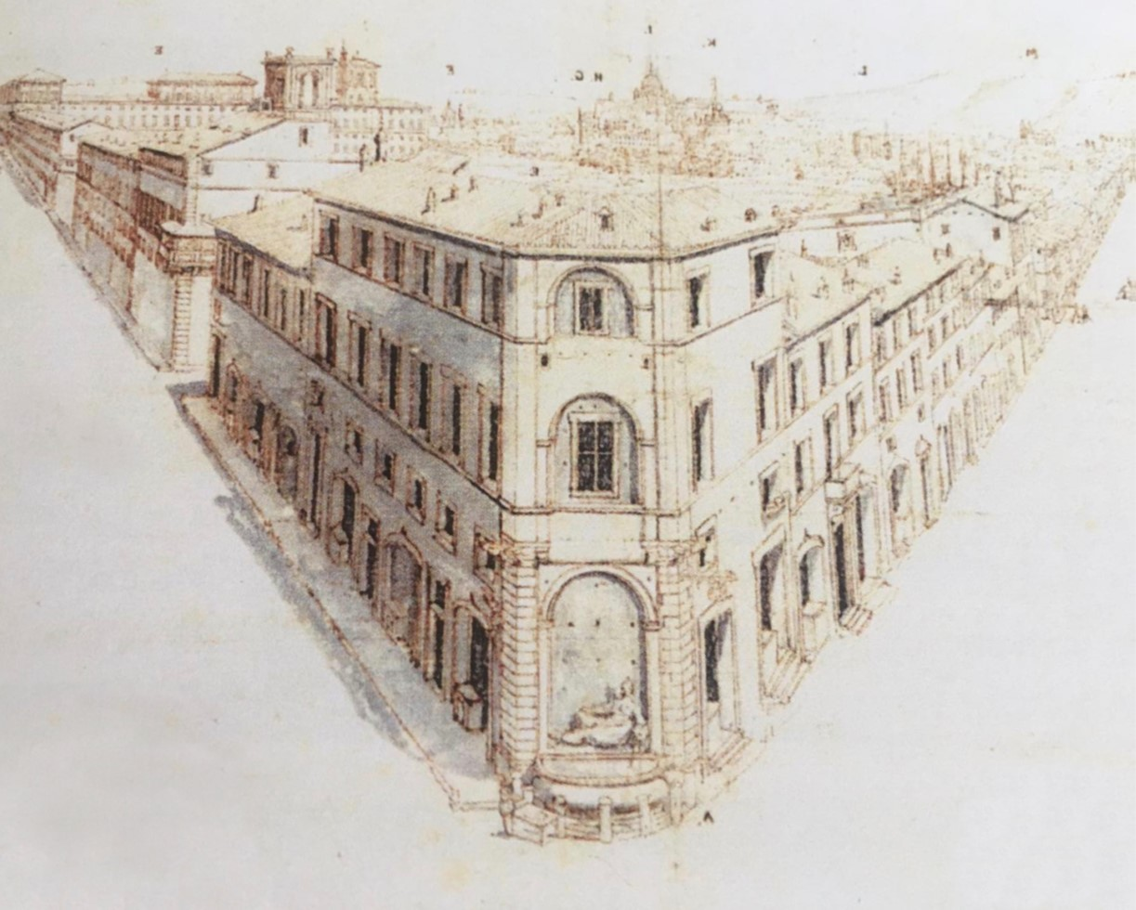
New Challenges for Market Supervisors
INSURANCE BEYOND INSURANCE
The Alternative Risk Transfer mechanisms
Stefano De Polis
IVASS
Secretary General
Florence, November 5, 2021

Slide 2
New Challenges for Market Supervisors
Alternative risk transfer mechanisms. Possible common elements:
tailor made for specific needs of the risk taker;
multidimensional coverage: multiannual and/or multi-risk;
replace pure risk transfer with risk financing;
make it possible to underwrite risk by parties other than (re)insurers;
incorporate financial instruments such as derivatives.

Slide 3
New Challenges for Market Supervisors
In the ART there is always:
an alternative counterpart (i.e. self-insurance; reinsurance poll)
or
an alternative product (i.e. insurance linked security; finite reinsurance)

Slide 4
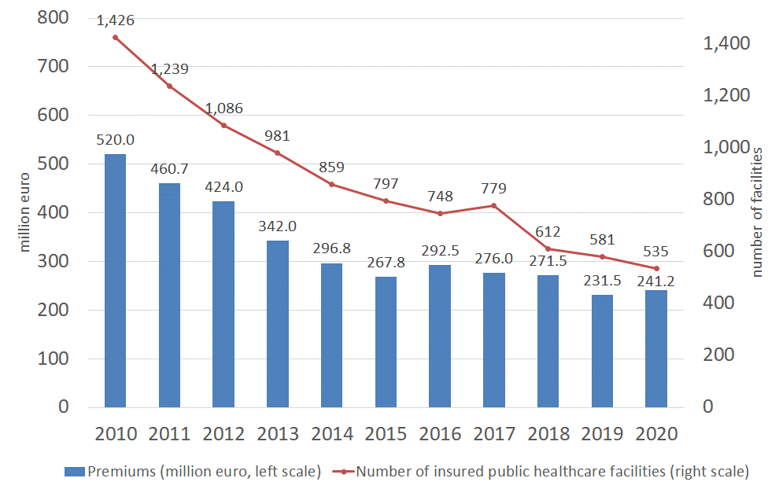
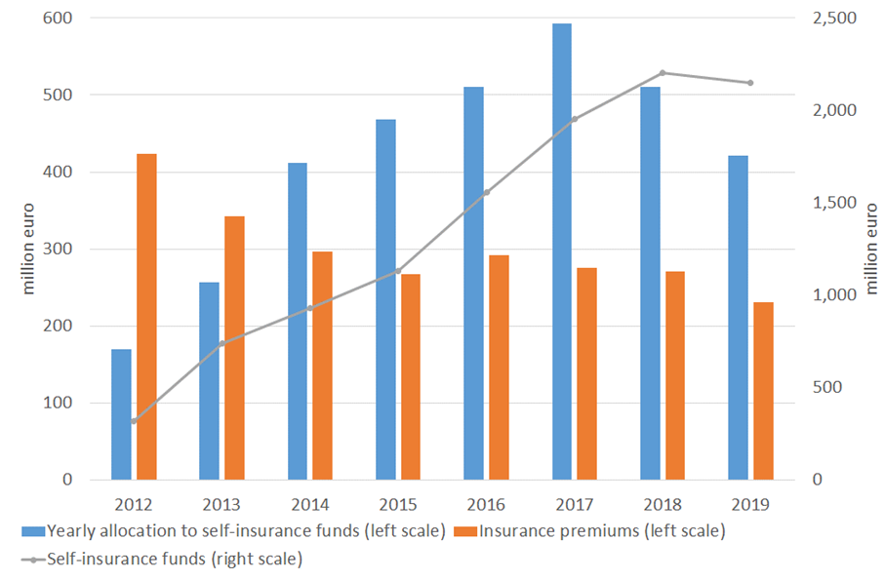
New Challenges for Market Supervisors
Medical liability insurance for public healthcare facilities: premiums collected and number of insured facilities
(2010-2020)
Medical liability risks of public healthcare facilities: financial resources for self-retention insurance and for conventional insurance

Slide 5
New Challenges for Market Supervisors
Challenges for supervisors
asses the ART effective insurance risk transfer;
avoid improper use (circumvention of capital requirements);
pay attention to possible substantial levels of basic risk or other (new) risks;
prevent regulatory arbitrage between different legal systems;
keep pace with increasingly innovative and bespoke forms of reinsurance and adjust competences and methodologies accordingly;
push for convergence in international supervisory practices;
the July 2021 EIOPA Opinion on the use of risk mitigation techniques.

Slide 6
Thank you very much!

