Slide 1
AIDA Webinar of 5th November 2021
HYBRID SEMINAR
INSURANCE BEYOND INSURANCE
Dr. Kyriaki Noussia: “New Technologies in Insurance Markets: the Case of Telematics”

Slide 2
Formation of insurance contracts: legal requirements
No formal requirement→ except for marine insurance contracts
Section 22 MIA 1906:
“a contract of marine insurance is inadmissible in evidence unless it is embodied in a marine policy in accordance with this Act” (BUT cf. the statement of the Law Commission whereby it was pointed out that s. 22 is ‘outdated and problematic’)
Contract law rules apply as to the formation of a contract:
Offer
Acceptance
Consideration
Intention to create legal relations
Certainty of terms

Slide 3
Online Formation of insurance contracts
Ways to conclude insurance contracts concluded online:
Standard practice:
insurance company’s website/ comparison websites / insurance broker website
An online click by the buyer to accept the offer i.e., the price and T&Cs (this way the “consideration” and the “intention to create legal relationship” elements are achieved)
London Market: Electronic placement platform: PPL

Slide 4
Online Formation of insurance contracts
London Market: Electronic placement platform: PPL
PPL → London Market's electronic placing platform
→ enables brokers/ insurers to quote, negotiate, bind, endorse
business digitally
→ risks can be placed electronically
→ to support face-to-face negotiations
→ removing paper from the process
→ creating a digital information flow and audit trail

Slide 5
Online Formation of insurance contracts
London Market: Electronic placement platform: PPL
Electronic environment→ in place prior to the digitization of last years
Covid-19 → high acceleration of online and digital transactions
- less ‘face to face’ dealing in London market
- replaced by electronic means of communication
4th Industrial Revolution challenges
Digitisation challenges
GDPR
Various sectors affected – including insurance

Slide 6
The case for Telematics: continuous data flows / parametric insurance
Challenges posed by the new digital environment in the practice of insurance business
→ Telematics → continuous data flows → parametric insurance
e.g., Telepass (Italy) sole processor of electronic toll payments on Italy’s highways,
2019 : Telepass launched a car insurance brokerage service
Use of Telepass data → tailored insurance products
on behalf of insurance companies
for commission on converted leads.
Insurewave (MAERSK) → (marine insurance)
Telematics → aid in all but large size / complex insurance claims
(travel / earthquake insurance or insurance of keys for cryptocurrency)
Tendencies
– digital (mainstream now and in future)
aimed to be the main distribution means

Slide 7
The case for Telematics: continuous data flows / parametric insurance
March 2021
Lloyd’s launched pioneering earthquake insurance policy in New Zealand, in partnership with insurance start-up Bounce
cutting-edge technology and real-time GeoNet data
automatically pay customers within five days following a strong earthquake
affordable earthquake insurance
fast claims payments

Slide 8
The case for Telematics: continuous data flows / parametric insurance
Method: tracking Peak Ground Velocity (PGV)
PGV- triggers payment at levels of 20 centimetres per second and above
DOES NOT replace conventional earthquake insurance re significant losses
Provides immediate cash flow
to cover many expenses to allow financial recovery.
Removes any potential conflicts of interest
Provides transparency to customers
Payment eligibility is based on shaking intensity
Payments based on ‘steps’
The stronger the earthquake the more of the cover is paid out.

Slide 9
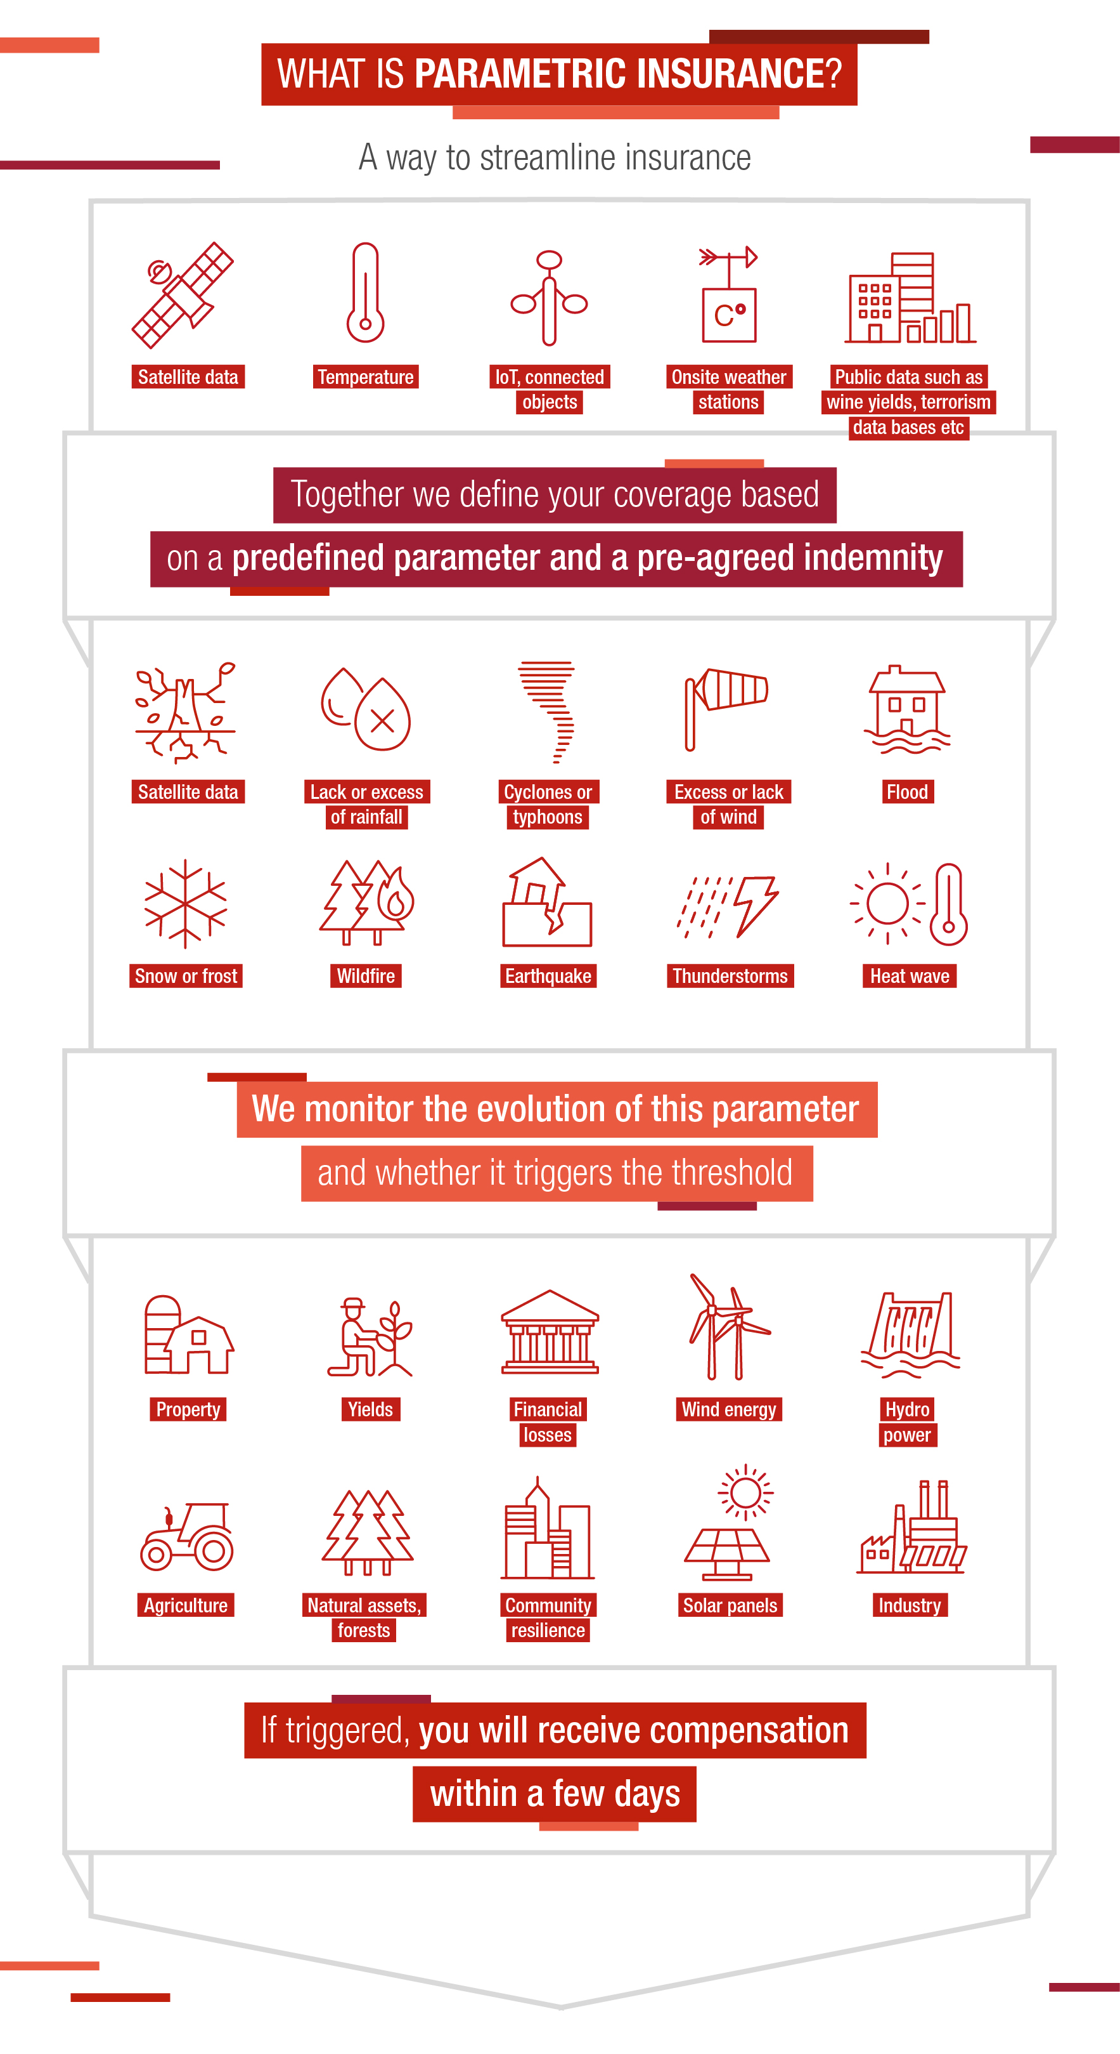
The case for Telematics: continuous data flows / parametric insurance
Example from the Generali website https://www.generaliglobalcorporate.com/solutions-for-you/parametric-insurance.html

Slide 10
Insurtechs with Parametric Solutions Uncertainties in the Digitasation Era
The market for parametric insurance is growing both in:
end-customer propositions
solution provider technology.
Various InsurTechs
handle massive new data sources (including IoT, satellite imagery, sensors, radar, sonar, and third-party data)
utilize proprietary data integration algorithms
for machine learning risk models
to provide underwriting insights.

Slide 11
Insurtechs with Parametric Solutions Uncertainties in the Digitasation Era
Advantages
Increased data usage
expanded predictive analytics capabilities for the reinsurer/insurer
=> straight-forward and affordable coverage for assureds.
reduction of uncertainty around risk predictors
(high uncertainty – higher premiums or no coverage)
Reduction of costs (no need as in traditional insurance for claims assessors and other requirements for claims)

Slide 12
Insurtechs with Parametric Solutions Uncertainties in the Digitasation Era
Disadvantages
IoT and parametric insurance – to identify the right data source
Need for considerations for IoT data stream disruption
Need for contingency for missing data
Solutions to be developed → data fallback (platforms/ IoTdata integration with wider cloud infrastructure)

Slide 13
Uncertainties in the Digitasation Era
Uncertainties faced by insurance industry in the Digitisation era
The issue of data protection - possible update of the GDPR?
Uncertainties due to constraints put by the GDPR on personal data
Will the same constraints exist for the use of corporate data?

Slide 14
AIDA Webinar of 5th November 2021 THANK YOU FOR LISTENING
HYBRID SEMINAR
INSURANCE BEYOND INSURANCE
Dr. Kyriaki Noussia: “New Technologies in Insurance Markets: the Case of Telematics”

