Slide 2
In-house Counsel Committee
A Celebration of
Inclusion & Diversity in Insurance
Collaboration, Community, Engagement, Progress

Slide 3
Inclusion@Lloyd’s
September 2021

Slide 4
agenda
About Me
Understanding Inclusion & Diversity
Insurance Market & Social Trends
Where to Get Started?
How to Measure I&D Progress?
Inclusion@Lloyd’s Partner Networks
Discussion
Resources

Slide 5
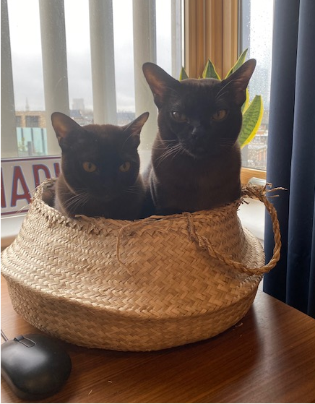
About Me
How do I identify? It is complicated…

Slide 6
Understanding Inclusion & Diversity
Keep it simple
Diversity - A range of many people or things that are different from each other - the quality or fact of including a range of many people or things.
Diversity is a fact.
Inclusion - The fact of including somebody/something; the fact of being included; the fact or policy of providing equal opportunities and resources for people who might otherwise not get them, for example people who are disabled or belong to minority groups.
Inclusion is a choice.
Notes:
Diversity is about difference, it is a fact, difference exists.
Inclusion is about behaviours and with every behaviour, we choose how to behave.
I won’t go into all the studies out there that demonstrate that more diversity in business leads to:
Less risky decisions;
Greater sales;
Greater innovation;
Higher profits;
Higher RoEs.
These studies exist, but for me frankly, they miss the point.
Making progress on diversity and inclusion is about ethics. Is it ethical to not be inclusive? Is it ethical to be discriminatory?
I am not saying that managing a diverse team is easy, it could actually be harder, but if done well, can lead to superior results.
You will see business benefits from improved inclusion and diversity, but measuring them can be hard.

Slide 7
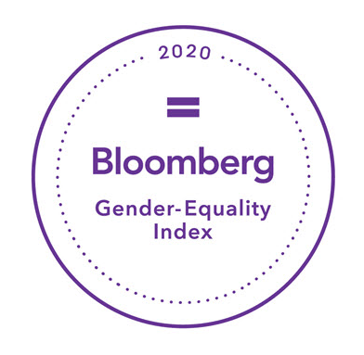
Insurance market & Social trends
The momentum is building
Social Momentum
Employee Pressure
Regulatory Pressure
Industry Momentum
Notes:
Employee & Social Pressures – There is social pressure building to ensure that businesses act ethically, one of way of demonstrating this is through work to ensure that firms are inclusive and reflect the societies that they operate in.
Regulator Interest – In the UK the Financial Conduct Authority and Prudential Regulation Authority have made culture, including diversity and inclusion, a focus of their work. Lloyd’s has also rolled out a voluntary framework on culture, inclusion, and diversity.
PRA issued a letter on Board diversity in March 2020.
The FCA is looking at including diversity in its oversight of the Senior Managers Certification Regime.
Lloyd’s recently introduced voluntary culture and behaviour standards… these likely won’t be voluntary for long.
Trade Body & Customer Focus – Federation of European Risk Management Associations, the British Insurance Brokers’ Association, ANRA in Italy, and many more are looking at ways to improve inclusion and diversity in insurance.

Slide 8
Where to get started?
Start simple, stay focused, be realistic, be credible
Town Halls – Profile staff to ‘tell their story’.
Newsletter – Share stories and experiences.
External Partners - Leverage external I&D networks for their expertise and events.
Employee I&D / Culture Committee – Staff led initiative with Board / ExCo representation.
Focused Events - Promoting relevant I&D days / months (e.g. Pride).
Staff Data - Campaign to populate diversity data on HR system.

Slide 9
How to measure I&D progress?
Focus on measuring inclusion
Employee Engagement Survey – Develop a series of questions to measure inclusivity and create an ‘Inclusion Index’. This index should ‘move’ faster than your diversity data.
HR System – Encourage self-declaration of diversity characteristics.
External Indices – Participate, on an ad-hoc basis, in external I&D indices.

Slide 10
Inclusion@Lloyd’s Partner Networks
Collaboration, community, engagement, and progress
The I@L Partner Networks – A group of six volunteer led cross-market I&D networks that benefit from limited I@L financial support, who collaborate to drive progress across the industry.
What Can You Do?
Collaborative events.
Sponsorship / partnership.
Promote to staff and new hires.
Engagement with internal ERGs / Committees.
Notes:
Collaboration
Lots of collaboration across Partner Networks.
Collaboration with the CII, ABI, Insurance Supper Club, Insider Progress, and London Market Forums.
Going Virtual
Over 65 virtual events delivered in 2020!
Mentoring / Connecting
On-line mentoring built out by iCAN.
Virtual ‘coffee’ dates.
Wellbeing sessions.
Celebration
All Partner Networks were nominated for, shortlisted, or won industry and/or national awards for their work.
All Partner Networks had volunteers and/or Steering Committee members shortlisted or winners of awards.
All partner networks meet the ‘Partner Network Requirement’s’ for both 2020 and 2021 – evidence of supporting I@L strategy.
The annual reviews and 2021 plans support that the Partner Networks are working to support I@L’s strategy.
One partner network shortlisted or a winner of a D&I award by year-end 2020 – evidence of improved governance supporting excellence in partner networks.
All Partner Networks had volunteers and/or Steering Committee members nominated for, shortlisted, or winners of awards in 2020.
GIN won the Women in Insurance Award in 2020.
Aggregated membership / mailing list subscribers of partner networks increased by 50% from Jan 2020 of application and year-end 2021 – demonstrating increased market engagement.
1 Jan 2019 – c. 1,670; 1 Jan 2020 – c. 4,250; 1 Jan 2021 – c. 6,040 members.
42% growth in 2020 and 262% from 2019.

Slide 11
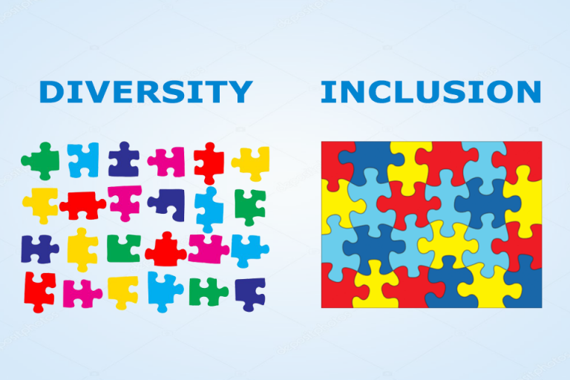
Discussion
What do you think?

Slide 12
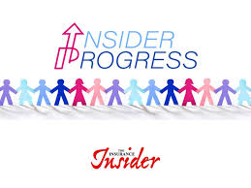
Resources
Relevant industry resources
Employers’ Network for Equality & Inclusion - https://www.enei.org.uk/diversity-inclusion/.
Culture at Lloyd’s - https://www.lloyds.com/about-lloyds/future-culture-at-Lloyds.
Association of British Insurers - https://www.abi.org.uk/about-the-abi/abi-diversity-hub/,
Inclusion@Lloyd’s – https://inclusionatlloyds.com/.
Insider Progress – https://events.insuranceinsider.com/InsiderProgress/.
Dive In Festival - https://diveinfestival.com/.
Inclusive Behaviours Pledge - https://inclusiveinsurancepledge.co.uk/.

Slide 14
In-house Counsel Committee
Visit us on
AIDA Europe Website
https://aidainsurance.org/regional-groupings/aida-europe/governance-structure/
aida-europe-in-house-counsel-committee
LinkedIn
https://www.linkedin.com/groups/8606681/
or reach out
by email
pirmin.stalder(at)lgtcp.com

Slide 15
FORTHCOMING AIDA
EUROPE WEBINARS IN 2021
14 October 2021 - Transparency in Insurance Regulation and Supervisory Law
2 December 2021 - Insurance and Human Rights
Visit AIDA Europe website pages for further details:
https://aidainsurance.org/regional-groupings/aida-europe

