Slide 1
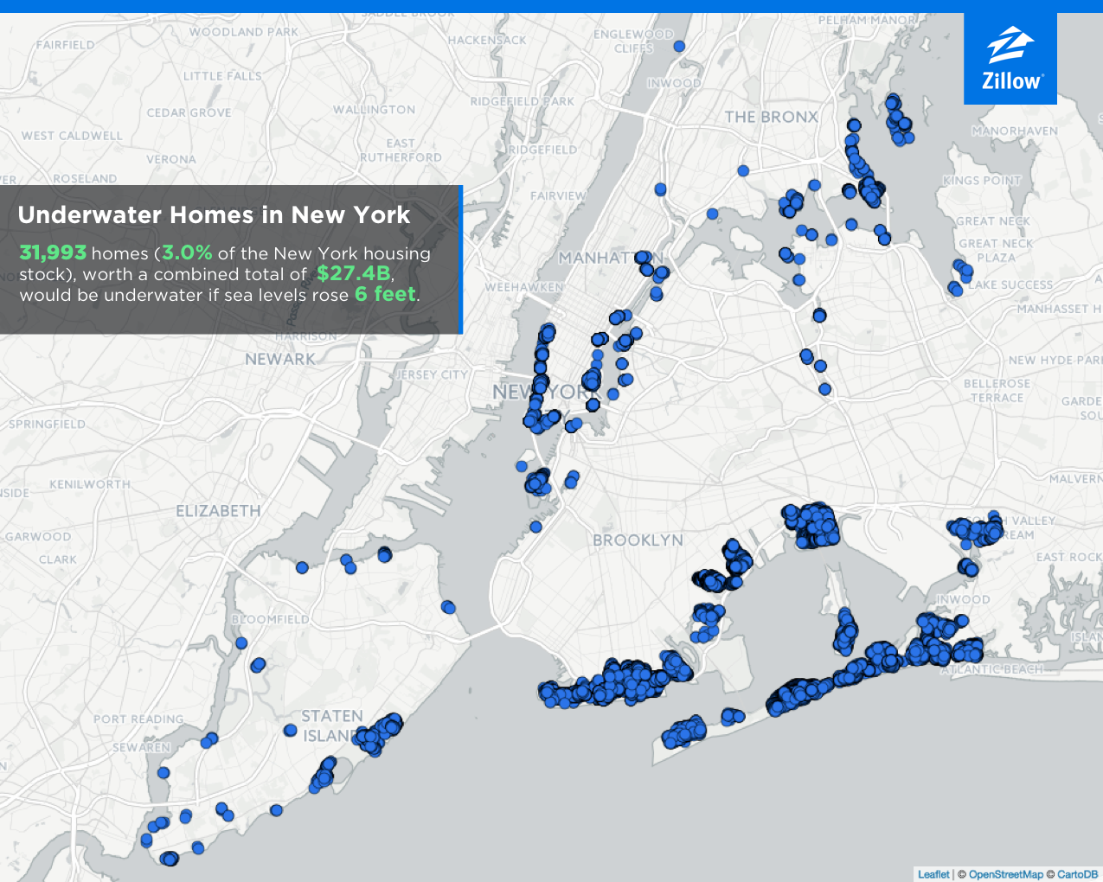
2017 Report from Zillow Reflecting Estimated Damage to N.Y. Homes From 6 Foot Sea Level Rise:

Slide 2
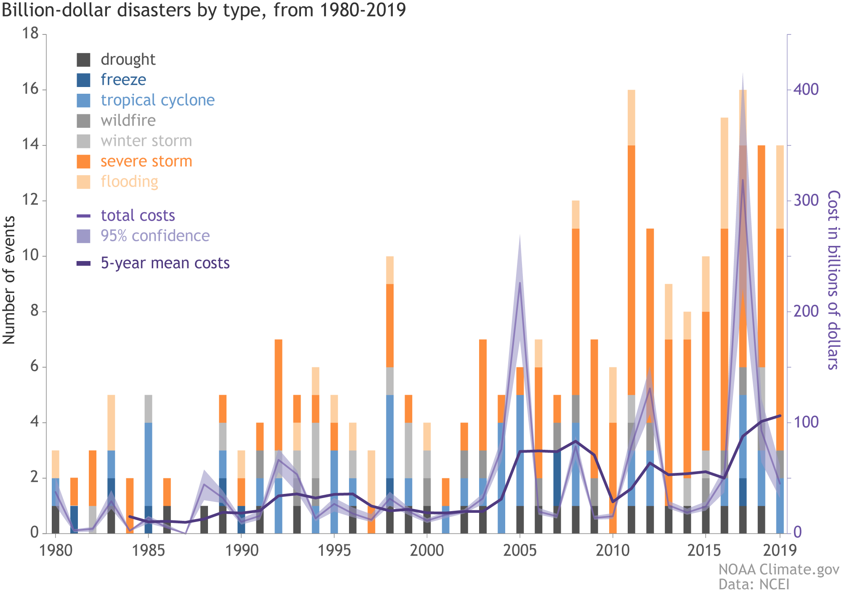
NOAA: 2010-2019: A landmark decade of U.S. billion-dollar weather and climate disasters
Source: https://www.climate.gov/news-features/blogs/beyond-data/2010-2019-landmark-decade-us-billion-dollar-weather-and-climate

Slide 3
Climate Change - Damages
Top Five Costliest Hurricane’s to Impact U.S. Mainland - - All in Twenty-First Century:

Slide 4
According to NOAA:
Even if the world follows a low GHG pathway, global sea level will likely rise at least 12 inches (0.3 meters) above 2000 levels by 2100.
If we follow a pathway with high emissions, a worst-case scenario of as much as 8.2 feet (2.5 meters) above 2000 levels by 2100 cannot be ruled out.
In U.S., high-tide flooding, 300% to 900% more frequent than 50 years ago.
(NOAA) https://www.climate.gov/news-features/understanding-climate/climate-change-global-sea-level

Slide 5
The Insurance Coverage Implications of Climate Change
A New Frontier

Slide 6
PRESENT: Minimal coverage actions and decisional law relating to insurance for Climate Change.
FUTURE: This will likely change soon, given:
- The rising prominence of the issue,
- The mounting scientific studies,
- The substantial costs involved, and
- The increased litigation activity by municipalities and private parties against fossil fuel companies and other target defendants.
** CGL, D&O, and Property insurance are all in the sight line of Climate Change litigation.

Slide 7
THE COVERAGE ISSUES
Choice of Law
Which state’s law is chosen can often be dispositive.
A number of states have diametrically conflicting views on certain of the coverage issues and policy language.

Slide 8
THE COVERAGE ISSUES
(CGL)
Commercial general liability (CGL) insurance policies generally provide defense and indemnity coverage when a third-party sues the insured for money damages due to bodily injury and/or property damage that took place during the policy period.

Slide 9
Basic Sample CGL Insuring Agreement:
We will pay those sums that the insured becomes legally obligated to pay “as damages” because of “bodily injury” or “property damage” to which this insurance applies.
We will also defend any suits which seek damages for such “bodily injury” or “property damage.”
This insurance applies only if:
(1) The “bodily injury” or “property damage” is caused by an “occurrence” that takes place in the coverage territory;
(2) The “bodily injury” or “property damage” occurs during the policy period; and
(3) The “bodily injury” or “property damage” is neither expected not intended from the standpoint of the insured.

Slide 10
The Duty to Defend:
Duty to defend is broader in scope than the duty to indemnify.
The insurer usually must defend even if the insured is ultimately found to have no legal obligation to pay damages.
The insurer's duty to defend is typically determined by the allegations contained in the complaint, not by facts that may later be established that ultimately show the claim is not covered.
Insurer’s payment of defense costs is often in addition to policy limits.
**Defense costs associated with the “underlying” Climate Change cases are likely to be substantial.

Slide 11
“Property Damage” is generally defined as:
(1) Physical injury to tangible property, including all resulting loss of use of that property…
or
(2) Loss of use of tangible property that is not physically injured…
** Not all CGL policies cover loss of use of property not physically injured.

Slide 12
Some Preliminary Coverage Questions
Do Climate Change suits seek “damages”?
The term “damages” is usually not defined in CGL policies.
Insurers argue the term “damages” is limited to “legal” damages and does not include equitable relief.
Monetary relief to compensate for injury usually qualifies as damages; but injunctive relief usually does not.
A majority of states have ruled that environmental response costs incurred pursuant to governmental orders are “damages” and are covered under the CGL policy.
However, several of the pending Climate Change suits demand that the court require the defendants establish a “Climate Change Abatement Fund” for anticipated future harm - - Will that qualify as “damages” ?

Slide 13
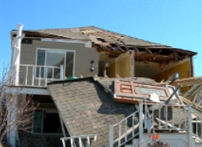
Some Preliminary Coverage Questions
Do the Climate Change suits against the insureds involve “Property Damage”?
Are physical changes to the earth’s climate “Property Damage”?
To the extent its alleged that the Earth’s climate has changed and that seas are rising because of it - - is that “Property Damage”?
If seas rise and start to cause actual “Property Damage,” is all future damage covered?
See Oak Ford Owners Ass’n v. Auto-Owners Ins. Co., 510 F. Supp. 2d 812 (M.D. Fla. 2007) (Court held insured’s damage to wetlands by dredging of a creek to make it deeper and wider, constituted “physical damage to tangible property.” Court explained that injury had already occurred even though most of the effects, such as flooding and erosion, would take place and increase in the future.)

Slide 14
Some Preliminary Coverage Questions
Do the Climate Change suits against the insureds involve “Property Damage”?
To the extent the Climate suits allege water damage to real property, buildings and structures from sea level rise, it may qualify as “Property Damage."
However, mitigative and prophylactic efforts to curtail or avert “Property Damage" (e.g. dams, dikes and raising, or relocating buildings) will likely raise coverage disputes.
**Courts have found coverage for such costs especially where “Property Damage" is present and the mitigation is to avoid further damage.

Slide 15
Some Preliminary Coverage Questions
Do the Climate Change suits against the insureds involve “Property Damage”?
Are lost profits or diminished real estate values covered “Property Damage”?
Economic loss alone, without any accompanying physical damage to or loss of use of tangible property, is generally not considered covered “Property Damage.”
See Concord Gen Mut. Ins. Co. v. Green & Co. Bldg. & Dev. Corp., 8 A.3d 399 (N.H. 2010) (No physical injury to tangible property where CO2 was leaking from insured’s chimney, as the gases did not physically alter the property and the homeowners were able to continue living in their house.)
** Insurers are likely to argue that coastal property which has decreased in value due to rising sea level is not covered, unless there is an accompanying physical damage or loss of use.

Slide 16
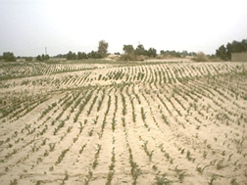
Some Preliminary Coverage Questions
Do the Climate Change suits against the insureds involve “Property Damage”?
Are detrimental effects on crops covered “Property Damage”?
Crop failures may not be covered if the seeds fail to germinate, BUT there may be coverage if there is physical damage to existing crops.
See, Farm Bureau Mut. Ins. Co. v. Earthsoils, 812 N.W.2d 873 (Minn. Ct. App. 2012) (Court ruled no coverage where farmer obtained only half the expected crop yield due to fertilizer with insufficient nitrogen content, because smaller yield did not result from physical injury to the crop).
But see, W. Heritage Ins. Co. v. Green, 54 P.3d 948 (Idaho 2002) (Court found a covered loss due to physical injury to crops resulting from alleged misapplication of fertilizer that caused potato plants to form yellow foliage, poor root systems and misshapen potatoes.).

Slide 17
Some Preliminary Coverage Questions
Is There Property Damage “During the Policy Period”?
This will be a significant issue – likely involving a “battle of the experts”.
If “Property Damage” has happened, in which policy year(s) did it take place?
Most large target companies have liability insurance policies stretching back to at least the 1950s.
Nearly every major insurance company will be implicated if the “Property Damage” is deemed to have occurred from the 1950s through present.

Slide 18
Do the Climate Change suits against the insureds involve Property Damage arising from an “Occurrence”?
"Occurrence" is generally defined as:
“An accident, including continuous or repeated exposure to substantially the same general harmful conditions which results in injury or damage which is neither expected nor intended from the standpoint of the insured.”
“Occurrence” is the act of the insured (the accident, event or conditions) that results in injury.
To qualify as an occurrence, the accident/exposure must be unexpected, and must result in property damage during the policy period.

Slide 19
The “Occurrence” Requirement
There are generally four issues:
(1) Whether the “neither expected nor intended” requirement concerns the offending act or resulting injury;
(2) Whether there should be an objective or subjective standard applied in determining “expected or intended” (subjective standard is majority approach);
(3) How to define “expected” (e.g. whether the insured knew damage would result, or whether the insured should have known damage would result.); and
(4) Who bears the burden of proof on the “expected or intended” issue. This question turns on whether the court will interpret the occurrence requirement as an exclusion or as part of the definition of coverage.
**If considered an exclusion, the insurer bears the burden but otherwise it’s the insured who would bear the burden, the latter being the majority view.

Slide 20
The “Occurrence” Requirement
All of the major Climate Change suits allege intentional and knowing conduct by the fossil fuel defendants dating back to at least the 1960s. Such allegations may support a finding of no “occurrence.”
See, AES Corp. v. Steadfast Ins. Co., 725 S.E. 2d 532 (Va. 2012) (Supreme Court of Virginia found that the underlying allegations that the insured intentionally released tons of carbon dioxide and GHGs into the atmosphere as part of its business operations did not constitute an “occurrence” within the terms of the policies.)

Slide 21
How Many Occurrences Are There?
The answer to this question could have huge monetary implications on available policy limits and exhaustion of coverage.
Typical limits of liability language:
“For the purpose of determining the limits of the Company’s liability, all injury or damage arising out of continuous or repeated exposure to substantially the same general harmful conditions shall be considered as arising out of one occurrence.”

Slide 22
The Approaches to the Number of Occurrences.
The “Cause” Test:
Do diverse injuries or claims share a common, uninterrupted proximate cause? (Majority Rule)
The “Effects” Test:
Focus is on the point at which people or property are damaged by insured’s act or omission.
Two possible outcomes in Climate Change coverage action would be:
One “Occurrence” – Insured’s decision to manufacture and supply a “defective” product (fossil fuels which, when burned, release persistent GHGs).
OR
Multiple “Occurrences” – Any isolated discrete injuries separated in place and time.
CAUTION - Case law addressing number of occurrences is often extremely fact specific, result-oriented, often affected by SIRs/deductibles, and even inconsistent within particular jurisdictions.

Slide 23
Products/Completed Operations Hazards:
Many CGL policies only contain aggregate policy limits for products/completed operations hazards (as defined).
If no applicable aggregate limit, than may be no cap to the amount insurer will pay for multiple occurrences.
A Climate Change complaint’s assertion of strict liability and other “defective product” allegations could implicate this aggregate limitation.
Depending on the number of occurrences outcome, the applicability of the products hazard definition could have a significant impact on available policy limits and an insurer’s ultimate exposure.

Slide 24
Other Likely Coverage Issues Include:
Trigger of Coverage (what must occur during the policy period to give rise to potential coverage under the specific terms of the policy):
- Four Main GL Trigger Theories Applied:
1) Injury in fact (All policies are triggered if they are in effect during the time the injury or damage is shown to have actually taken place, even if the injury or damage continues over time).
2) Exposure (All policies are triggered if they are in effect during exposure to injurious or harmful conditions) (Applied more often in bodily injury cases).
3) Manifestation (The policy is triggered when the injury or damage is discovered or manifests itself - or in some cases is capable of being discovered - during the policy period) (Applied more often in first-party property cases).
4) Continuous (All policies are triggered if they are in effect during any of the following times: exposure to harmful conditions; actual injury or damage; and upon manifestation of the injury or damage).

Slide 25
Other Likely Coverage Issues Include:
Allocation of Damages (Climate Change-related property damage could likely implicate many years of coverage)
Knowledge based Defenses (including known loss/lack of fortuity).

Slide 26
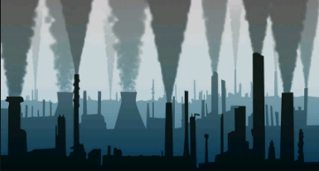
Pollution Exclusions
Three main types of pollution exclusions:
Sudden and Accidental (1973-1985)
Absolute (1986 - )
Total (1988- )
Exclude coverage for, inter alia, “Property Damage” arising out of the discharge of “Pollutants…”
The term “Pollutant” is most commonly defined in a CGL policy as:
“Any solid, liquid, gaseous or thermal irritant or contaminant, including smoke, vapor, soot, fumes, acids, alkalis, chemicals and waste…”

Slide 27
Pollution Exclusions
All three types of pollution exclusions require a discharge and a finding that the offending substance (e.g. GHGs, carbon dioxide, methane) falls within the definition of “Pollutant.”
Courts generally apply either a “traditional environmental pollution” approach or a broader, literal interpretation to the Pollution Exclusions.
“Traditional” approach -- courts interpret the exclusion to preclude coverage only for those claims that are commonly considered to arise from “traditional” environmental pollution (e.g. dumping waste at a landfill).
“Literal” approach -- courts focus on the plain language of the policies and apply the exclusion to all claims arising from contaminants or irritants that cause damage, regardless of whether the claims involve traditionally understood contamination.

Slide 28
Pollution Exclusions
The U.S. Supreme Court has on multiple occasions held that greenhouse gases (including carbon dioxide and methane) fall within the CAA definition of “air pollutant.” (See, e.g., Am. Elec. Power Co. v. Connecticut, 564 U.S. 410 (2011).) Insurers should have a reasonably strong argument that the exclusion applies in a Climate Change coverage action, especially in “Traditional” pollution states.
See, Essex Ins. Co. v. Tri-Town Corp., 863 F. Supp. 38 (D. Mass. 1994) (finding carbon dioxide constitutes “pollutant” under pollution exclusion).
But see, Donaldson v. Urban Land Interests, Inc., 564 N.W.2d 728 (Wis. 1997) (Court held that exhaled carbon dioxide was not unambiguously a “pollutant” and the “exclusion did not plainly and clearly alert a reasonable insured that coverage was excluded for personal injury claims that had their genesis in activities as fundamental as human respiration.”)
See also, Motorists Mut. Ins. Co. v. RSJ, Inc., 926 S.W. 2d 679 (Ky. Ct. App. 1996) (finding carbon dioxide leaking from insured’s boiler vent stack did not constitute a “pollutant” under the exclusion, and thus suit by neighbor alleging injury was covered).
The “discharge” requirement of the PE arguably should be met in most of the Climate Change cases.

Slide 29
Coverage actions relating to Climate Change liability are virtually non-existent, but that may change soon …
In AES Corp. v. Steadfast Ins. Co., 725 S.E. 2d 532 (Va. 2012), the Virginia Supreme Court held that the insurer had no obligation to provide a defense or indemnity for the insured’s potential climate change-related liabilities arising from the “underlying” Native Village of Kivalina suit.
The underlying suit alleged damages to a native village due to rising sea level from global warming and GHGs.
Claims were based on public/private nuisance, as well as concert of action.
The Supreme Court of Virginia found by way of SJ, that because the underlying complaint alleged that the insured intentionally released tons of carbon dioxide and GHGs into the atmosphere as part of its business operations, there was no “occurrence,” i.e., no accidental event, within the terms of the policies.
The Court acknowledged that the underlying complaint alleged both negligent and intentional conduct by the insured, but held that “whether or not AES’s intentional act constitutes negligence, the natural or probable consequence of that intentional act is not covered.”

Slide 30
Is Climate Change Liability a D&O Issue?

Slide 31
Is Climate Change Liability a D&O Issue?
▪ Shareholders are demanding More Climate Disclosures:
- Chevron asked to disclose the amount it has spent on direct and indirect lobbying through trade associations and other organizations.
- Exxon and Chevron asked to align their business strategies with the Paris Agreement and to include emissions from the burning of their products in their climate disclosures.
- Passage of 2017 shareholder resolution compelled Exxon to acknowledge that its core oil & gas assets face some risk of becoming “stranded” due to government policies and international agreements seeking to limit Climate Change.
- Extends beyond fossil fuel companies:
Hertz investors filed resolutions asking companies to disclose plans to reduce their carbon footprint.
JP Morgan Chase recently dismissed a shareholder proposal seeking disclosure on how its lending activities align with the Paris Agreement. JP response to SEC argues that the proposal seeks to compel investment decisions based on GHG emissions – decisions solely in the hands of management.
** SEC is considering amendments to shareholder resolution process over concerns that proxy firms are promoting resolutions based on political agenda rather than investor profit.

Slide 32
Is Climate Change Liability a D&O Issue?
Public Companies Begin to Acknowledge Climate Litigation Threatens Bottom Line in 2019 10K’s:
Arch Coal - “Increasing attention to global climate change has resulted in an increased possibility of governmental investigations and, potentially, private litigation against us and our customers. For example, claims have been made against certain energy companies alleging that greenhouse gas emissions constitute a public nuisance. While the United States Supreme Court held that federal common law provides no basis for public nuisance claims against energy companies, state law tort claims remain a possibility and a source of concern … Moreover, the proliferation of successful climate change litigation could adversely impact demand for coal and ultimately have a material adverse effect on our business, financial condition and results of operations.”
Alliance Resource Partners (2nd largest coal producer in eastern U.S) – “The United States Supreme Court did not … decide whether similar [Climate Change] claims can be brought under state common law… As a result … tort-type liabilities remain a concern.”
ConocoPhillips – “Increasing attention to global climate change has resulted in an increased likelihood of governmental investigations and private litigation, which could increase our costs or otherwise adversely affect our business… The ultimate outcome and impact to us cannot be predicted with certainty, and we could incur substantial legal costs associated with defending these and similar lawsuits in the future.”
Devon Energy – “These and other regulatory, social and market risks relating to climate change described above could result in unexpected costs, increase our operating expense and reduce the demand for our products, which in turn could lower the value of our reserves and have a material adverse effect on our profitability, financial condition and liquidity.”

Slide 33
Is Climate Change Liability a D&O Issue?
Zurich Quarterly Claim Journal (Spring 2018):
“From a D&O perspective it is more than likely that the industry will see an increase in claims in the future as a result of companies failing to adequately manage the risk of climate change on their business and to disclose these risks to investors.
▪ Grantham Research Institute on Climate Change and the Environment Report (2018):
Expect to see an increase in suits asserting liability for "injuries arising from an alleged failure to anticipate and address [the] foreseeable consequences of climate change," given investors and insurers mounting attention to the “growing gap between scientific understanding of climate change and sluggish adaption efforts.“
▪ U.K's largest money manager, Legal and General Investment Management ("LGIM"):
The world is facing a "climate catastrophe" and businesses around the world must urgently address it. If businesses "remain ignorant to this crisis, they face shareholders refusing to back them anymore.“
▪ Blackrock’s 2020 Annual Letter to CEO’s:
“Climate change has become a defining factor in companies’ long-term prospects… The evidence on climate risk is compelling investors to reassess core assumptions about modern finance… Investors are increasingly reckoning with these questions and recognizing that climate risk is investment risk…. Indeed, climate change is almost invariably the top issue that clients around the world raise with BlackRock… We believe that when a company is not effectively addressing a material issue, its directors should be held accountable…Where we feel companies and boards are not producing effective sustainability disclosures or implementing frameworks for managing these issues, we will hold board members accountable.”

Slide 34
Is Climate Change Liability a D&O Issue?
SEC Guidance Regarding Public Company Disclosure Requirements Concerning Climate Change Risk:
In 2010, the S.E.C. issued “interpretive guidance” (not a new rule) on existing disclosure requirements regarding how companies are to address the risks posed by climate change in their securities filings. (See, 17 CFR Parts 211, 231 and 241) [Release Nos. 33-9106; 34-61469; FR-82]
“This interpretive release is intended to remind companies of their obligations under existing federal securities laws and regulations to consider climate change and its consequences as they prepare disclosure documents to be filed with us and provided to investors.”

Slide 35
Is Climate Change Liability a D&O Issue?
SEC Statement Regarding “Modernizing” Financial Disclosure Requirements (January 30, 2020)
On January 30, 202o, SEC Chairman and SEC Commissioner issued separate Public Statements about initiatives to “modernize” certain financial disclosure requirements, including those dealing with “materiality”.
Climate Change received special mention, including reminder that the last time SEC addressed Climate Change was in their 2010 “Guidance”:
“Much has changed in the last decade with respect to what we know about climate change and the financial risks it creates for global markets. The science is largely undisputed and the effects increasingly visible and dire; the looming economic threat to markets worldwide is more and more apparent; investors have increased their demands on companies and regulators for consistent, reliable, and comparable disclosures. [Climate Change] may be the single most momentous risk to face markets since the financial crisis.” ( SEC Commissioner Allison Herren Lee)
“[T]he landscape around these issues is, and I expect will continue to be, complex, uncertain, multi-national/jurisdictional and dynamic. In 2010, the Commission issued an interpretive release to provide guidance to public companies regarding the Commission’s existing disclosure requirements as they apply to environmental and climate-related matters. Since then, SEC staff has continued to consider these matters, including, as part of regular reviews of annual and periodic reports and other company filings by the Division of Corporation Finance. Our staff in the Office of Compliance Inspections and Examinations is reviewing disclosures of investment advisers and other issuers regarding funds and other products that pursue environmental or climate-related investment mandates to ensure that investors are receiving accurate and adequate information about the material aspects of those strategies.” (SEC Chairman Jay Clayton)

Slide 36
Is Climate Change Liability a D&O Issue?
NY & MA Attorney Generals allege investor “climate fraud” by Exxon.
NY: Exxon allegedly used two different accounting methods – one for communicating climate change to the public and another kept private for internal projections. Sought as much as $1.6 billion in restitution to shareholders.
MA: Exxon allegedly deceived investors by failing to divulge potential climate change related risks to their investments and whether Exxon violated Massachusetts consumer protection laws by misleading consumers on the impact of its products on climate change.

Slide 37
Is Climate Change Liability a D&O Issue?
New York & Massachusetts AG Fraud Allegations (STATUS):
NY: Suit dismissed by trial court following bench trial and NO appeal to be taken:
“The office of the Attorney General failed to prove, by a preponderance of the evidence, that ExxonMobil made any material misstatements or omissions about its practices and procedures that misled any reasonable investor… The office of the Attorney General produced no testimony from any investor who claimed to have been misled by any disclosure…
However, Judge Barry Ostrager cautioned:
Nothing in this opinion is intended to absolve ExxonMobil from responsibility for contributing to climate change through the emission of greenhouse gases in the production of its fossil fuel products … ExxonMobil is in the business of producing energy, and this is a securities fraud case, not a climate change case.”
On April 22, 2021, NYC filed suit in state court against Exxon, Shell, BP, and the American Petroleum Institute for allegedly misleading NY consumers about the role their products play in climate change and for allegedly "greenwashing" their practices to make them seem more eco-friendly.
- Seeks to permanently enjoin the defendants from engaging in any acts that violate NYC's consumer protection law, award civil penalties "in an amount to be proven at trial" and attorneys' fees, and grant any other further relief that the court finds "just and proper."

Slide 38
Is Climate Change Liability a D&O Issue?
New York & Massachusetts AG Fraud Allegations (STATUS):
MA: - On October 24, 2019, Mass. AG filed suit in state court seeking a ruling that Exxon is violating the state’s Consumer Protection Act and an order that Exxon pay civil penalties and perform injunctive relief.
- Exxon removed lawsuit to federal court and in March 2020 a motion to remand was granted.
- Lawsuit asserts that Exxon allegedly deceived investors by failing to divulge potential climate change related risks to their investments and that Exxon violated Massachusetts consumer protection laws by misleading consumers on the impact of its products on climate change.

Slide 39
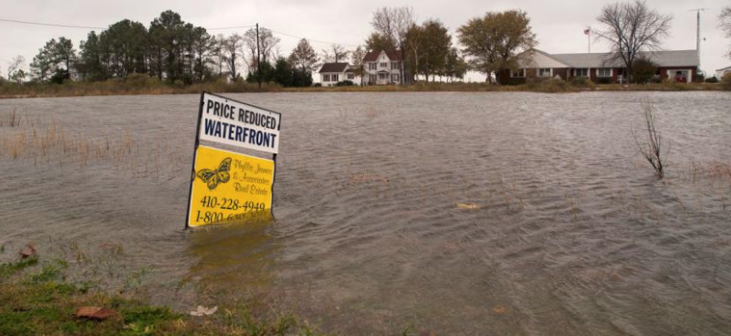
First-Party Property Insurance Considerations

Slide 40
First-Party Property Considerations:
2017 Report from Zillow determined:
If sea levels rise as predicted by the year 2100, almost 300 U.S. cities would lose at least half their homes, and 36 U.S. cities would be completely lost.
One in eight Florida homes would be under water.
Nationwide, almost 1.9 million homes worth a combined $882 billion – are at risk of being underwater by 2100.
Univ. of Delaware Disaster Research Center (2019):
“There are 49 million housing units in at-risk areas on the U.S. coast, and over $1 trillion worth of infrastructure within 700 feet of the coast.”

Slide 41
First-Party Property Insurance Considerations:
Projected increases in the frequency and severity of natural disasters =
- More homeowner and business owner property claims and more business interruption losses.
Coverage issues will include:
- Direct physical loss, flood vs. wind coverage disputes, actual loss sustained, as well as business interruption and contingent business interruption issues such as business income, period of restoration, and insufficient supply chain coverage.
** National Flood Insurance Program is billions in debt and in extreme state of flux as amendments are considered, which among other things, could cause premiums to greatly increase.

Slide 42
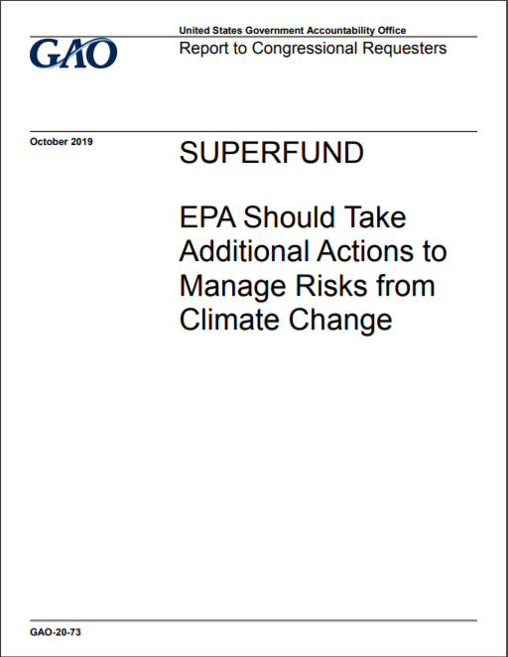
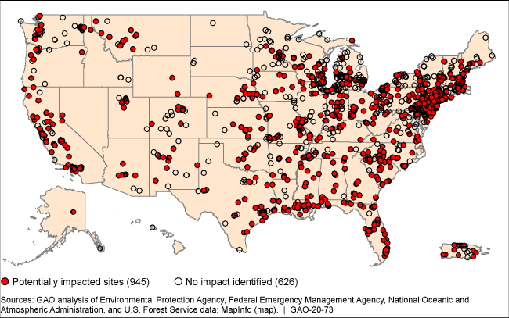
GAO: More than 60% of non-federal Superfund Sites in areas that are affected by flooding or wildfires
Superfund Sites Located in Areas that May Be Impacted by Flooding, Storm Surge, Wildfires, or Sea Level Rise
Source:
https://www.gao.gov/products/gao-20-73
Notes:
https://www.gao.gov/products/gao-20-73

Slide 43
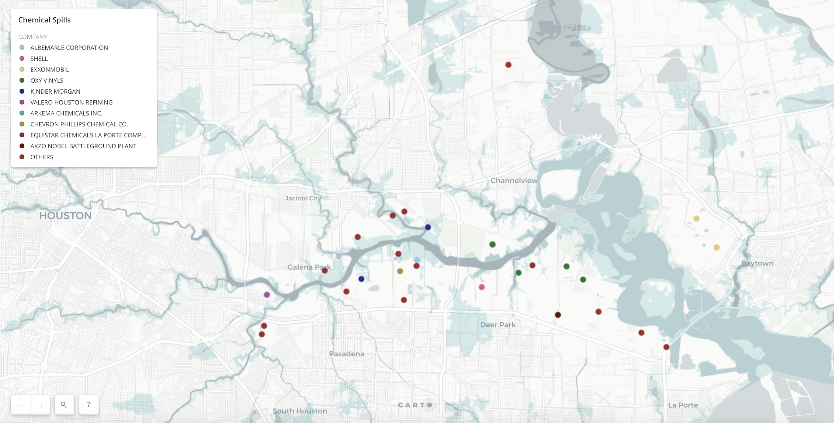
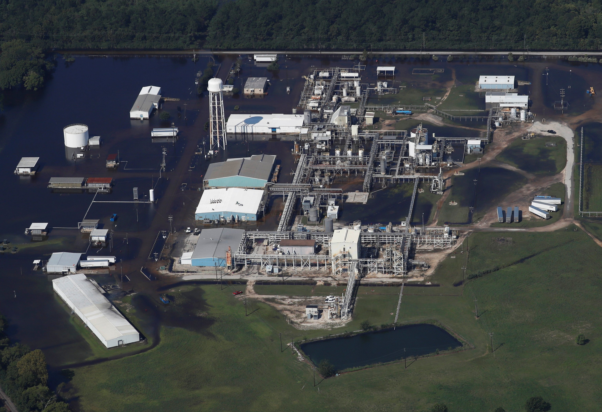
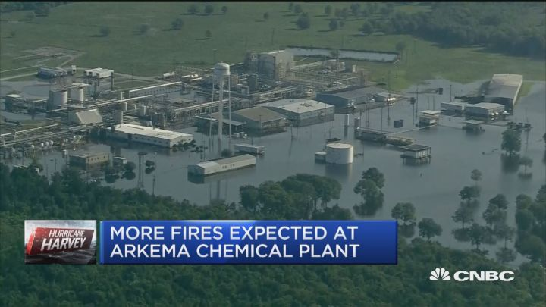
Hurricane Harvey: ∼100 Chemical Releases
Hurricane Harvey: Multiple Facilities Affected: Extreme flooding, failures, and toxic releases
Flooding, failures, power losses, fires, chemical releases with multiple implications
Source: Houston Chronicle
Arkema Chemical

Slide 44
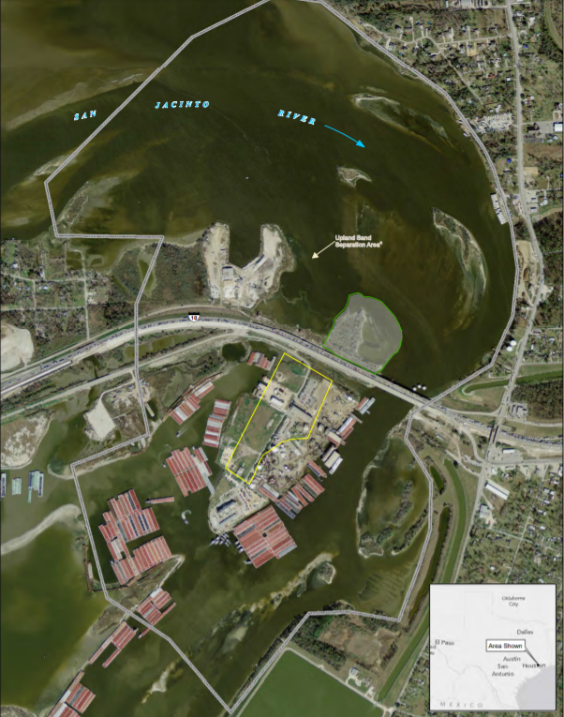
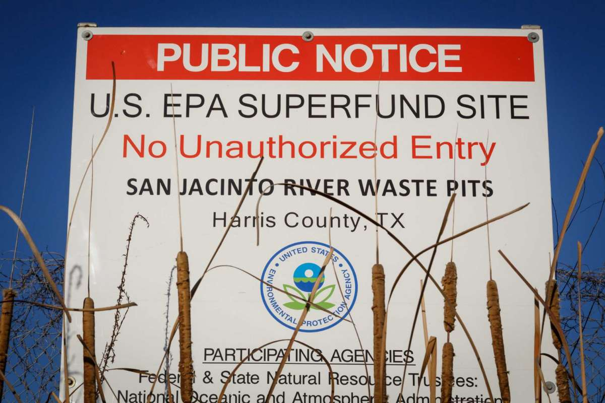
Hurricane Harvey: San Jacinto River Waste Pits
Dioxin containing waste covered with an armored cap
Excessive rainfall resulted in a 500-year flood in San Jacinto River
Damage to surface and submerged caps
Erosion of riverbed next to the cap
History of continuing damage
ROD 2017: removal and excavation of most of the armored cap and waste materials
Former Waste Pits
Armored Cap
Sources:
https://www.epa.gov/sites/production/files/2017-10/documents/sjrwp_rod_final_10_11-2017_signed.pdf
https://www.houstonchronicle.com/

Slide 45
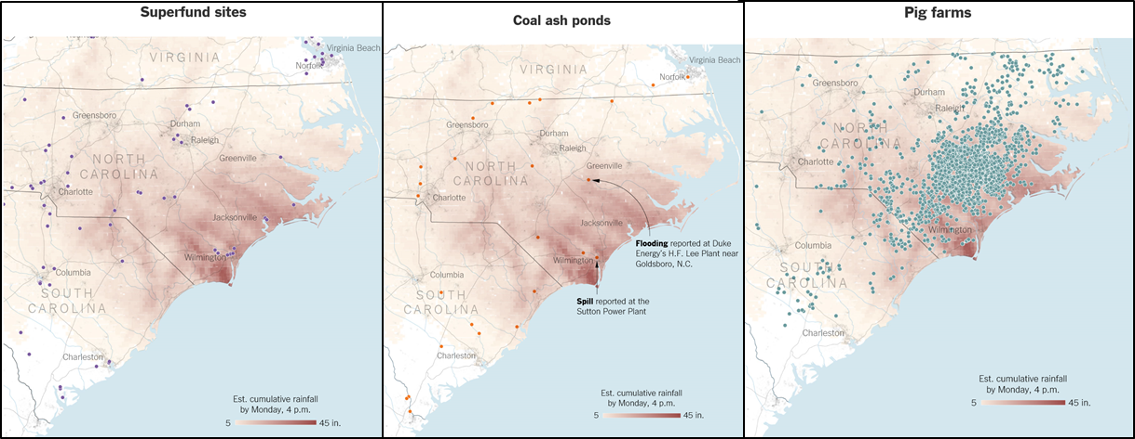
Hurricane Florence: Multiple facilities at risk from extreme flooding, failures, and toxic releases
Superfund Sites
Coal Ash Ponds
Pig Farms

Slide 46
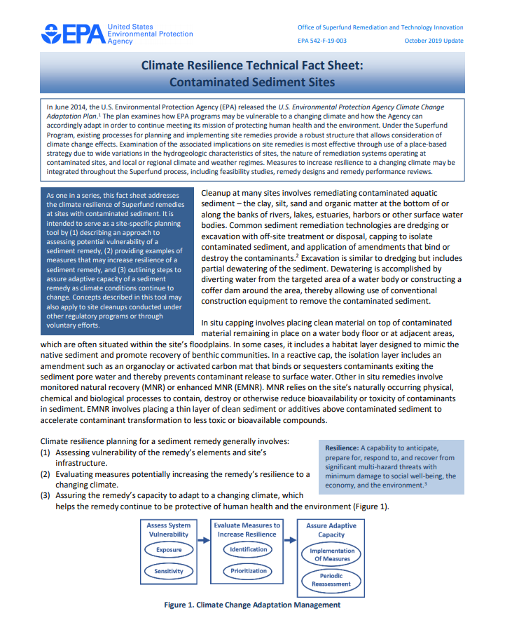
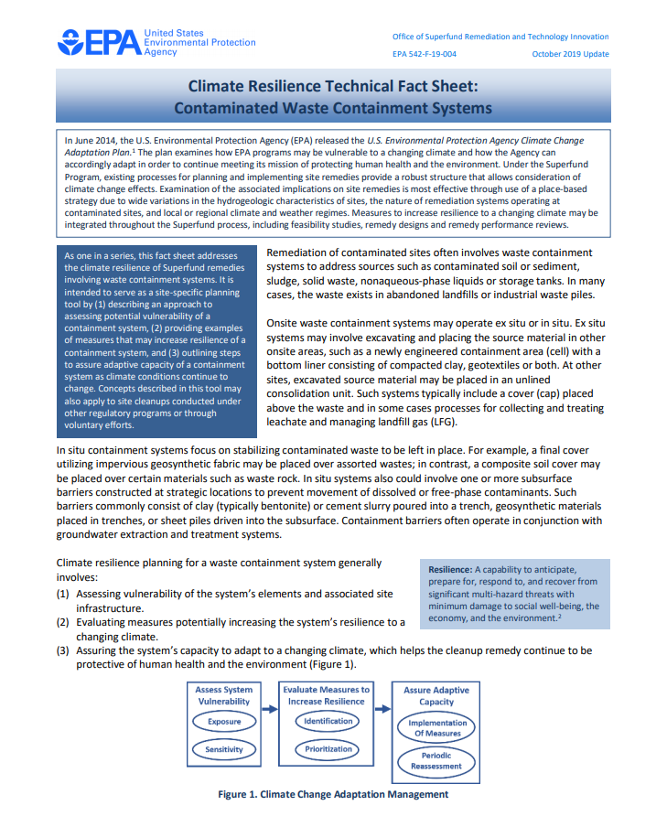
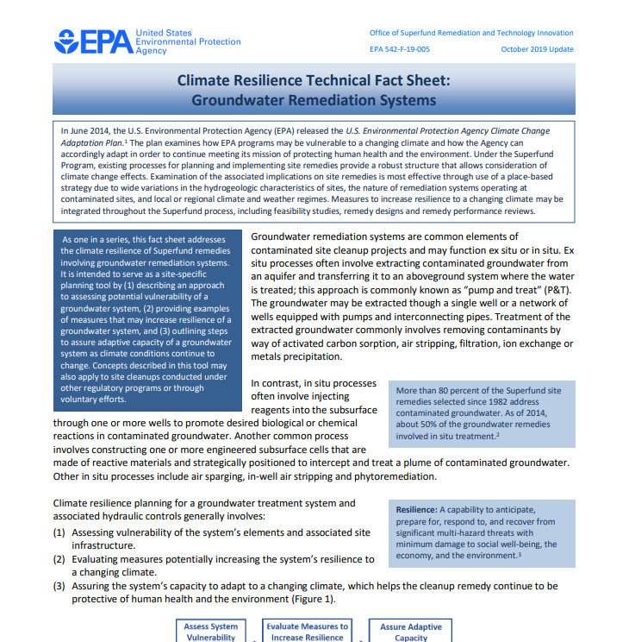
Guidance to prepare for the future
EPA taken mostly reactive approach
Guidance documents issued on remedy resilience
Proactive assessments of facilities sites by parties may be necessary
EPA Website:
“Remedies at contaminated sites may be vulnerable to the implications of climate change and extreme weather events. EPA's Superfund program developed an approach that raises awareness of these vulnerabilities and applies climate change and weather science as a standard operating practice in cleanup projects.
The approach involves periodic screening of Superfund remedy vulnerabilities, prioritizing the Superfund program's steps to adapt to a changing climate and identifying adaptation measures to assure climate resilience of Superfund sites.”
Source:
https://www.epa.gov/superfund/superfund-climate-resilience

Slide 47
COVID-19 and Climate Change
The COVID “lockdowns” had a dramatic effect on daily carbon emissions, causing a 17% drop globally during peak confinement measures by early April 2020 – levels not seen since 2006.
Its estimated to be the largest annual decrease in emissions since the end of World War II, however, 2020 still determined to be the warmest year on record (tied with 2016 ).
Scientists studied lockdown measures in 69 countries that are responsible for 97% of global carbon dioxide emissions. They point to massive decreases in transportation usage and industrial activities during the pandemic as the main sources of the decline.
According to the study, the largest factor was a lack of vehicles on the road, accounting for 43% of the decrease. Although air travels carbon footprint fell by a staggering 60%, that industry only generally accounts for about 3% of yearly global carbon emissions — making its overall impact far smaller than other industries.

Slide 48
COVID-19 and Climate Change
Despite the significant reduction of GHG emissions due to the pandemic, the amount of greenhouse gases actually in the air — is at a record high.
According to readings from the Scripps Institution of Oceanography and NOAA, the amount of CO2 in the air in March 2021 hit an average of slightly greater than 417.64 parts per million (ppm). This is the highest monthly average value ever recorded, and is up from 414.74 ppm in March 2020.
A World Metrological Organization Report cautions that since the gas “remains in the atmosphere and oceans for centuries, this means that the world is committed to continued climate change regardless of any temporary fall in emissions due to the Coronavirus epidemic.”
UN 2020 Emissions Gap Report (Difference between “where we are likely to be and where we need to be” is known as the ‘emissions gap’.) Underscores that “the unprecedented scale of COVID-19 economic recovery measures presents the opening for a low-carbon transition that creates the structural changes required for sustained emissions reductions. Seizing this opening will be critical to bridging the emissions gap.”

Slide 49
COVID-19 and Climate Change
AON’s 2021 Weather, Climate & Catastrophe Insight Report found:
One of the most challenging aspects for local and federal officials has been the planning process around large-scale evacuations and post-event temporary housing procedures in the COVID-19 environment.
The social distancing and strict screening guidelines have often required new evacuation center set-ups that limit the number of evacuees per facility.
Another difficulty identified has been locating enough volunteers to aid and/or be deployed to begin the relief and recovery process.
Varying restrictions around social distancing and public health safety has also limited the number of insurance adjusters that were deployed in the aftermath of events.
Many re/insurers have begun to incorporate new technologies to aid the claims process, incl. introduction of drones to conduct survey assessments from the air.

Slide 50
Climate Change – Significant Additional Areas of Activity
Carbon Taxation
Attribution Science
Catastrophe (“CAT”) Bonds
Carbon Capture & Sequestration Efforts and Techniques
Financial Institutions Divestiture from Fossil Fuels and related companies (“Stranded Assets”)
“Carbon Neutrality” Efforts and related legislation
Overhaul of the U.S. National Flood Insurance Program

Slide 51
Q & A
Contact Us:
ADAM D. KRAUSS, Esq.
Senior Counsel
Traub Lieberman Straus & Shrewsberry LLP
(914) 347-2600
akrauss@tlsslaw.com

Slide 52
“Today’s flood will become tomorrow’s high tide.” (Margaret Davidson – Founder of NOAA’s Coastal Services Center) Questions/Comments?

