Slide 1
Peer-to-Peer Insurance: New Contractual Structures
Margarida Lima Rego
Webinar: Smart contracts, distance contracting, peer-to-peer insurance
Joint Meeting of AIDA Working Parties and Universities of Exeter, Florence and NOVA School of Law, Lisbon
10 November 2020

Slide 2
Peer-to-Peer Insurance Margarida Lima Rego
New challenges stemming from the online environment have made it increasingly difficult to define an insurance contract.
Any serious attempt to define an insurance contract must come in the form of a new question:
For what purpose?
For purposes of regulation and supervision of the insurance business?
For contractual purposes?
For tax purposes?
...
“The English courts know an elephant when they see one; so too a contract of insurance.” (Malcolm Clarke)

Slide 3
Peer-to-Peer Insurance Margarida Lima Rego
Sharing economy: the new global village and a return to the origins of insurance, by virtue of the elimination of most links in the insurance distribution chain and the reinvention of direct exchanges.
P2P insurance? – the carrier model;
– the broker model;
– the self-governing model.
The multiplication of products aimed at satisfying insurance needs but which do not exhibit the characteristics typically assign to insurance contracts: a regulatory challenge.

Slide 4
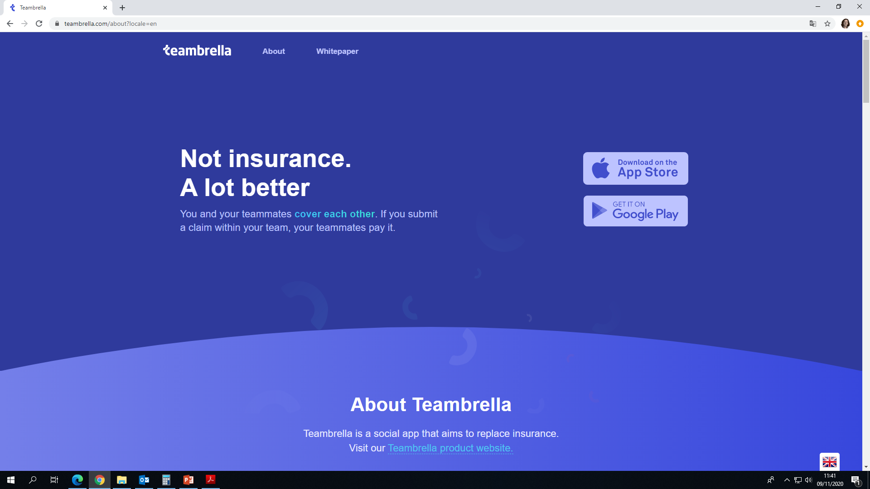
Peer-to-Peer Insurance Margarida Lima Rego
Teambrella: a case study

Slide 5
Peer-to-Peer Insurance Margarida Lima Rego
Image Credit: Huffington Post
Teambrella’s predominantly blue image sends out a message that it aims to build its relationship with its target-market on the basis of TRUST.

Slide 6
Peer-to-Peer Insurance Margarida Lima Rego
Teambrella: A Peer-to-Peer Coverage System
Version 2.2
Alex Paperno, Vlad Kravchuk, Eugene Porubaev
Abstract
There is a conflict of interest between insurance companies and policyholders. We propose a way to solve this issue by implementing a system that provides peer-to-peer coverage. Peers have mutual control on most aspects of their coverage, such as risk evaluation and processing of payments. The mutual control is implemented via a voting mechanism that can be delegated to proxies. To ease the burden of payments between peers, we use a blockchain as a mean of providing coverage and payment of reimbursements.

Slide 7
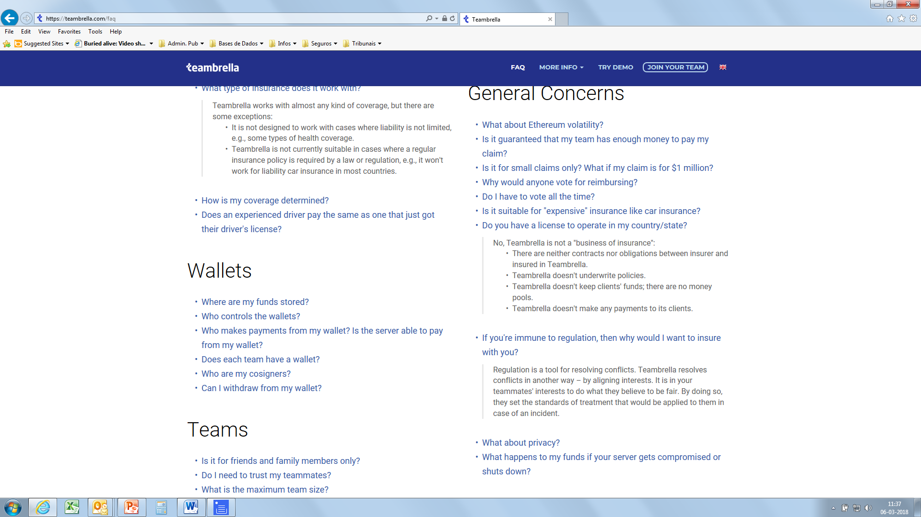
Peer-to-Peer Insurance Margarida Lima Rego
Do you have a license to operate in my country/state?
No, Teambrella is not a "business of insurance": There are neither contracts nor obligations between insurer and insured in Teambrella.
Teambrella doesn’t underwrite policies.
Teambrella doesn’t keep clients’ funds; there are no money pools.
Teambrella doesn’t make any payments to its clients.

Slide 8
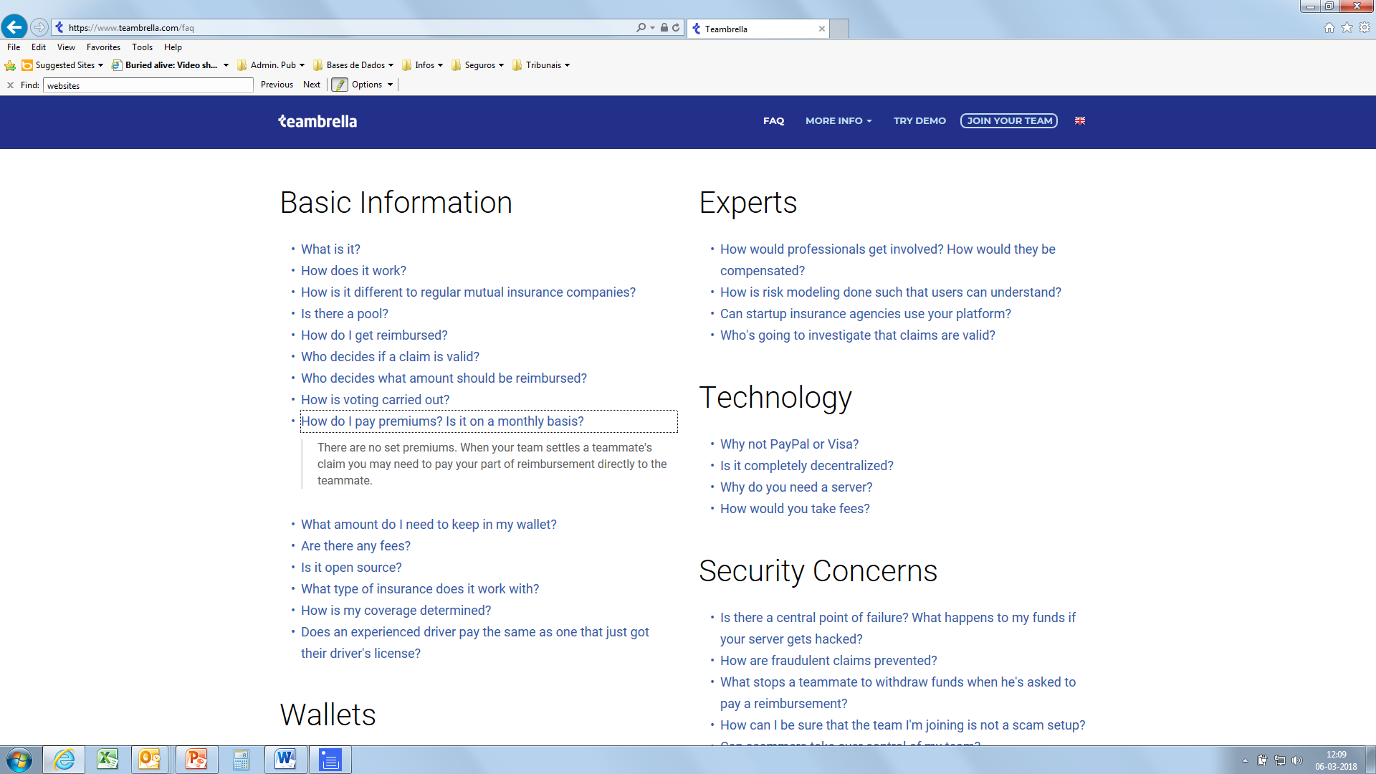
Peer-to-Peer Insurance Margarida Lima Rego
How do I pay premiums? Is it on a monthly basis?
There are no set premiums. When your team settles a teammate’s claim you may need to pay your part of reimbursement directly to the teammate.

Slide 9
Peer-to-Peer Insurance Margarida Lima Rego
Conclusions
In the new global village, insurance regulation would fail miserably, were it to allow economic agents that cater for basic insurance needs to escape it. If one accepts that the new business models must fall within insurance regulation, then such regulation must be brought up to speed with the new tech-based means of providing insurance. Namely, insurance regulation must get over the paradigm of the traditional insurer who is the sole designer of its ready-made mass products and embrace the notion that insurance customers will be increasingly called upon to play an active role in putting together their own tailor-made insurance products, with the assistance of and by means of new tech-based instruments.
Protection of such active customers must come in new forms, as the sharing of designer roles between the insurer and its customers should not entail the diffusion of the underlying responsibility - and potential liability - for the resulting insurance products.

Slide 10
Thank you!
Margarida Lima Rego
margarida.rego@novalaw.unl.pt
10 NOVEMBER 2020

