Slide 1
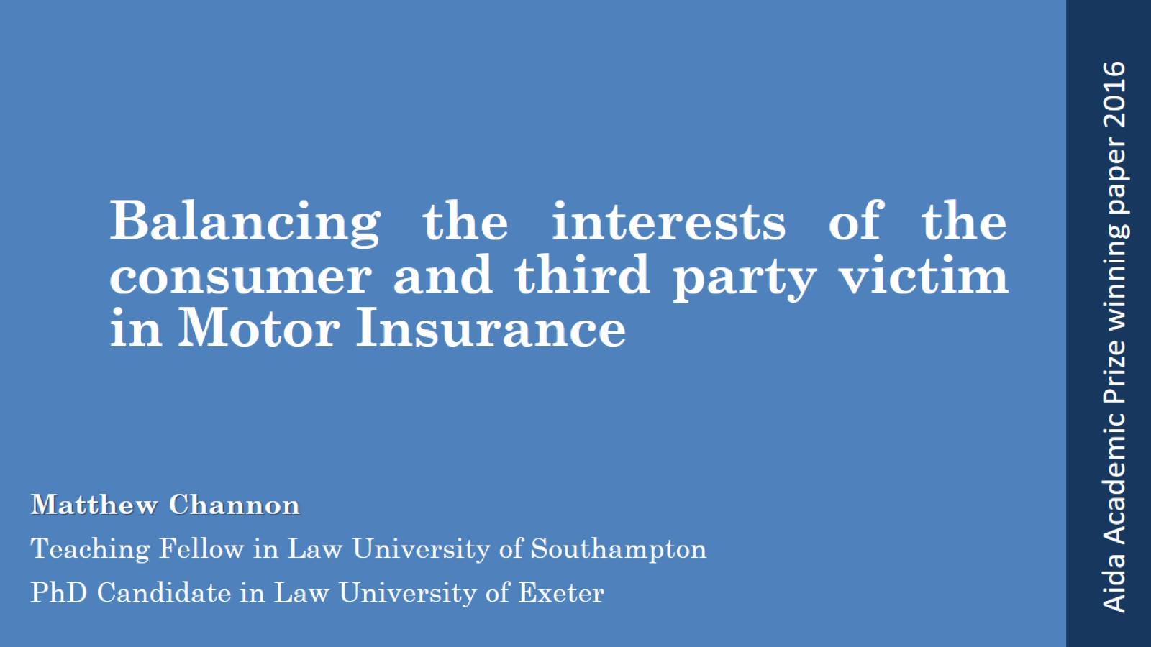
Balancing the interests of the consumer and third party victim in Motor Insurance

Slide 2
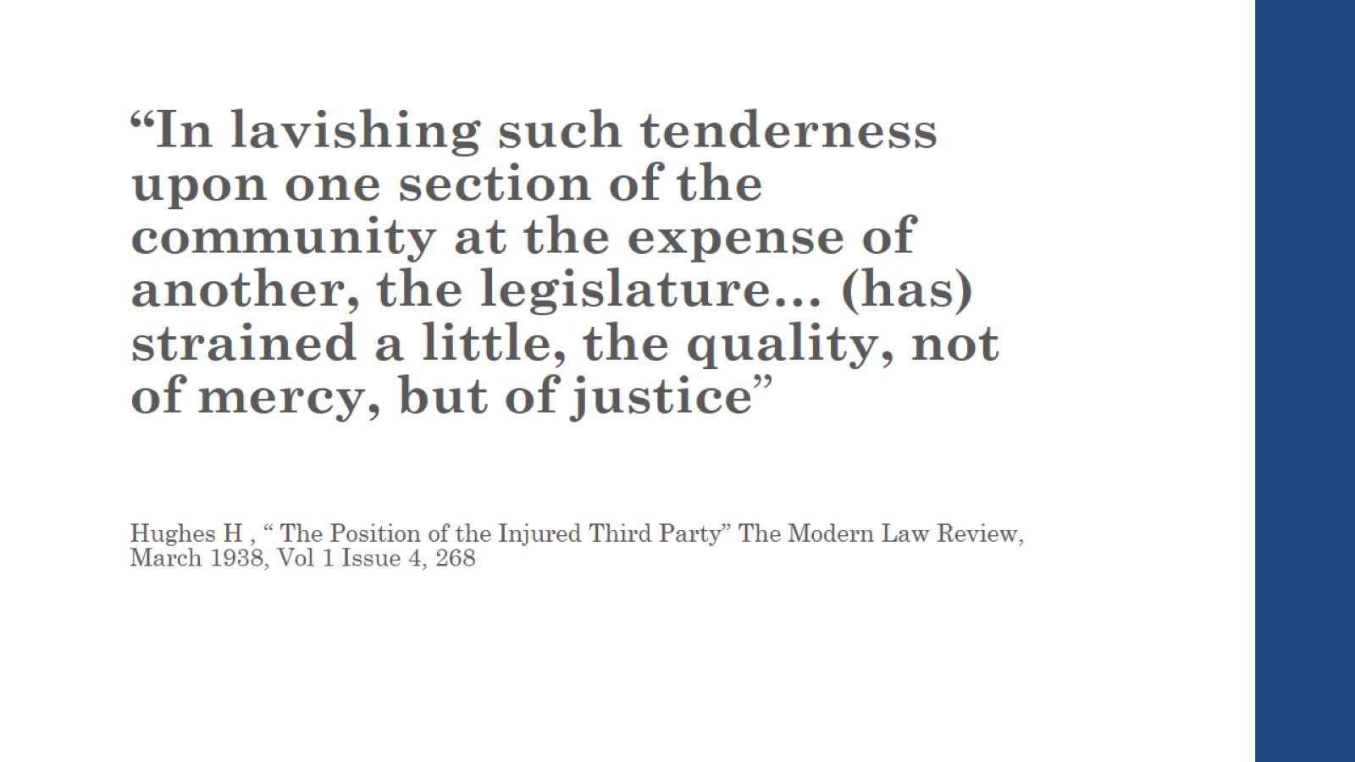

Slide 3
1930 Hughes-Chorley Debate

Slide 4
Current Position

Slide 7
Blameworthiness and Criminal

Slide 8
Blameworthy and Criminal (2)

Slide 9
Strict Liability?

Slide 10
UK: Delaney

Slide 11
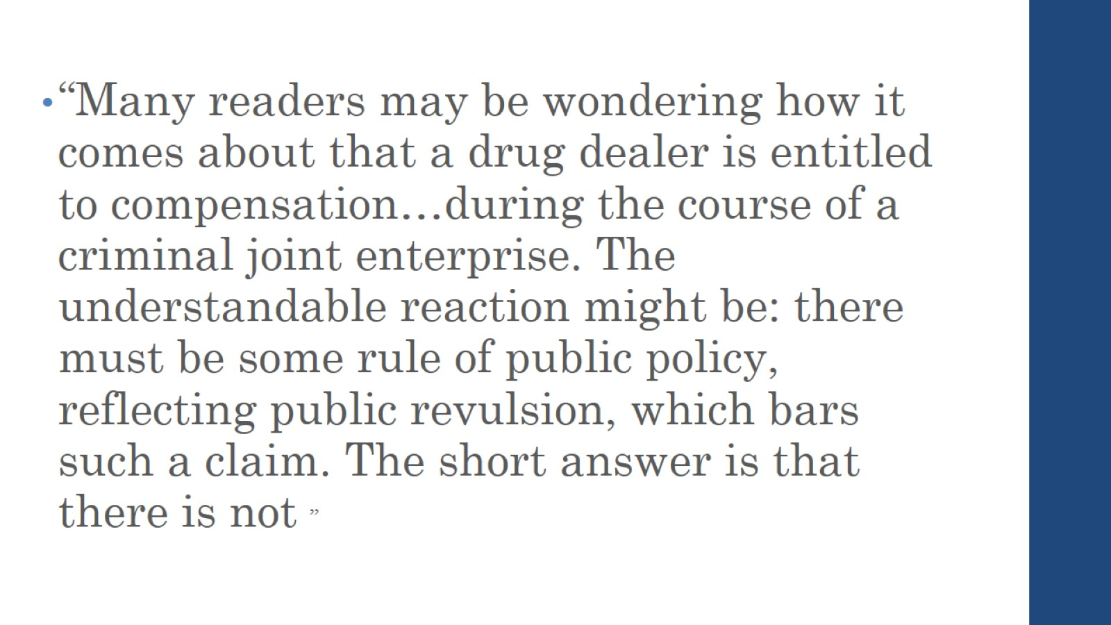

Slide 12
Delaney

Slide 13
Should we compensate the criminal?

Slide 15
Ex Turpi Causa- Illegal Act

Slide 16
Scope of Insurance : EU/UK

Slide 17
Scope

Slide 18
Conclusion

