Slide 1
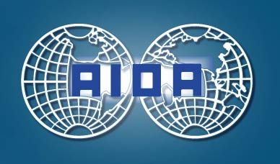
Costs for Removing Lost Cargo: Cargo or P&I ?
Satoshi Nakaide
Professor, Waseda University
LLM(London), Diploma(Cambridge)
nakaide@waseda.jp
Marine Insurance WP 30 September, 2014 Rome

Slide 2
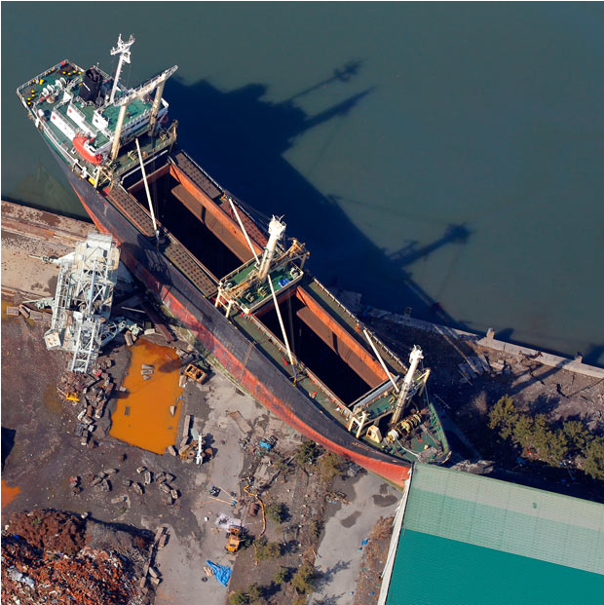
コピー禁止、Miyahiro（Japan P&I Club)提供
Photo is provided by Mr. Miyahiro, Japan P&I Club. Copy is not allowed.

Slide 3
Outline of the Presentation
Importance of the Issue
Difficulties of the legal Issue
Tests
Case Study 1
Case Study 2
Case Study 3
Case Study 4
Summary
3

Slide 4
1. Importance of the Issue
Seriousness
Often the issue becomes a big issue involving wide range of people.
Urgency
The issue is often an urgent matter. Any delay further worsens the situation.
Difficulties of Adjusting Conflicting Interests
Removing damaged cargo involves a greater cost than the value of cargo. Nobody wants to bear the cost.
4

Slide 5
2. Difficulties of the Law on the Issue
Various Situations
Situation varies case to case.
- nature and quantity of the cargo
- seriousness of the damaged cargo
- place of the damaged cargo
- parties involved
- insured or not insured
Any generalization may be misleading
Disclaimer:
Each case must be examined based on its actual situation.
Today’s presentation is aimed at providing a brief guidance
based on my personal understandings.
5

Slide 6
3. Tests to be Considered (1)
Q1 Nature, seriousness of damage and quantities of cargo
- perishable - dangerous - oil
- volume of the damaged cargo
Q2 Is the damaged cargo on board the vessel?
ex. sea water damage of corns onboard
ex. round logs washed over board
Q3 Is the value of the damaged cargo more than the removal costs?
Q4 Where is the damaged cargo?
- in the high seas, territorial waters, port,
- on land … public beach, private place, road, river …
6

Slide 7
Tests to be Considered (2)
Q5 Cause of the damage of the cargo
- negligence of the ship owner or operator
- dangerous nature of the damaged cargo itself
- force majeure
Q6 Does the vessel need removal, too?
Q7 Are the cargo and vessel insured for its liability?
- special cover for cargo owner against removal liability <rare>
- P&I insurance of ship owner for cargo indemnity
Is the premium paid?
7

Slide 8
4. Case Study (1) ① * Hypothetical case
Case: Vessel with cargo sank in the shallow water and both became total loss. Ship owner is a member of Japan P&I.
Issues involved:
- Whether the cargo need to bear the part of removal costs or not?
Possible solution: My Personal View
- As far as the cost of removing ship only, i.e. where ship needs to unload the damaged cargo, is higher than the costs of removing both, P&I may bear the cost.
The cost will be regarded as reasonable.
- Even if ship owner asks cargo owner to contribute to the removal costs, cargo owner will resist its payment, asserting ship owner's responsibility for the accident.
8

Slide 9
Case Study (1) ② * Hypothetical case
Question?:
How will be the apportionment if the removal costs becomes greater because of the nature of the cargo, such as the dangerous nature of the cargo?
Possible solution: My Personal View
- If there is not any justifiable logic for the ship owner to bear the whole cost, P&I may not be able to bear the whole costs. Cargo owner need to bear the part of the cost increased solely by the nature of the cargo.
- Cargo owner may resist its payment, asserting ship owner's responsibility for the accident. The liability will be judged on the terms of the carriage contract.
9

Slide 10
5. Case Study (2) * Hypothetical case
Case: Wheat on the vessel were totally lost because of the sea water entered into the hold from the hatch cover during the heavy weather.
Issues involved:
- Who should pay the cost of removing cargo from the ship and damping it, so far as the cargo owner waives his right of property?
Possible solution: My Personal View
- The vessel needs to unload the cargo as usual although it may incur extra charge.
- Cargo owner need to damp the cargo and bear the extra charge for it. The cost are not covered by his cargo policy.
- Cargo owner may claim compensation against the ship owner for his loss caused by the vessel under the relevant carriage contract up to the limit of the carriage contract.
- If the liability of ship owner of charter is established, relevant P&I club will pay the insurance money for it under her cargo indemnity cover.
10

Slide 11
6. Case Study (3) * Hypothetical case
Case: Round logs imported to Japan were washed over board and were drifted to the beach.
Ship owner is a member of Japan P&I.
Issues involved:
(a) Ownership of the damaged cargo
- Who is the owner of the property .. seller or buyer?
(b) Transfer of property under marine cargo policy
- Is the cargo owner entitled to abandon the cargo to the cargo insurer as it is totally lost under its marine cargo policy with ICC?
Can insurer refuse the transfer of it?
- Does the property transfer from cargo owner to its insurer after his payment for total loss based on Art. 24 of the Japanese Insurance Contract Act?
Can insurer reject its transfer?
11

Slide 12
Case Study (3) * Hypothetical case
Issues involved:
(c) Liability for the accident
- Is the ship owner responsible for the accident?
- Is the owner entitled to limit his liability under the carriage contract?
(d) Liability for the removal costs
- What law and regulation apply to the case?
12

Slide 13
Case Study (3) * Hypothetical case
Possible Solution : my personal view
Transfer of ownership arises based on the contract of sale between the seller and its buyer irrespective of the terms of the INCOTERMS.
In many cases, the buyer will be the owner of the cargo after the payment for the cargo.
Cargo insurer will be entitled to reject accepting transfer of property against the notice of abandonment from the assured under the English Institute Cargo Clauses 2009.
Cargo insurer will be entitled to reject the legal transfer of the damaged property under the Japanese Insurance Act Art. 24.
13

Slide 14
Case Study (3) * Hypothetical case
Possible Solution : my personal view
Liability of its removal will arise based on various laws and regulations.
Ex:
Port Regulation Law, Port and Harbor Law, Maritime Traffic Safety Law, The Law about Prevention of Maritime Disasters, such as Sea Pollution, The Law on the Sea Coast, Law on the Natural Parks, Wastes Disposal and Public Cleaning Law
Various regulations of the local authorities
Right of claim for removing obstacle under the Civil Code ….
The party responsible for the removal costs will be judged by the applicable law and regulations.
ex: ship owner, party responsible for the accident…
14

Slide 15
Case Study (3) * Hypothetical case
Possible Solution : my personal view
In reality,
Immediate removal of the cargo will be needed.
In many cases, the name of the vessel will be reported by the mass media. However, its is rare that the name of the cargo owner is disclosed. It may not be easy for the public to know the various cargo owners of the damaged cargo.
Ordinary persons will consider that the shipping company which caused the accident should be responsible for the removal costs.
- Local authority may ask the ship owner and its P&I and in many cases actually issues a formal order to remove the logs.
Ship owner may not be able to prove that he has no fault about the accident.
P&I may bear the removal costs as far as there is a formal order by the authority against the ship owner to remove the cargo and cargo owner abandons the property.
15

Slide 16
7. Case Study (4)
Case: Many vessels, some with cargo, were drifted and grounded on land and became total loss because of the huge Tsunami after the large earthquake of 11 March 2011 in Japan.
Number of damaged vessels
fishing boats 19,811
vessels other than fishing boats
vessels less than 20 GT 15,500
more than 20 GT 57
* base on the figure of Ministry of Land, Infrastructure, Transport and Tourism Bureau of Shipping, 2011
16

Slide 17
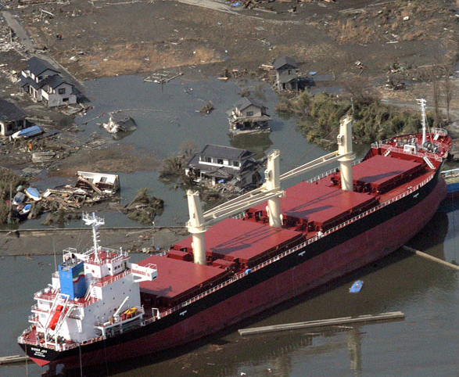
Photo is provided by Mr. Miyahiro, Japan P&I Club. Copy is not allowed.

Slide 18
Case Study (4)
Various places of the damaged property
Ocean, Port, Coast, Park, River, Road, Private place …
Liability of its removal will arise based on various laws and regulations.
Ex:
Port Regulation Law, Port and Harbor Law, Maritime Traffic Safety Law, The law about Prevention of Maritime Disasters, such as Sea Pollution, The Law on the Sea Coast, Law on the Natural Parks, Law on the River, Wastes Disposal and Public Cleaning Law
Various regulations of the local authorities
Right of claim for removing obstacle under the Civil Code ….
18

Slide 19
Case Study (4)
Legal Issues
Does P&I insurance cover Tsunami risk of the earthquake?
Does P&I insurance cover removal costs on land?
Can P&I Club recover the part of removal cost from the cargo?
Difficulties
It was not easy to find the owner of the damaged cargo as they were mingled with other properties such as house, warehouse, etc.
However, owner of the large ships were easily identified by the name stated on the vessel.
19

Slide 20
Case Study (4)
Solution :
Immediate removal of the wreck was needed.
Authorities noted the fact that Tsunami risk was not excluded from the P&I insurance and asked P&I to bear the removal costs of the merchant vessels covered by the P&I insurance.
As to the cargo vessels, the relevant authorities made orders against the ship owners to remove the vessel including its cargo.
to be continued
20

Slide 21
Case Study (4)
Solution :
Theoretically, the ship owners might have been able to ask its cargo owner if any to bear the part of the removal cost, insisting that the accident was caused by the force majeure and the expenses include those of the removal of cargo. However, as far as the removal order is against the ship owner, it was not easy for the ship owner to establish his right of claim against the cargo owner under the contract of carriage. It is not easy for the ship owner to prove that he has paid every reasonable measure to prevent such a drifting.
P&I insurance does not exclude the risk of tsunami or earthquake and it may not be easy to deny claim from the ship owner to bear the removal costs, so far as there is in fact a formal order by the authority against the ship owner to remove the vessel with cargo.
21

Slide 22
8. Tentative Solutions under Japanese Law
Personal View
(1) Cargo on board the vessel
If the cargo owner wants to obtain it, cargo owner will bear the cost of the removal of cargo.
Where the carrying vessel is also a wreck and it is reasonable to remove both of the ship and cargo together, P&I Club may bear the whole of the removal costs.
(2) Cargo outside the vessel
It is controversial. However, in reality, ship owner and its P&I will bear the removal cost of removing cargo under its indemnity cover, unless the ship owner may well establish that he owes no liability for the accident.
(3) Costs increased by the nature of the cargo
Increased cost caused by the nature of cargo, such as the dangerous nature of cargo, should be born by the cargo owner.
22

Slide 23
9. Conclusions
Difficult area of laws
Law is not clear.
Immediate removal is necessary and it may not be wise to bring the matter into court. If the ship owner tries to lesser its burden by bringing the matter into court, ship owner will face serious reputational risk.
In reality, P&I Club works very efficiently and settle the matter nicely among conflicting interests.
Thank you for listening ! The END
23

