Slide 1
DamNed If you Do and Damned if you don’t – The Insurance Liability Implications for dam construction and Management
Chris Rodd
MEETING of 15th AIDA CCEWP and
CILA CAMBIO
CLIMÁTICO WORKING PARTY
Santa Cruz – BOLIVIA – 3 May 2017
O

Slide 2
DAM(n) Disasters
Mill River Dam collapse – Williamsburg USA 1874 – 139 killed
Causes – poor design , and lax regulation
Austin Dam collapse – Austin USA 1911 – 78 killed
Causes – poor design ( and apparently ) use of dynamite to remedy a structural problem
Desna Dam collapse - Czech Republic 1916- 62 killed
Causes – construction flaws
Gleno Dam collapse -Bergamo Province Italy 1923 – 356 killed
Causes- poor construction and design

Slide 3
Dam(N) Disasters
Vega de Tera Dam Collapse – Spain 1959 – 144 killed
Causes- structural deficiencies and poor construction.
Teton Dam collapse –Idaho USA 1976- 11 killed
Cause – water leakage through earthen wall.
Val di Stava Dam – Tesero Italy 1985 – 268 Killed
Causes- Poor maintenance and low margin for error in design.
Kantale Dam collapse – Kantale Sri Lanka 1986- 180 killed
Causes - Poor maintenance , leakage and consequent failure.
Camara Dam collapse - Brazil 2004- 3 killed ….
and for a big one …….

Slide 4
DAM(N) Disasters
Shimantan and Banquia Dam failures – Henan Province .China 1975
Causes – Poor design and rapid construction combined with the worst storm ever recorded in the region.
During the 1950’s over 100 dams and reservoirs constructed in the Henan Province as part of “the great leap forward. “
Result – 171,000 people killed.
Currently in SW China 32 major dams have been constructed -100 more are planned.
Of the 130 Dams , 48.2 % are reputed to be in areas of high to very high seismic hazard.
Many of the old dams are poorly constructed – The Central Government have identified 40,000 dams at risk of breach !

Slide 5
FUNDAO DAM – Brazil
The GOOD and the BAD of Dam construction
Mining dams and dumps are among the highest risk structures on earth.
..and large tailings dams among the most dangerous
Regulation and enforcement vary wildly among different jurisdictions with many companies effectively self regulated.
“Around the world it’s a hodgepodge..These structures are so complex that to write a pre-scripted regulation is almost impossible”
( Harvey McLeod – Chairman of the Tailings Committee at ICOLD )

Slide 6
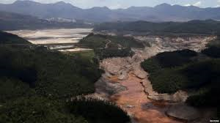
Fundao Dam – “The Bad”- 19/11/2015

Slide 7
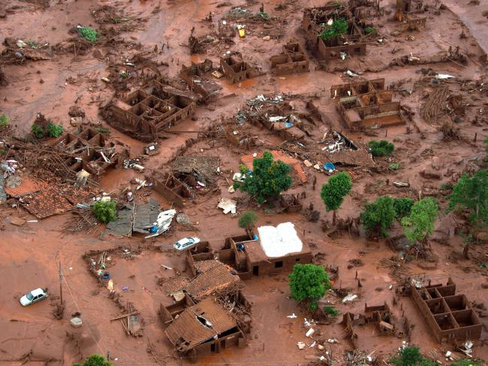

Slide 8
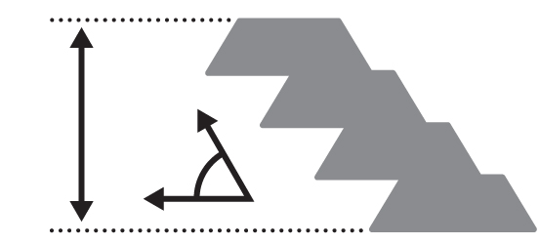
Fundao Dam Construction- a lesson in bad DESIGN
Height and angle – The taller the dam the greater the disaster if it fails – The Fundao disaster was inevitable
Heigh

Slide 9
INSTITUTO PRISTINO REPORT – 2013 POOR CONSTRUCTION and MANAGEMENT
Warned of design flaws in the tailings dam -Carlos Eduardo Pinto ( state environmental prosecutor ) Minas Gerais
concluded that mine spills were no accident but a result of mistakes in operation and negligence in monitoring .
In October 2013 Samarco granted a licence to increase dam capacity despite no compliance with prior conditions
Report recommended further geo technical analysis of the structure .
Regular monitoring reports were recommended – none supplied

Slide 10
Fundao Dam Failure – Consequences
!7 killed and 16 injured
. The village of Bento Rodriguez destroyed
60 million cubic metres of iron ore waste flowed into the Doce River
Toxic mudflows reached the Atlantic Ocean 17 days after the collapse
.massive toxic mudflows into the Santarem River Valley
Toxic mudflows along the Espirito Santo coast closing beaches
The worst environmental disaster in Brazilian history

Slide 11
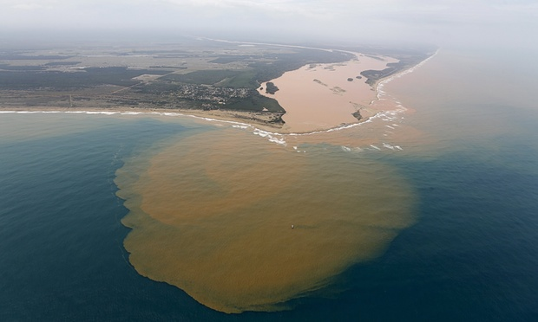

Slide 12
Is Fundao an Insured loss ?
Brazilian Prosecutors have filed a $58 Billion law suit against Vale , BHP Billiton and iron ore joint venture partner Samarco Mineracao
Share holder class action in the USA against Vale Securities on the basis of alleged false statements and failing to disclose material adverse facts about the Samarco iron ore project
Insurer Ace leads the property programme for Samarco
Samarco Executives - criminal charges
If criminal culpability found, the property and casualty cover may not respond.

Slide 13
Fundao Tailings Dam Review Panel Report -25/8/2016
Report commissioned by lawyers Cleary Gottlieb Steen & Hamilton behalf of the joint venture mining companies
Chair – Norbert Morgenstern. Panel members – Steven G Vick , Bryan D Watts and Cassio Viotti
Report designed to establish cause , rather than apportion or focus on blame
The fact the report commissioned by the miners and the legal liabilities they now face, led the authors to avoid making recommendations as to how to make tailings dams safer

Slide 14
Findings of the Report
Fundao had been experiencing drainage problems since at least 2009
A change in design in 2012 worsened its drainage and left a key section of the dam face resting on unstable silt like mine waste ( slimes )
A series of small earth quakes 5/11/2015 , may have contributed the “liquefaction flow slide” - Robert Morgenstern
According to the Executive Summary- “The Failure of the Fundao Tailings Dam by liquefaction flow sliding was the consequence of a chain of events and conditions . A change in design brought about an increase in saturation which introduced the potential for liquefaction….” ( Page iii )

Slide 15
Fundao
No doubt there is Directors and Officers cover available which again, will not respond, if criminal findings made against executives .
There would be potential cover for defence of proceedings costs, but not for fines or penalties
Critical to claims by homeowners , business owners , farmers and the 2 states involved will be the issue of criminality – policies would not respond to criminal acts foreseeable and preventable.
2 municipalities have lodged claims for $1.2 billion in damages exclusive of the $5.1 billion in environmental damages , family and business owner claims

Slide 16
“The Good” ? – Wivenhoe Dam

Slide 17
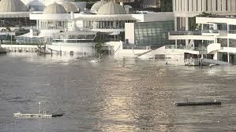

Slide 18
Management of Wivenhoe DAM – January 2011
The consequences of the flood and water releases are known to all
Litigation arising from losses sustained was instituted in the NSW Supreme Crt in July 2014 - Seqwater , Sunwater Ltd , and the State of Queensland .
Class action with approx. 5500 claimants
Basis of claim was that the dam was operated in direct breach of its own Operations Manual …..
Particulars of alleged negligence ….failing to utilise , available rainfall forecasts AND failing to adopt appropriate water release strategies as and when required.

Slide 19
Wivenhoe Litigation
The primary obstacle confronting the claimants is – CAUSATION
Claimants must prove ( on the balance of probabilities ) that -
The extent of the flooding was caused by or exacerbated by the breaches of the Wivenhoe Dam Operations Manual.
Despite adverse comments/ findings about dam management , contained in the Royal Commission Report , the claimants cannot rely on the findings and MUST prove causation, by leading evidence at trial .
There may be over 5000 in the class action , but few if any insurers have joined the subrogation proceedings !

Slide 20
InSurance Protection
Insurers paid out millions in flood and storm water claims.
What is SUBROGATION ?
Upon payment of claims, insurers are entitled to exercise subrogated rights and pursue recovery against any negligent third party who caused the loss – SEQWATER ??
SEQWATER has both assets – annual report of 2010/11 revealed $3B in assets and insurance
Seqwater holds Directors and Officers , Professional Indemnity as well as General Liability policies .
Q’land government revealed in Feb 2012 ………..

Slide 21
Insurance Protection
The Queensland Government Insurance Fund ( QGIF) , which has reserves of approximately $900m was in place to respond to claims arising from proven liability.
Notably the Queensland Government did not insure its infrastructure assest – roads, bridges etc . Why ?
Sunwater has was also required to hold insurance – Professional Indemnity , Public and Products Liability ( 2011 annual report disclosed assets of $148B including $675.9M in net assets
With this insurance and asset protection, why haven’t all the major insurers joined the class action against the named defendants ? Alleged the 11 major insurers, were involved.

Slide 22
The Class Action and Subrogated Proceedings
We know the basis of the claim – essentially management of the dam and inflows and , of course , releases allegedly in breach of the “operating manual”.
This includes failure to make controlled releases from Somerset Dam to Wivenhoe to facilitate a more controlled and gradual release.
How do the policies respond ?
Obviously policies respond to “acts of negligence” in its widest context .
Question … what negligence ?
Is it negliegnce covered under a general Liability policy ?
Is it negligence for which a professional indemnity policy should respond ?

Slide 23
What were the insurers Insuring ?
Did the insurers fully appreciate the risk they were being asked to take on ?
Why would an insurer pick up Directors and Officers cover and Professional Indemnity cover under a General Liability policy ?
Are lined and unlined spill ways covered under the material damage property cover ?
Are the insurers picking up a maintenance risk or maintenance contract for the dam and spill ways ?
What types of material damage claims are covered under a material damage cover ? Certainly not routine maintenance repairs !!!

Slide 24
So what would Engineers expect to be covered For ?
. Clearly professional indemnity claims arising from their conduct as professionals – design, construction , supervision , maintenance and operations … and of course ADVICE .
Subject to the nature of their role – Directors and officers cover
As for the owners and operators of the dams, including the above, public liability ,….. material damage arising from accidental damage ( unforeseen event ) BUT NOT , routine OR preventative maintenance. !
I suspect that there is a level of “difference in understanding “ about what some insurers believe is intended to be covered and what the engineer sees as covered.

Slide 25
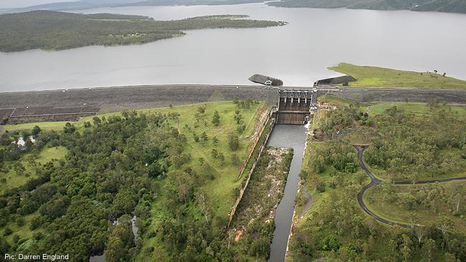

Slide 26
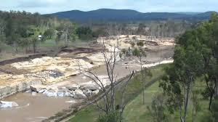

Slide 27
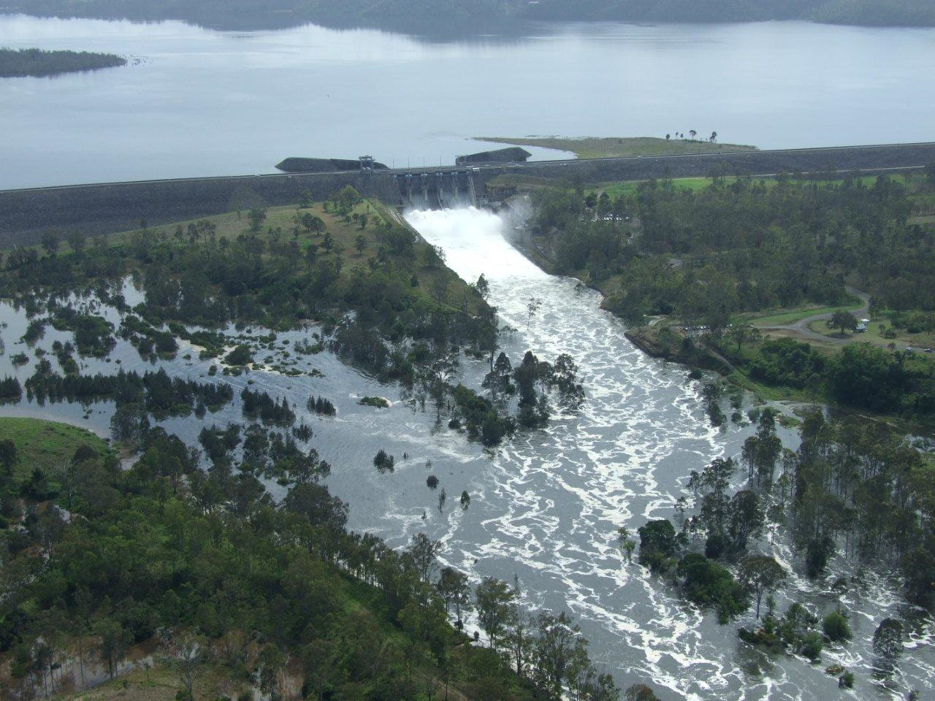

Slide 28
Was all the damage to Wivenhoe Covered ?
The photos show graphic images of the spill way
Is the spillway damage covered or not ?
Clearly as matter of insurance law a policy of insurance DOESNT cover damage caused DELIBERATLY or by a DELIBERATE act .
The releases from Wivenhoe were deliberate releases , not accidental ,…. and while clearly not intended to cause damage… DAMAGE was FORESEEABLE and inevitable.
Does the policy respond ?

Slide 29
Damage Covered ?
Was the release of water “an intentional act causing unintentional damage” ?
An intentional or deliberate act causing unintended or unintentional damage does not generally negate cover.
Reckless indifference to likely consequences can negate cover.
Reasonable care / reasonable precautions does not equate with Recklessness.
Breach or statutory regulation does NOT automatically negate cover ie breach of law or breach of regulation.

Slide 30
Damage Covered ?
If , the releases were in breach of the operating manual , was it negligent mismanagement ?
If negligent in the management of the releases then negligence is covered and the policy responds.
If not negligent but RECKLESS , possibly not.
What if the releases were “illegal”- in breach of a statutory regulation ?
What is illegal ? Simple example …lighting a fire on a total fire ban day.
As the matter is currently the subject of litigation I make no further comment ,other than to make observervations ……..

Slide 31
CAUSE OF ACTION ????
In November 2014 , Justice Garling of the NSW Supreme Crt, granted the defendants application to strike out the Statement of Claim and directed the Plaintiffs to provide a copy of its experts report upon which it intends to rely
A fresh Statement of Claim was filed.
The class action originally set down for trial in July this year, was vacated in September 2015 as the matter clearly not ready for trial.
Trial now anticipated 2017 with an expected duration of up to a year !!!
A windfall for the legal profession and a hellishly expensive exercise for the insurers !!!!

Slide 32
DAM Insurance –International Market
For dams operating for revenue – the big player is the international insurer GENERALI GLOBAL RISK
The cover – design , construction , loss of profits and includes transport and operational cover
The company covers both large and smaller commercial dams , at a global level
In Europe a Norwegian company ( NEFO ) has become the primary insurer for large dams in Scandanavian countries. Formed in 1989 as an initiative of the Norwegian Electricity Federation
NEFO ,currently insuring 5000 dams in Europe … looking at global expansion.

Slide 33
The Insurance Market
Currently a soft insurance market caused by excess capital
Despite what engineers may be experiencing, premiums in the general insurance market ,generally lower than usual
What does your market look like ? Many large multinationals are insured in the O/S market.
The Wivenhoe experience has made a number of local underwriters very cautious
While insuring dams and particularly the operation of dams makes some nervous there is still a market ….but at the “right price” ( for insurers) !

Slide 34
The current insurance for “dam”Risks
Primary Cover– Sum insured retained by the one insurer or co insured with a number of insurers sharing the risk up to 100% of a given sum
Reinsurance – “The insurance of insurers” . Here the insurer ( the ceding company or reinsured ) lays off part of the risk to a reinsurer.
A reinsurer may even reinsure its own liability . Such contracts referred to as “retrocessions”
Classes of Reinsurance – Broadly 2 types –” Facultative” and “Treaty”
Facultative – Reinsurance of a single risk
Treaty – Reinsuring a large number of risks by class or account

Slide 35
Insurance Market – What are insurers looking for ?
Risk Management and demonstrated risk management procedures critical – This should be sel evident !
Regular and proactive review of operating manuals and procedures
Close relationship between insured , broker and underwriter.
Increased focus by underwriters on precisely what risk(s) they are insuring.
Higher premiums – for both primary cover and reinsurance.
What is the right premium split between primary and excess layers ?

Slide 36
Insurance Market
My enquiries reveal something like a 50/50 split between primary and excess layers.
Reinsurers insisting on higher premium to reflect “catastrophic risk” – ie an incident blowing through the primary cover more likely than not.
Big exposures with reinsurance premium matching the exposure.
Any incident is seen as likely to impact reinsurers.
Example Primary Cover – Up to $150 M . First Excess layer $100 excess of $100 M Second Excess layer $ 300 M of $250 M
Reinsures now asking for a larger proportion of the premium.
primary insures insisting on higher premiums generally.

Slide 37
Insurance Market
So what does all this mean for you ?
Higher premiums in the short term.
…and longer term … pure guess work, as insurance operates in a cyclical market .Unfortunately for you, while the market is relatively “soft” you are experiencing increased premiums.
Anecdotally I am told little interest in the market in insuring “tailings dams” … particularly those in third world countries.
I wonder why ?????

Slide 38
Private Dams – small and large
While large dams have received much focus , there has been little attention shown to smaller private dams such as those on rural properties.
These also present a significant risk and the law around the liability in the event of a dam failure is very clear.
The common law rule of law is still dictated by the old House of Lords decision in Rylands v Fletcher [1868] UKHL 1
A dam is an artificial structure for which there is strict liability for land owners for damage caused by dangerous substances that escapes from their land – in this case water damage caused by a dam failure
Regulation of the safety and engineering inspection of e dams of this nature varies from state to state.

Slide 39
BuT Fundao was no Wivenhoe !!!

Slide 40
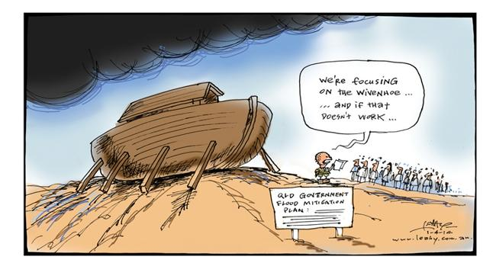

Slide 41
“ Whilst it does not fall within the reach of human foresight or precaution to be able to guard effectually against the baneful recurrence of such awful visitations , or to avoid being more or less involved therein , YET when the too fatal experience of years , has shown the suffers the inevitable consequences of their wilful and wayward habit of placing their residences and stockyards within reach of the floods ; and whilst it must be had in remembrance that many of the deplorable losses which have been sustained within the last few years at least , might have been in great measure averted , had the settlers paid due consideration to their own interests and to the frequent admonitions they had received , by removing their residences from within the flood marks to the TOWNSHIPS assigned for them on the HIGHLANDS , it must be confessed that the compassion excited by their misfortunes is mingled with sentiments of astonishment and surprise that any people could be found so totally insensible to their true interests, as the settlers have in this instance , proved themselves .

Slide 42
His Excellency , however , still cherishes the hope that calamities which have befallen the settlers will produce at least the good effect of stimulating them to the highly expedient and indispensible measure of proceeding to establish their future residences in the town ships allotted for the preservation of them selves , their families , and their property , and they will , one and all , adopt the firm resolution of forthwith erecting their habitations on the highlands , cheered with the animating hope and fair prospect of retrieving , at no very distant day , their losses and securing themselves from further recurrence .

Slide 43
THOSE , who , notwithstanding , shall perversely neglect the present admonition and exhortation to their own benefit , must be considered wilfully and obstinately blind to their true interests , and UNDESERVING any future indulgences , whilst , on the contrary, those who shall meet this severe dispensation of providence , with manly fortitude and unbroken spirit , may rest assured that their exertions and industry will not only merit , but OBTAIN , the favourable consideration and protection of this government .” THESE ORDERS are to be read during the time of DIVINE SERVICE at each of the CHURCHES and CHAPELS throughout the Colony , on the three next ensuing SUNDAYS

Slide 44
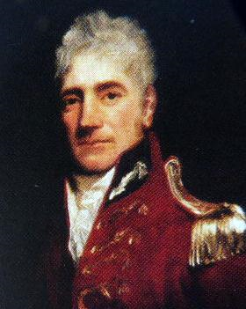
GOVENOR LACHLAN MACQUARIE – March 5th 1817
Governor of the colony of NSW
His Excellency delivered the preceding general Order as a consequence of flooding events along the Nepean and Hawkesbury Rivers which had significant impact on the settlers homes and farms in and around Richmond .

