Slide 1
AIDA Austria Climate Change Working Party
Dieselgate and D&O Implications
By
Dr Adolfo Paolini
University of Buckingham UK and DACBeachcroft LLP
Vienna, November 2016

Slide 2
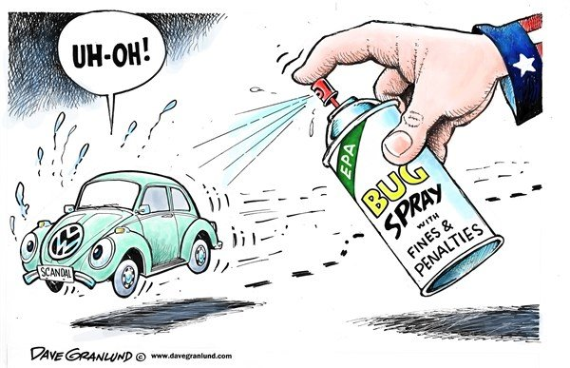
Volkswagen May be in Trouble

Slide 3
D&O Main Features
Developed to protect Directors and Officers and not the Company
Liability Insurance: Professional Indemnity Insurance/Third Party Insurance
Liability must be established to trigger substantive cover
Claims Made Policies
D&O does not cover wilful misconduct/fraud
D&O does cover regulatory investigations
Types: Side A , Side B and Side C
Pollution is often excluded

Slide 4
Uncontested Facts
11/09/2015 VW made public a statement highlighting how prosperous and environmentally friendly VW was. ‘world’s most sustainable automotive group’
Investors had purchased American Depository Receipts (ADR’s) in US/ share price lost more than a third of its value
18/09/15 US Environmental Protection Agency served a notice of VW
VW faces billions of Dollars in fines: $37.000 per vehicle/VW set aside $ 7 Billion / Almost 0.5 million cars affected in US and 11 million worldwide.

Slide 5
Uncontested Facts
25/09/15 Germany disclosed that 2.8 million cars have been affected and VW supervisory board has instructed lawyers both in US and Germany to investigate the case
VW admitted liability for the use of ‘defeat devices’ to rig the emissions test/software to circumvent EPA
VW senior officers denied liability and/or knowledge of misconduct
The US Authority has reached an agreement in the range of 14.7 Billion USD
German State of Bavaria is considering suing VW for losses caused to pension funds of its civil servants/ 700.000 Euros.
Public Prosecution Office in Braunschweig has received at least 150 complains against VW

Slide 6
D&O Implications at Insurance and Reinsurance Level
1. Exclusion of Fraud/wilful misconduct
2. Failure to monitor / delegated duties
3. German Insurance Code Art 81: Allocation, illegality, defence costs
4. Composite or joint cover: UK: Arab Bank v Zurich Insurance/ Germany: the default provision in that liability to the company is joint and several
5. Liability must be ascertained and not merely alleged. VW CEO Martin Winterkorn position: accepted full responsibility but has done nothing wrong and acted for the benefit of the company.

Slide 7
D&O Implications at Insurance and Reinsurance Level
6. Non Executive directors/ German Two Tier System/ insured v. insured exclusions
7. Policy Exclusions/ Pollution Hazards are most of the time excluded in D&O policies:
Strict Liability
Criminal nature of fines in the UK v. Administrative nature of fines in Germany: potential problem
Market capacity/clean up costs too high
Environmental Liability is usually retroactive and this affect D&O market predictions
Legal precedent: see next two slides

Slide 8
D&O Implications at Insurance and Reinsurance Level
Northstar Aerospace v Ministry of Environment Ontario Canada [2012]
The company knew about the polluting agent and did its best to clean the site.
The Company run out of cash to continue to clean the site and became insolvent.
Directors did not act maliciously or negligently
Directors and Officers were held personally liable to fund the cleaning up cost of company’s site.
D&O’s agree to pay up to 4.5 Can $ and the dispute was settled
D&O Insurance policy excluded pollution.

Slide 9
D&O Implications at Insurance and Reinsurance Level
High Voltage Eng’g Corp v Federal Ins Co: US decision
The issue was whether a pollution exclusion clause, contained in a D&O policy, related to those polluting acts which directors have personally participated in, authorised or approved.
The Court was satisfied that the exclusion clause applied when there is a claim against the company or its directors

Slide 10
D&O Implications at Insurance and Reinsurance Level
8. Defence Costs/UK view
Advance of defence costs v. substantive liability/ follows the fortune of substantive cover
Dishonesty relieved the insurer from both substantive and defence cover
The claim must fall within the primary insurance clause
When insurers’ consent is needed, defence costs cover is trigger when such consent is obtained and the claim fall within cover
In the absence of express exclusion the insured could be entitled to defence costs incurred with insurers’ consent
Policy wording is always crucial

Slide 11
D&O Implications at Insurance and Reinsurance Level
9. Reinsurance
Facultative reinsurance and presumption of back to back cover
Strategy would be to prove directors liable for intentional or wilful misconduct
Company could suggest that it incurred vicarious rather than primary liability/ Attribution/ Safeway v Trigger scenario/ inconsistency with the aim of anti pollution rules
Germany has a business judgement rule
In Germany Liability to the company is joint and several
German statutory deductible: at least 10% up to 1.5 times salary

Slide 12
D&O Implications at Insurance and Reinsurance Level
10. Liability to Third Parties
UK limits this possibility
Germany supports this possibility/ creditors could directly claim/liability to creditors cannot be waived

Slide 13
Thank You
adolfo.Paolini@Buckingham.ac.uk
apaolini@dacbeachcroft.com

