Slide 1
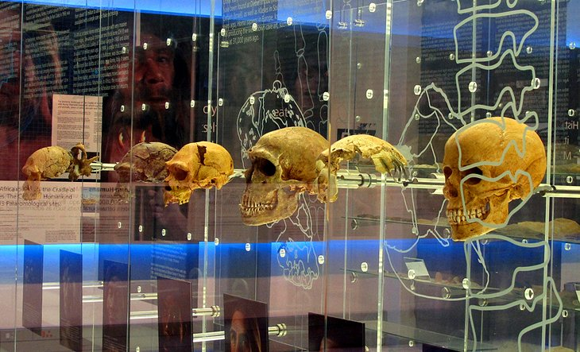
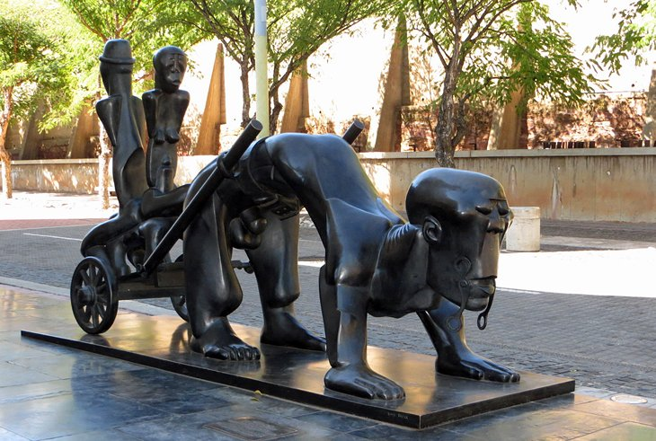
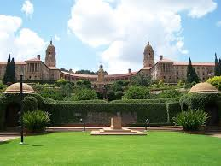
The South African Chapter of the International Insurance Law Association ('AIDA') cordially invites you to the
Annual AIDA Conference
from 5 to 7 October 2020
We look forward to welcoming national and international AIDA delegates
to South Africa - 'A world in one country'.

Slide 2
Faculty of Law
University of Pretoria
South Africa

Slide 3
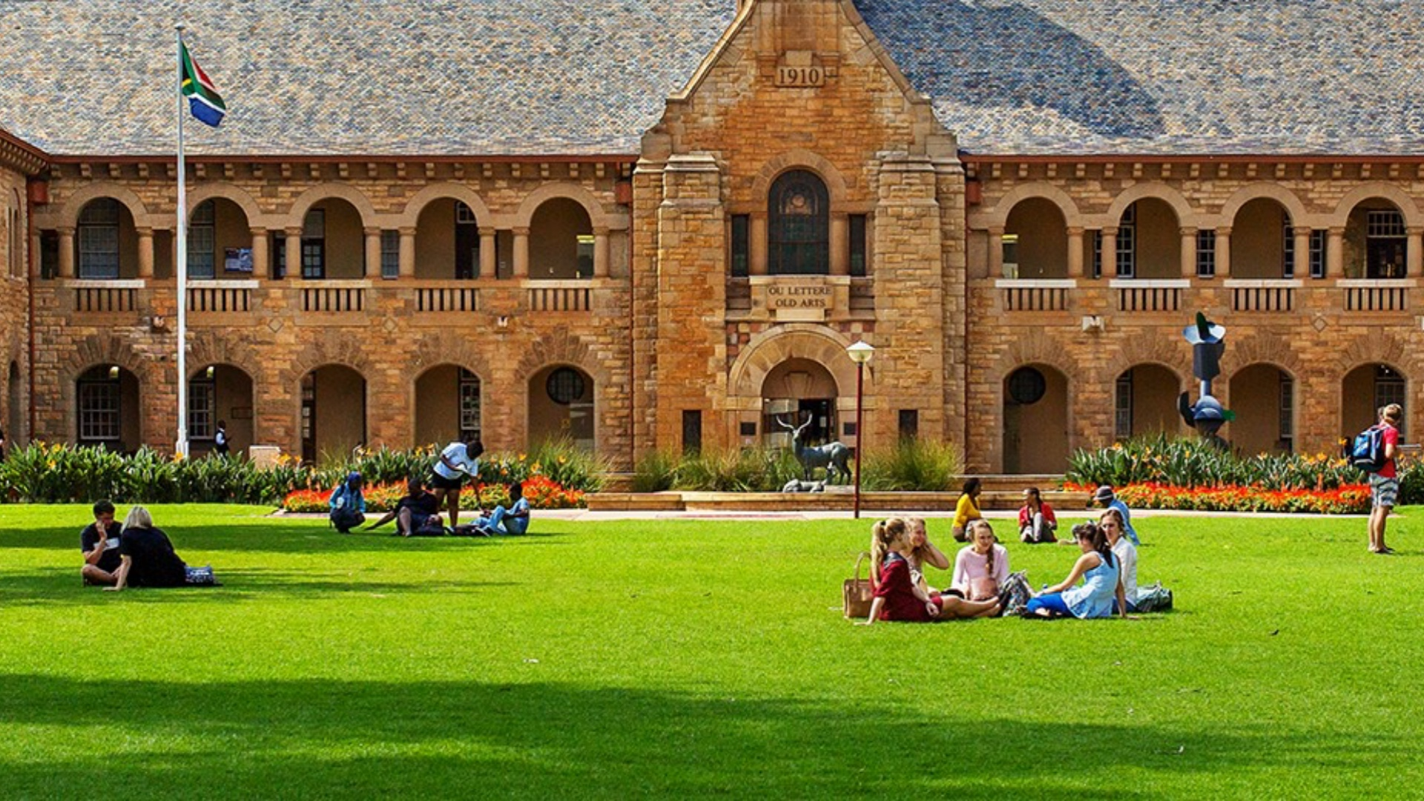
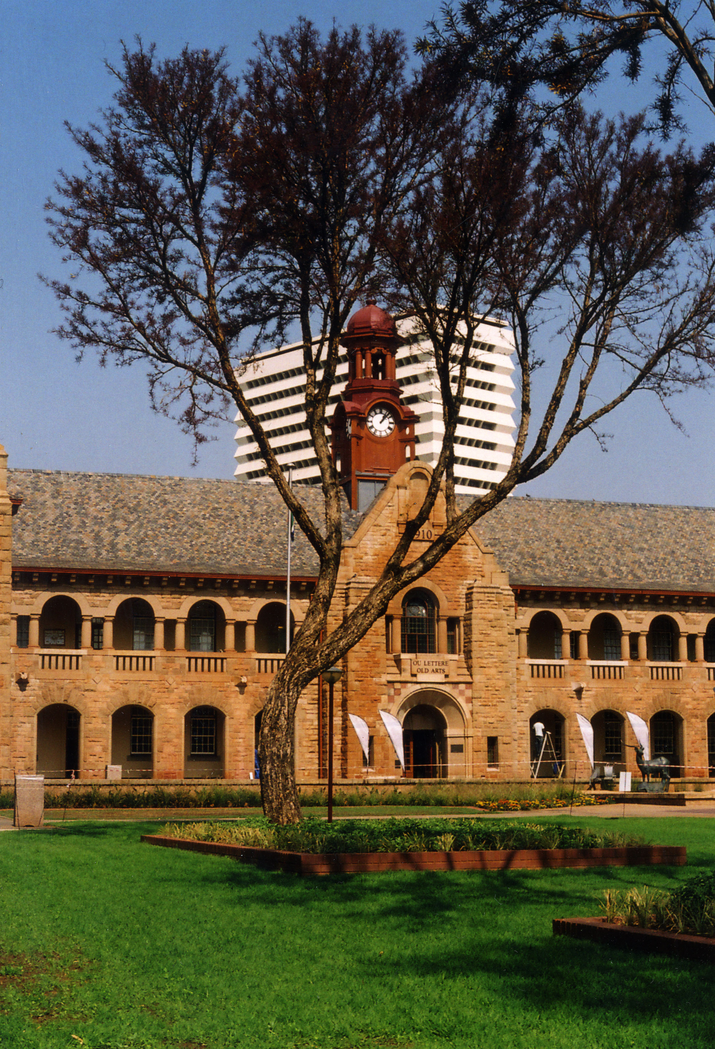
The Faculty of Law at the University of Pretoria strives to be an internationally recognised leader in socially relevant legal research and education in South Africa, Africa and globally. In pursuing its vision, the Faculty of Law creates and sustains a research and education environment that is grounded in values of social justice and excellence.
The Faculty currently ranks under the top 80 universities globally and best in Africa. It houses specialised research centres and chairs in Advanced Corporate and Insolvency Law, Child Law (with representation on the United Nations Committee on the Rights of the Child), Extractive Industries Law in Africa, Human Rights, Intellectual Property Law, International and Comparative Law, Law and Medicine and Sports and Entertainment Law. It is currently in the unique position where three law professors (Professors Dire Tladi, Ann Skelton and Christof Heyns) serve as international experts on key United Nations bodies in Geneva, responsible for the development and application of international law. Its Deputy Dean, Professor Birgit Kuschke, serves as Vice-President of the Associaiton International de Droit des Assurances and is a representative of the South African Chapter.
The Faculty delivered a record number of 35 doctoral degrees in 2017 and 179 master’s degrees. In 2018, 173 master's and 27 doctoral degrees were awarded. It currently employs 70 dedicated full-time academics, of which approximately two-thirds have doctoral degrees in various fields of law. They are supported by highly motivated administrative and su0pport staff, and together they serve and prepare our student community, as preferred employees, for the various law-related career opportunities.

Slide 4
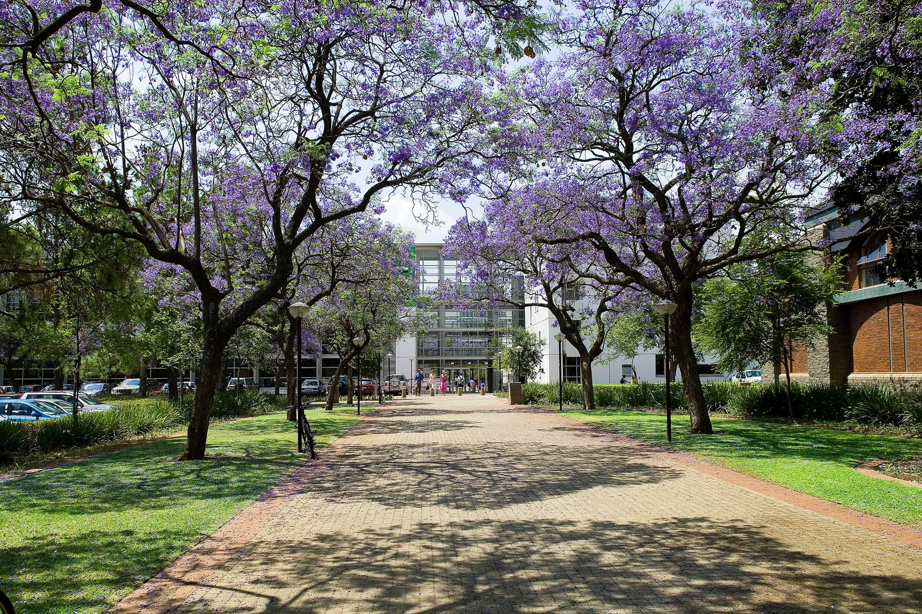

Slide 5
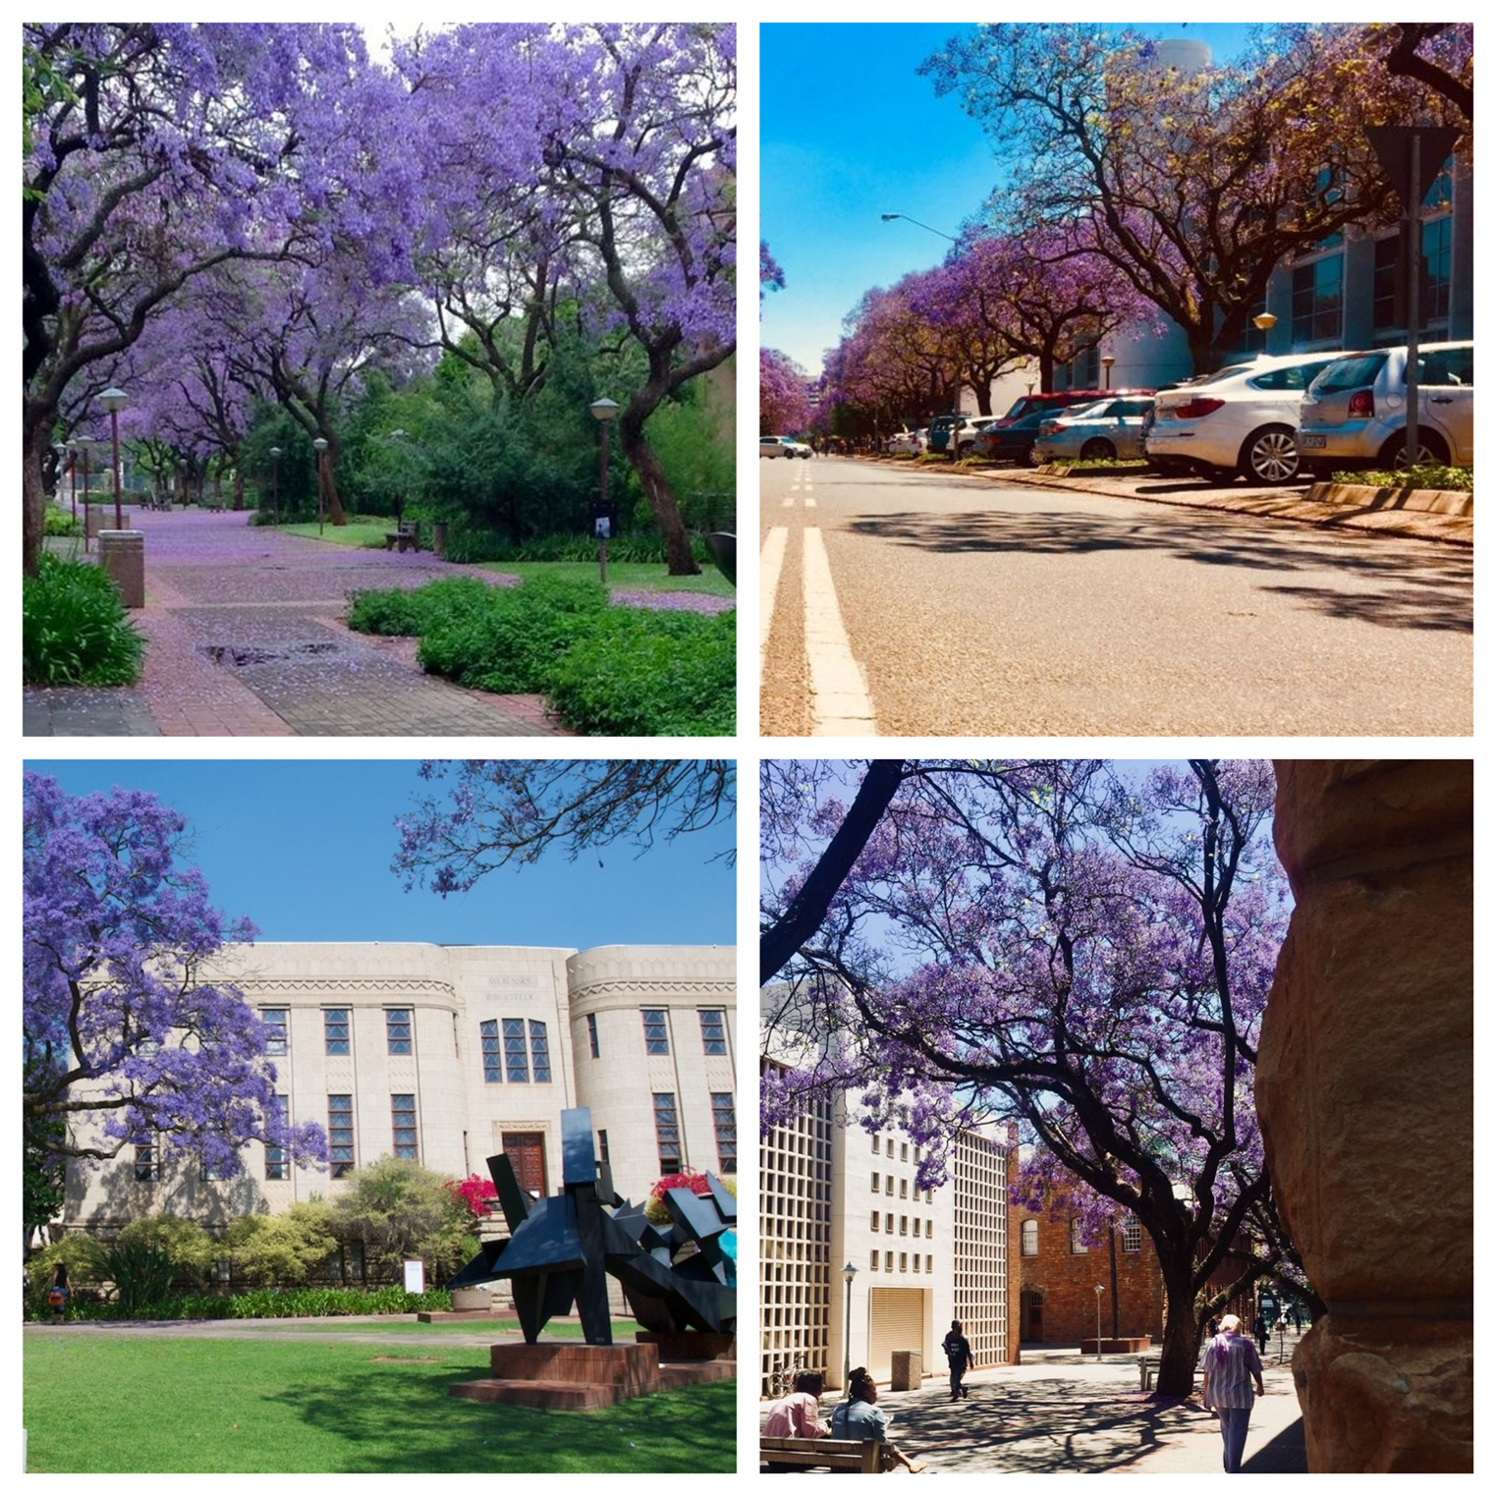
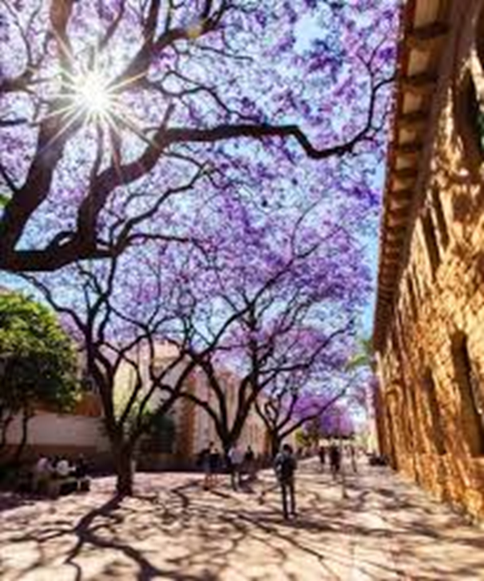
The Faculty of Law at the University of Pretoria is involved in the following upcoming high profile meetings and conferences in 2019 and 2020:
Professor Ann Skelton, UNESCO Chair: Education Law in Africa will be chairing two international expert meetings during 2019, which are taking place in Cote d'Ivoire and Venice respectively. Kindly forward an email to pontso.phahlane@up.ac.za for more information.
The Association of Human Rights Institutes (AHRI) Conference will be hosted by the Centre for Human Rights in the Faculty from 4 to 5 September 2020 at the University's Future Africa Campus.
The Department of Mercantile Law in the Faculty is hosting the 4th University of Pretoria International Consumer Law Conference from 23 to 25 September 2020 at Future Africa.
The South African Chapter of the International Insurance Law Association ('AIDA') is hosting its annual conference from 5 to 7 October 2020 in Pretoria, during which the Presidential Council meeting for AIDA and meetings of its Working Parties will be hosted.
The Faculty is hosting an International Academy of Comparative Law Thematic Conference on 'Diversity and Plurality in Law' from 7 to 9 October 2020 in Pretoria. For more information kindly forward an email to conference organisers Professors Elsabe Schoeman or Steve Cornelius via amelia.jansen@up.ac.za.

