Slide 1
Information duties stemming from the IDD an example of faulty application of the principle of proportionality (?)
Mgr Marta Ostrowska, PhD Candidate
Insurance Law Institute, Faculty of Law and Administration
University of Warsaw

Slide 2
________________________________________________________________________________________
AGENDA:
Argument.
Principle of Proportionality – meaning.
Research Question.
Test of Proportionality.
Preliminary Conclusions.
_____________________________________________________________________________________________________
VIIIth AIDA Europe Conference Lisbon, 3-4 October 2019
Notes:
Due to the time discipline, I will not go through every information duty, however I assume that we all pretty well familiar with this subject.

Slide 3
________________________________________________________________________________________
Information duties introduced by the IDD do not comply with the EU principle of proportionality.
TRUE
FALSE
ARGUMENT
_____________________________________________________________________________________________________
VIIIth AIDA Europe Conference Lisbon, 3-4 October 2019

Slide 4
________________________________________________________________________________________
PRINCIPLE OF PROPORTIONALITY (1/3)
Article 5(4) of Treaty on European Union:
„Under the principle of proportionality, the content and form of Union action shall not exceed what is necessary to achieve the objectives of the Treaties”
further development and interpretation of the principle by the European Court of Justice
’Don’t use a sledgehammer to crack a nut’
_____________________________________________________________________________________________________
VIIIth AIDA Europe Conference Lisbon, 3-4 October 2019

Slide 5
________________________________________________________________________________________
PRINCIPLE OF PROPORTIONALITY (2/3)
further development and interpretation of the principle by the European Court of Justice
“the principle of proportionality (…) requires that measures adopted by the Community institutions do not exceed the limits of what is appropriate and necessary in order to attain the objectives legitimately pursued by the legislation in question; when there is a choice between several appropriate measures recourse must be head to the least onerous, and the disadvantages caused must not be disproportionate to the aims pursued.”
Judgement of the Court of 5 May 1998, Case C- 157/96
_____________________________________________________________________________________________________
VIIIth AIDA Europe Conference Lisbon, 3-4 October 2019

Slide 6
________________________________________________________________________________________
PRINCIPLE OF PROPORTIONALITY (2/3)
EU measure is proportional if it meets the following requirements jointly:
EU measure is suitable (appropriate) to attain the desired objective;
EU measure is necessary to attain the desired objective;
disadvantages caused by adopting EU measure are acceptable compared to the benefits of the objective achieved (proportionality sensu stricto)
_____________________________________________________________________________________________________
VIIIth AIDA Europe Conference Lisbon, 3-4 October 2019
Notes:
Usually in order to find out whether or not the measure is proportional ECJ applies so-called test of proportionality. This view gives us the idea of how test of proportionality looks like. Basically, it consists of 3 steps: First, we examine the suitability of the measure. Second, necessity of the measure. And finally, although not always, proportionality sensu stricto is analysed.

Slide 7
________________________________________________________________________________________
PRINCIPLE OF PROPORTIONALITY (3/3)
THEORY
EU measure is suitable (appropriate) to attain the desired objective;
PRACTICE
Information duties are suitable (appropriate) to attain optimal insurance choice of the customer;
EU measure is necessary to attain the desired objective;
disadvantages caused by adopting EU measure are acceptable compared to the benefits of the objective achieved (proportionality sensu stricto)
Information duties are necessary to attain optimal insurance choice of the customer;
disadvantages caused by adopting information duties are acceptable compared to the benefits of the achieved optimal insurance choice of the customer (proportionality sensu stricto)
_____________________________________________________________________________________________________
VIIIth AIDA Europe Conference Lisbon, 3-4 October 2019
Notes:
Now, how does this theory translates into practice with respect to the IDD and information duties?
By optimal insurance choice we understand rational and informed choice.

Slide 8
________________________________________________________________________________________
RESEARCH QUESTION
Are the information duties introduced by the IDD proportional?
Are the information duties introduced by the IDD suitable to ensure optimal insurance choice of the customer?
Are the information duties introduced by the IDD necessary to ensure optimal insurance choice of the customer?
Is there and appropriate balance between the damage suffered by the customers & insurance distributors and the benefit obtained by achieving enhanced customer protection as a consequence of introducing the information duties?
_____________________________________________________________________________________________________
VIIIth AIDA Europe Conference Lisbon, 3-4 October 2019
Notes:
Now, how does this theory translates into practice with respect to the IDD and information duties?

Slide 9
________________________________________________________________________________________
TEST OF PROPORTIONALITY: SUITABILITY
Are the information duties introduced by the IDD suitable to ensure optimal insurance choice of the customer?
The casual link between information duties and informed choice confirmed by previous studies
C. Camerer, S. Issacharoff, G. Loewenstein, T. O’Donoghue, M. Rabin, Regulation for Conservatives Behavioural Economics and the Case for “Assymetric Paternalism” (2003) 151 UPaLRev 1211;
P. Nelson, Information and Consumer Behavior, (1970), JPolEcon 311;
L.D.Loacker, Informed Insurance Choice? The Insurer’s Pre-Contractual Information Duties in General Consumer Insurance, Elgar, 2015
OECD, G20 High Level Principles on Financial Consumer Protection, October 2011;
EIOPA, Consultation Paper on the proposal for Implementing Technical Standards on a standardized presentation format of the insurance product information document (EIOPA-CP-16/007), 2016
_____________________________________________________________________________________________________
VIIIth AIDA Europe Conference Lisbon, 3-4 October 2019

Slide 10
________________________________________________________________________________________
TEST OF PROPORTIONALITY: NECESSITY
Are the information duties introduced by the IDD necessary to ensure optimal insurance choice of the customer?
Will the objective come by itself?
Is there other measure which is as useful as information duty in achieving the objective?
Financial education?
Totality of Regulation (the quantitative dimension)
_____________________________________________________________________________________________________
VIIIth AIDA Europe Conference Lisbon, 3-4 October 2019
Notes:
Will the objective come by itself? Will the customers start to make rational and informed decisions if no action on the side of the EU is taken?
Clearly, it is highly likely that the customers will not suddently change the way they normally take the financial decisions. However, if we consider the fact that there were already a numerous information duties in place before the IDD came into force, we could ask the question whether those information duties that existed before IDD were sufficient enough to change the customer’s decision making.
Is there other measure which is as useful as information duty in achieving the objective?
Here, a great potential is attributed to financial education programs. However, if we assume that there financial education is as useful as information duties, then we should compare the possible burdens / disadvantages that both measures bring. Major burden associated with the information duties is the negative effects of famous information overload, while in case of financial education it is mainly that it definitely takes more time for financial education to achieve the objective. Also what can be compared is costs. Financial education is probably more costly plus the costs are incurred on the government and not on the private sector. Possibly this is the reason why so far financial education has been considered supportive measure to the information duties rather than the principal one.
Totality of Regulation
While assessing proportionality of a measure and whether or not it is necessary, we should also look at the problem from broader perspective which is the totality of regulation. This approach help us to prevent from overlooking potential disproportion of the whole regulation while perfecting proportionality of particular provision. This, in this case we should identify all the information duties which are now in place. This work has been already done and also discussed in the AIDA forum so we are all well aware that the number of regulation is impressive to say the least.

Slide 11
________________________________________________________________________________________
TEST OF PROPORTIONALITY: NECESSITY
Totality of information duties
in insurance sector → big picture
Arthur Hillard, Insurance Europe, Issues arising from the implementation of the IDD, Presentation on 7th AIDA Europe Conference, Warsaw, 13 April 2018
_____________________________________________________________________________________________________
VIIIth AIDA Europe Conference Lisbon, 3-4 October 2019
Notes:
Having seen this big picture, the totality of information duties within insurance sector, we can ask yourself 2 questions:
First, more general regarding totality of information duties: is the sum of the information obligations proportional, meaning suitable and necessary to achieve the desired objective?
And second, regarding specifically information duties introduced by the IDD: are information duties introduced by the IDD really necessary to improve the customer’s decision making? To answer this question, most convenient would be to have empirical study on the effectiveness of the information duties existing before the IDD.

Slide 12
________________________________________________________________________________________
TEST OF PROPORTIONALITY: NECESSITY
Totality of information duties in insurance sector → negative effects of information overload
Results of the studies:
each individual has a limited capacity to process information
if an individual receives too much information and information that he/she does not understand or that is irrelevant, he/she fails to take rational decision
In order to prevent distortions to the customer’s decision making, we should seek for optimal information
optimal information = quality + quantity
Ultimate effect of information overload: failure to attain the objective
_____________________________________________________________________________________________________
VIIIth AIDA Europe Conference Lisbon, 3-4 October 2019
Notes:
As we know problem of information overload arises when the information provided is too complex and numerous to handle effectively.
Now the amount of studies undertaken in the field of information overload is very vast and significant. Most of the important results are delivered by the behavioral and information economics.
Here in the slide I put some selected conclusions derived from the economic studies which taken all together eventually let to the final conclusion that too much information can be as harmful as lack of information.

Slide 13
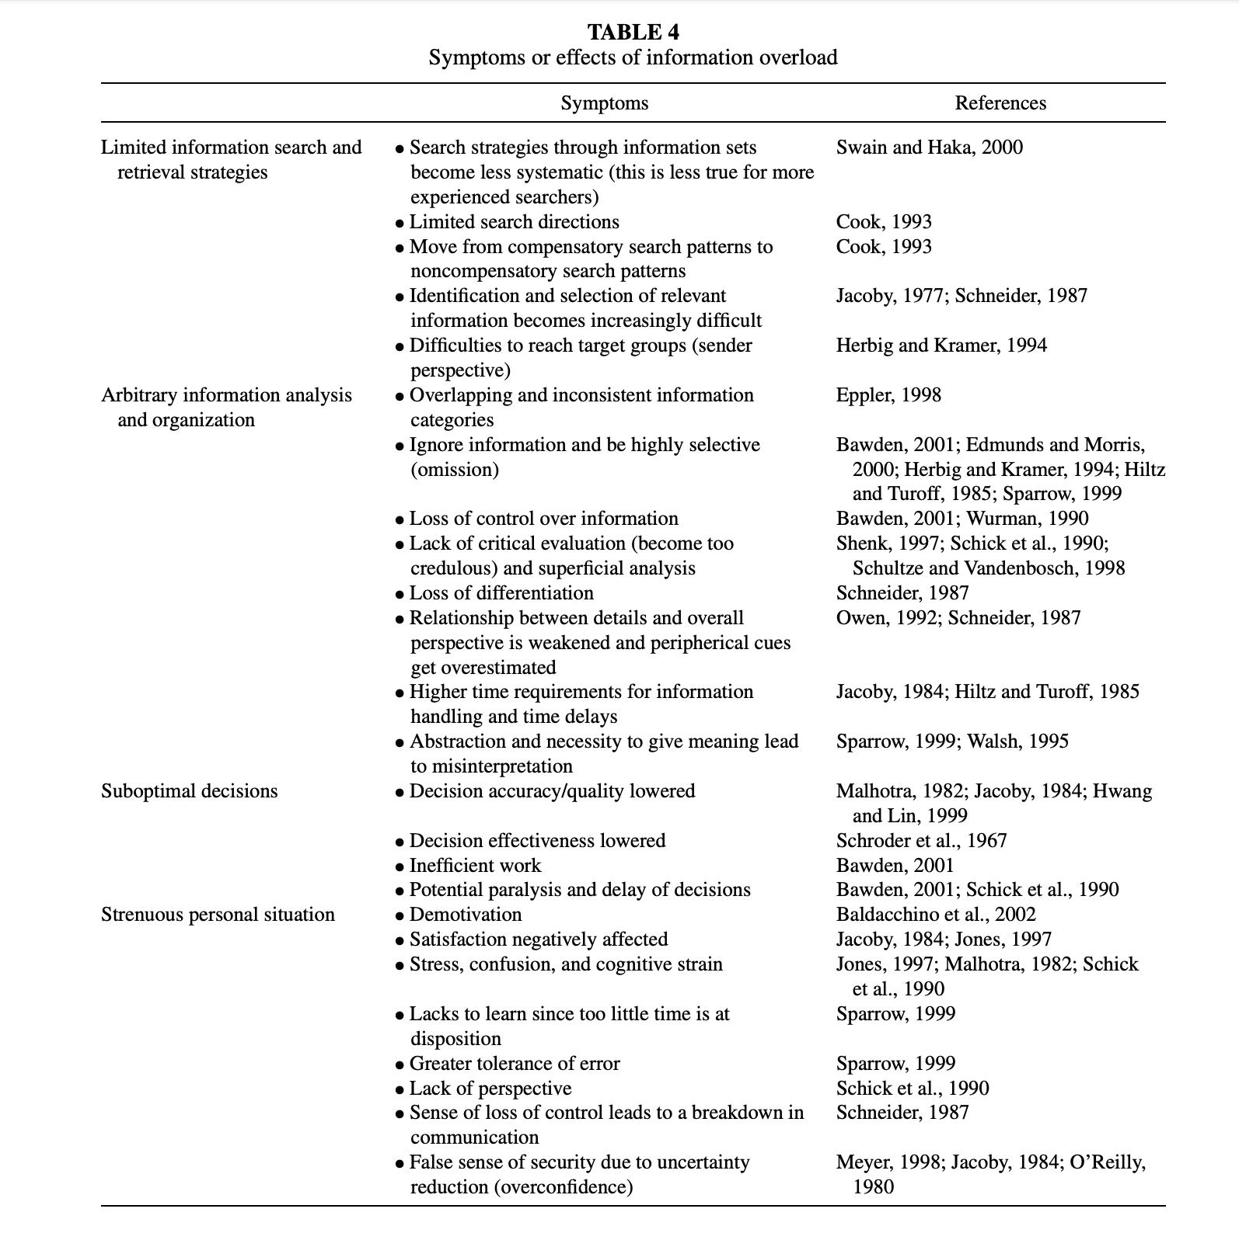
________________________________________________________________________________________
Eppler, M. J., & Mengis, J. (2004). The Concept of Information Overload: A Review of Literature from Organization Science, Accounting, Marketing, MIS, and Related Disciplines. The Information Society, 20(5), 325–344.
_____________________________________________________________________________________________________
VIIIth AIDA Europe Conference Lisbon, 3-4 October 2019
Notes:
As we know problem of information overload arises when the information provided is too complex and numerous to handle effectively.
Now the amount of studies undertaken in the field of information overload is very vast and significant. Most of the important results are delivered by the behavioral and information economics.
Here in the slide I put some selected conclusions derived from the economic studies which taken all together eventually let to the final conclusion that too much information can be as harmful as lack of information.

Slide 14
________________________________________________________________________________________
TEST OF PROPORTIONALITY: PROPORTIONALITY SENSU STRICTO
Is there an appropriate balance between the damage suffered by the customers & insurance distributors and the benefit obtained by achieving enhanced customer protection as a consequence of introducing the information duties?
BENEFITS
+
+
DAMAGES
-
-
-
_____________________________________________________________________________________________________
VIIIth AIDA Europe Conference Lisbon, 3-4 October 2019

Slide 15
________________________________________________________________________________________
TEST OF PROPORTIONALITY
PROBLEM: insurance coverage not compliant with customer's demands and needs → lack of the insurance coverage → stabilization of financial market
MEASURE | OBJECTIVE GENERAL OBJECTIVE: customer protection SPECIFIC OBJECTIVE: making customers’ financial decisions more reasonable and informed |  | COST EFFECTIVENESS
 | BENEFITS | DETRIMENTS
0 – Take no action (Baseline scenario) | 0 | identified problem will persist and could be aggravated by future market developments increase in the number of cases of mis-selling of insurance products and cases where customers are led to take undue risks | N/A
1 – Information disclosures | enhanced trust to insurance distributors and higher transparency clarity with regard to the principle-agent relationship, including how this may impact on advice facilitating comparison of insurance covers and prices improved understanding and identification of the most important pieces of policy information (comprehensibility) by introducing standard presentation of IPID | INFORMATION OVERLOAD & consequences: increased confusion decision effectiveness (accuracy and quality) lowered increased difficulty in identification and selection of relevant information loss of control over information lack of critical evaluation and superficial analysis loss of differentiation higher time requirements for information handling extension of sale process administrative burden (compliance risk) systemic risk entrepreneurial risk | Potential system changes are needed to enable these disclosures. Yet it is estimated that the costs related to the disclosures are not excessive. The initial analysis results in non-excessive costs.
2 – Identification of the customer’s demands and needs and provision of advice or recommendation | enhanced customer’s choice, confidence and quality of service received improved comparability of offers improved understanding by customers of the services and products on offer |  | subject to further economic analysis
3 – Financial education programs | improved financial literacy | 0 | subject to further cost analysis
_____________________________________________________________________________________________________
VIIIth AIDA Europe Conference Lisbon, 3-4 October 2019
Notes:
To each of the benefit and detriment we should attribute a certain value which is very subjective
In order to make the results of the study more apparent, i decided to add the additional table referring to the disadvwantages.
I took the liberty add a new column in order to make the results more apparent.

Slide 16
________________________________________________________________________________________
PRELIMINARY CONCLUSIONS
Information duties are suitable to attain their objective.
Considering the totality of regulation, the IDD information duties are not necessarily necessary.
Need for the revision of the existing information duties at the European and national level, both from the qualitative and quantitative perspective.
RESULTS OF THE TEST
SUITABILITY
NECESSITY
PROPORTIONALITY SENSU STRICTO
_____________________________________________________________________________________________________
VIIIth AIDA Europe Conference Lisbon, 3-4 October 2019

Slide 17
________________________________________________________________________________________
_____________________________________________________________________________________________________
VIIIth AIDA Europe Conference Lisbon, 3-4 October 2019

