Slide 1
The Ocean and Cryosphere in a Changing Climate Accepted by the Inter-governmental Panel on Climate Change (IPCC), Principality of Monaco, 24th September 2019
Richard K. Traub, Esq.
Presented to 8th AIDA Europe Conference – Climate and Catastrophic Events Working Party – Lisbon, Portugal (October 4, 2019)

Slide 2
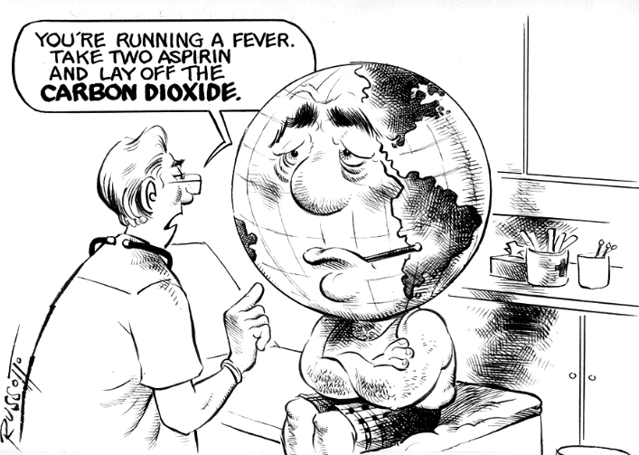
Climate Change Science The Basics

Slide 3
The Importance of the Ocean and Cryosphere for People
The cryosphere refers to frozen components of the Earth system.
All people on Earth depend directly or indirectly on the ocean and cryosphere. The global ocean covers 71% of the Earth surface and contains about 97% of the Earth’s water.
Around 10% of Earth’s land area is covered by glaciers or ice sheets. The ocean and cryosphere support unique habitats and are interconnected with other components of the climate system through global exchange of water, energy and carbon.
The projected responses of the ocean and cryosphere to past and current human-induced greenhouse gas emissions and ongoing global warming include climate feedbacks, changes over decades to millennia that cannot be avoided, thresholds of abrupt change, and irreversibility.
Notes:
All people on Earth depend directly or indirectly on the ocean and cryosphere. The global ocean covers 71% of the Earth surface and contains about 97% of the Earth’s water. The cryosphere refers to frozen components of the Earth system1. Around 10% of Earth’s land area is covered by glaciers or ice sheets. The ocean and cryosphere support unique habitats, and are interconnected with other components of the climate system through global exchange of water, energy and carbon. The projected responses of the ocean and cryosphere to past and current human-induced greenhouse gas emissions and ongoing global warming include climate feedbacks, changes over decades to millennia that cannot be avoided, thresholds of abrupt change, and irreversibility. {Box 1.1, 1.2}
Human communities in close connection with coastal environments, small islands (including Small Island Developing States, SIDS), polar areas and high mountains7 are particularly exposed to ocean and cryosphere change, such as sea level rise, extreme sea level and shrinking cryosphere. Other communities further from the coast are also exposed to changes in the ocean, such as through extreme weather events. Today, around 4 million people live permanently in the Arctic region, of whom 10% are Indigenous. The low-lying coastal zone8 is currently home to around 680 million people (nearly 10% of the 2010 global population), projected to reach more than one billion by 2050. SIDS are home to 65 million people. Around 670 million people (nearly 10% of the 2010 global population), including Indigenous peoples, live in high mountain regions in all continents except Antarctica. In high mountain regions, population is projected to reach between 740 and 840 million by 2050 (about 8.4–8.7% of the projected global population). {1.1, 2.1, 3.1, Cross-Chapter Box 9, Figure 2.1}
In addition to their role within the climate system, such as the uptake and redistribution of natural and anthropogenic carbon dioxide (CO2) and heat, as well as ecosystem support, services provided to people by the ocean and/or cryosphere include food and water supply, renewable energy, and benefits for health and well-being, cultural values, tourism, trade, and transport. The state of the ocean and cryosphere interacts with each aspect of sustainability reflected in the United Nations Sustainable Development Goals (SDGs). {1.1, 1.2, 1.5}

Slide 4
Conclusions by Category
Observed Physical Changes
Observed Impacts on Ecosystems
Observed Impacts on People and Ecosystems
Projected Physical Changes
Projected Risks for People and Ecosystems
Implementing Changes
Challenges
Enabling Conditions
Many of These Conclusions Will Not be a Surprise

Slide 5
Observed Physical Changes
It has been concluded with HIGH CONFIDENCE, that:
Over the last decades, global warming has led to widespread shrinking of the cryosphere, with mass loss from ice sheets and glaciers,
Reductions in snow cover,
Reductions in arctic sea ice extent and thickness, and
Increased permafrost temperature.

Slide 6
Observed Physical Changes
It is virtually certain that the global ocean has warmed unabated since 1970 and has taken up more than 90% of the excess heat in the climate system.
Since 1993, the rate of ocean warming has more than doubled.
Marine heatwaves have very likely doubled in frequency since 1982 and are increasing in intensity.
By absorbing more CO2, the ocean has undergone increasing surface acidification.
They believe that a loss of oxygen has occurred from the surface to a depth of 1000 meters.

Slide 7
Observed Physical Changes
Global mean sea level (GMSL) is rising, with acceleration in recent decades due to increasing rates of ice loss from the Greenland and Antarctic ice sheets as well as continued glacier mass loss and ocean thermal expansion.
Increases in tropical cyclone winds and rainfall, and increases in extreme waves, combined with relative sea level rise, exacerbate extreme sea level events and coastal hazards.

Slide 8
Observed Impacts on Ecosystems
Cryospheric and associated hydrological changes have impacted terrestrial and freshwater species and ecosystems in high mountain and polar regions through the appearance of land previously covered by ice.
Since about 1950 many marine species across various groups have undergone shifts in geographical range and seasonal activities in response to ocean warming, sea ice change and biogeochemical changes, such as oxygen loss, to their habitats.

Slide 9
Observed Impacts on Ecosystems
Coastal ecosystems are affected by ocean warming, including intensified marine heatwaves, acidification, loss of oxygen, salinity intrusion and sea level rise.

Slide 10
Observed Impacts on People and Ecosystem Services
Since the mid-20th century, the shrinking cryosphere in the Arctic and high-mountain areas has led to predominantly negative impacts on food security, water resources, water quality, livelihoods, health and well-being, infrastructure, transportation, tourism and recreation
Changes in the ocean have impacted marine ecosystems and ecosystem services with regionally diverse outcomes, challenging their governance (high confidence).
Both positive and negative impacts result for food security.

Slide 11
Coastal communities are exposed to multiple climate-related hazards, including tropical cyclones, extreme sea levels and flooding, marine heatwaves, sea ice loss, and permafrost thaw (high confidence).
A diversity of responses has been implemented worldwide, mostly after extreme events, but also some in anticipation of future sea level rise.

Slide 12
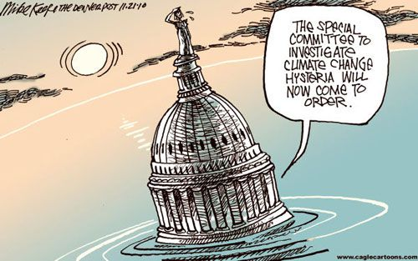
PROJECTED CHANGES AND RISKS

Slide 13
Projected Physical Changes
Global-scale glacier mass loss, permafrost thaw, and decline in snow cover and Arctic sea ice extent are projected to continue in the near-term (2031–2050) due to surface air temperature increases with unavoidable consequences for river runoff and local hazards.
The Greenland and Antarctic Ice Sheets are projected to lose mass at an increasing rate throughout the 21st century and beyond. (And you thought Trump was crazy)
The rates and magnitudes of these cryospheric changes are projected to increase further in the second half of the 21st century in a high greenhouse gas emissions scenario.
Good News: Strong reductions in greenhouse gas emissions in the coming decades are projected to reduce further changes after 2050.

Slide 14
Over the 21st century, the ocean is projected to transition to unprecedented conditions with increased temperatures.
Marine heatwaves and extreme El Niño and La Niña events are projected to become more frequent.

Slide 15
Sea level continues to rise at an increasing rate. Extreme sea level events that are historically rare (once per century in the recent past) are projected to occur frequently (at least once per year) at many locations by 2050, especially in tropical regions.
The increasing frequency of high water levels can have severe impacts in many locations depending on exposure.
Sea level rise is projected to continue beyond 2100.

Slide 16
In coming centuries, sea level rise is projected to exceed rates of several centimeters per year resulting in multi-meter rise.
Extreme sea levels and coastal hazards will be exacerbated by projected increases in tropical cyclone intensity and precipitation.
Projected changes in waves and tides vary locally in whether they amplify or ameliorate these hazards.

Slide 17
Projected Risks for People and Ecosystem Services
Future cryosphere changes on land are projected to affect water resources and their uses, such as hydropower and irrigated agriculture in and downstream of high-mountain areas.
Changes in floods, avalanches, landslides, and ground destabilization are projected to increase risk for infrastructure, cultural, tourism, and recreational assets.

Slide 18
Increased mean and extreme sea level, alongside ocean warming and acidification, are projected to exacerbate risks for human communities in low-lying coastal areas.

Slide 19
IMPLEMENTING RESPONSES TO OCEAN AND CRYOSPHERE CHANGE

Slide 20
Challenges
People with the highest exposure and vulnerability are often those with lowest capacity to respond.
Coastal communities face challenging choices in crafting context-specific and integrated responses to sea level rise that balance costs, benefits and trade-offs of available options and that can be adjusted over time.
All types of options, including protection, accommodation, ecosystem-based adaptation, coastal advance and retreat, wherever possible, can play important roles in such integrated responses.

Slide 21
Enabling Conditions
Enabling climate resilience depends critically on urgent and ambitious emissions reductions.
Key enablers for implementing effective responses to climate-related changes in the ocean and cryosphere include intensifying cooperation and coordination among governing authorities.
This report reflects the state of science for ocean and cryosphere for low levels of global warming (1.5°C), as also assessed in earlier IPCC and IPBES reports. If it is 2.0°C, all bets are off.

Slide 22
?

