Slide 1
DLT Networks / Platforms in Insurance
Dr. Philipp Frech, General Counsel / Corporate Secretary, B3i Services AG
4 October 2019, 8th AIDA Europe Conference, Lisbon

Slide 2
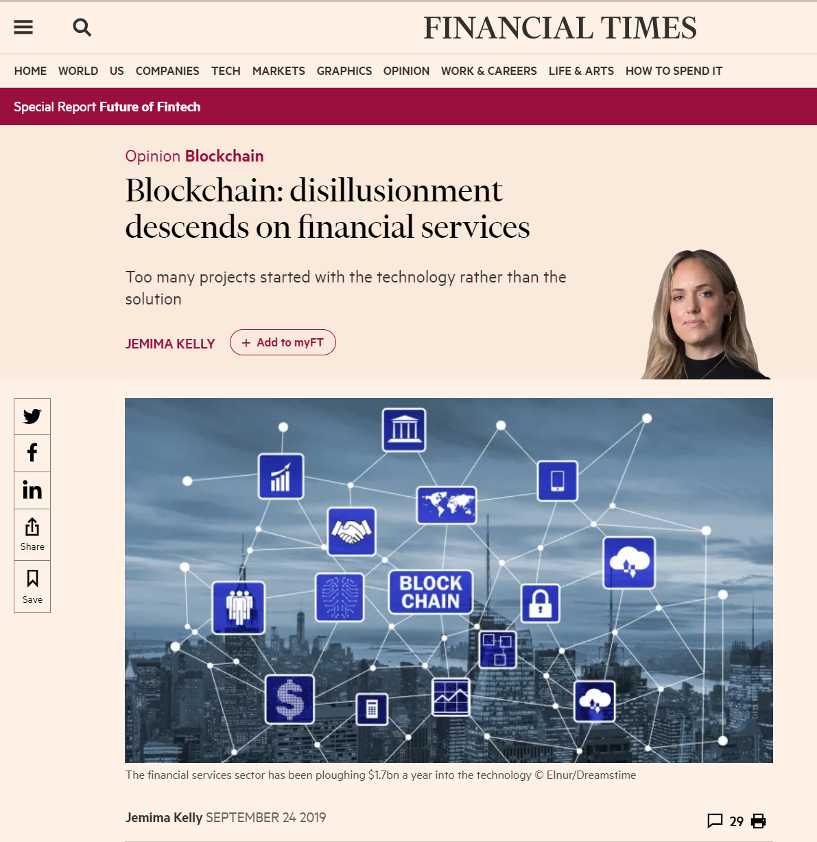
Blockchain: a solution looking for
a problem?

Slide 3
... but DLT is not Blockchain:

Slide 4
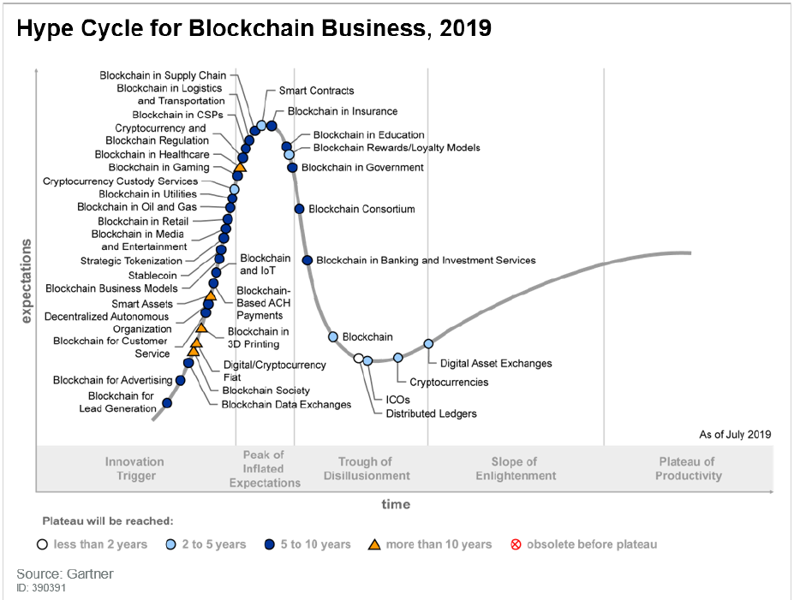
Gartner Hype Cycle for Blockchain Business 2019

Slide 5
Key Features of DLT (example B3i)
In a Distributed Ledger, each node processes and verifies every item, thereby generating a record of each item and creating a consensus (see also below) on each item's veracity. A distributed ledger can be used to record static data, such as a registry, and dynamic data, i.e., transactions.
As a private and permissioned DLT platform, the B3i Business Network provides its own centrally steered identity and authorization management on different authorization levels
The B3i Business network dynamically creates sub-networks/sub-ledgers for each transaction, only accessible by the authorized counterparties (“node”) specific to that transaction; the technology thus builds a secure network among counterparties involved in specific transactions.
Smart Contracts are capable of automatically validating a condition and it will automatically determine whether an 'asset' should go to a nominee or back to source, or a combination thereof. As part of the process the decentralised ledger also stores and replicates the document ensuring security and immutability.
Immutability is the ability for a Blockchain ledger to remain a permanent, indelible, and unalterable history of transactions. Crucially immutability has the added benefit of ensuring trust and integrity to the data businesses record everyday.
Consensus ensures relevant information is shared to only defined parties across a node; effectively only parties involved in a contract have access to the same information as it is updated.
Contrary to a classical blockchain implementation, Corda applications do not rely on a public consensus algorithm like Bitcoin (which uses a proof of work consensus mechanism which requires a lot of resources), but transactions are simply verified by the participating parties and a central notary node.
Secure distributed ledger technology ensures greater security for transactions on the node due to its decentralised nature and immutability.
sophisticated cryptographic techniques.
see also: https://b3i.tech/what-we-do.html

Slide 6
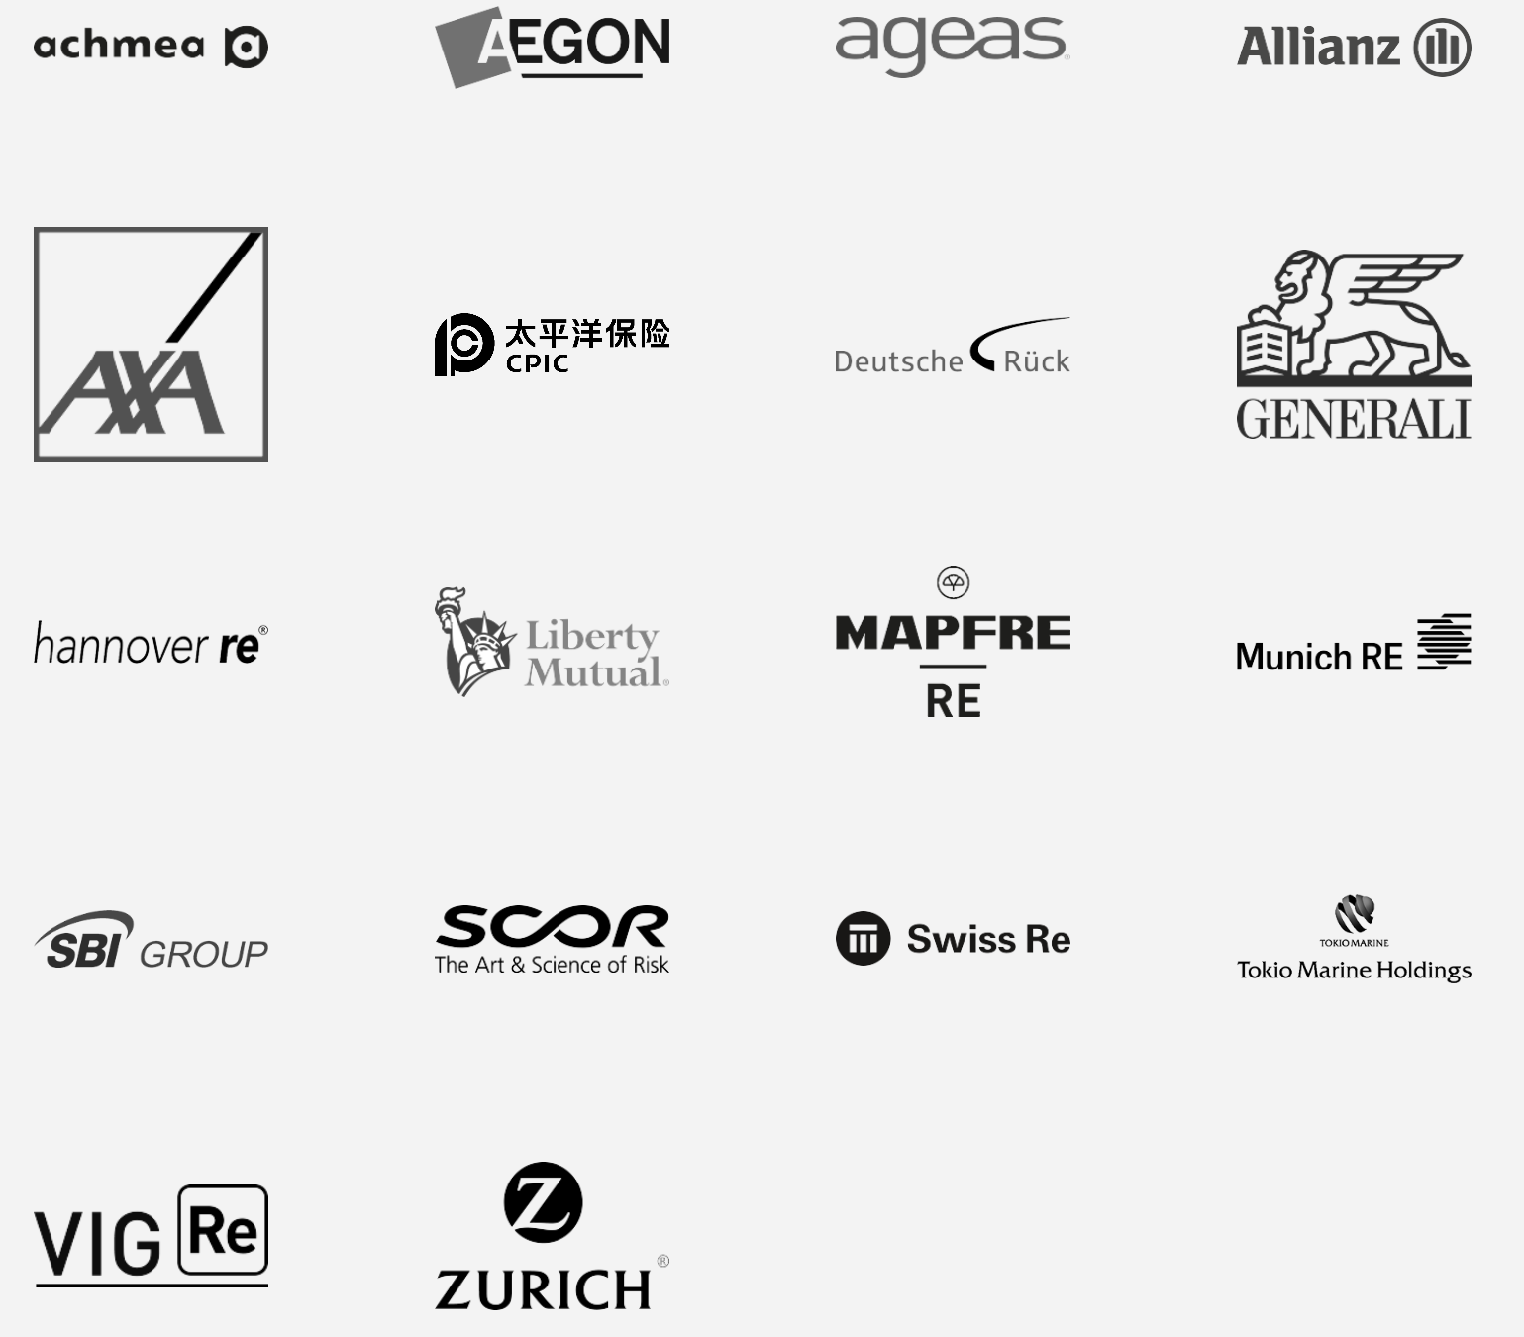
Legal Hot Topics DLT Platforms
A number of DLT Platforms in the insurance sector
B3i: (Blockchain Insurance Industry Initiative): based on Corda technology, which is technically not a blockchain, but a distributed ledger technology
B3i: By the market, for the market – owned by 18 players of the insurance:
B3i: a corporation (Swiss AG), not a cooperative
B3i mission:
Create a DLT based network through the adoption of standardised systems and protocols
Through the network, enable the market to optimise processes and capital allocation and generate significant cost savings
Offer network users a variety of integrated applications from B3i and partners, through its B3i Fluidity platform

Slide 7
Legal Hot Topics DLT Platforms
Security
- of nodes
- of network/platform
Smart contracts
- enforceability
Liability / warranty
Antitrust / competition law
- consortium
Governance of DLT Network
- Ownership of network
Compliance with insurance regulation
- Insurer? IDD?
- Outsourcing?
- KYC / AML?
- Financial market infrastructure?
Confidentiality
Data Privacy
- deletion/rtbf
Intellectual Property
- IP software; e.g., in specific developments which overlay core
- IP in data
Jurisdiction
...

Slide 8
Legal Hot Topics DLT Platforms
Public blockchains very different from permission-based DLT networks
Legal challenges:
difficult to find workable solutions in public blockchains;
Pragmatic solutions are available in permission-based DLT networks
Early collaboration with insurance regulators recommended

Slide 9
Appendix: Advantages of use of blockchain (incl. DLT) to insurers
Insurance companies work with many different players and their value chain is long. Since insurers operate in increasingly complex business ecosystems, the companies concerned must find an efficient way to manage all of these relationships. The aim is to provide a seamless customer experience. It is precisely this complex network of stakeholders that blockchain can coordinate efficiently [...]. Thanks to blockchain, different parties find a common denominator and communicate with each other in a simple way.
The main strengths of blockchain:
Increased efficiency in business ecosystems with many players: Overview of the entire value chain; automated data synchronization (all players have the same up-to-date view of transactions at any time); more effective and more efficient contract handling and cooperation
Support for the development of new products: Internet of things; on-demand insurance; pay as you drive; parametric insurance; peer-to-peer insurance
Greater transparency and data security for customers: Response to the customers' genuine fears of losing control over their personal data; improving the efficiency and security in processing and sharing personal data; the customer always remains the owner of their data and decides who may view it
Automated processes / simplified claims management: Fast and efficient processing and verification of claims; automatic payments; efficiency gains by mapping multiple processes in a system (e.g. payments, conclusion of contracts, supply chain, document sharing, protection against forgery); automated accounting transactions; faster settlement of claims payments for customers
From: https://www.axa.ch/en/unternehmenskunden/blog/start-ups-and-innovation/blockchain-insurance-switzerland.html

