Slide 1
Landfall of the Tech Storm
Leo P. Martinez
Dean Emeritus & Albert Abramson Professor of Law Emeritus
University of California, Hastings College of the Law
8th Association Internationale de Droit des Assurances (AIDA)
Europe Conference, Lisbon
October 3, 2019

Slide 2
Siri: What is the Future of InsureTech in EU and US Regulation?
Leo P. Martinez
Dean Emeritus & Albert Abramson Professor of Law Emeritus
University of California, Hastings College of the Law
8th Association Internationale de Droit des Assurances (AIDA)
Europe Conference, Lisbon
October 3, 2019

Slide 3
Siri: What is InsureTech?
“InsureTech represents the intersection of insurance and technology in nearly every form. InsureTech is a useful word in the insurance industry, as like other industries, insurance becomes more reliant on digital platforms and tools.”
- https://www.techopedia.com/definition/33220/insuretech

Slide 4
What is InsureTech?
InsureTech is “the innovative use of technology in insurance.”
- National Association of Insurance Commissioner’s (NAIC) Center for Insurance Policy and Research (CIPR)
Notes:
Hence I went about the task by rolling up my sleeves and doing some actual research.
The result is not any more illuminating.

Slide 5
What is InsureTech?
InsureTech is disruption.

Slide 6
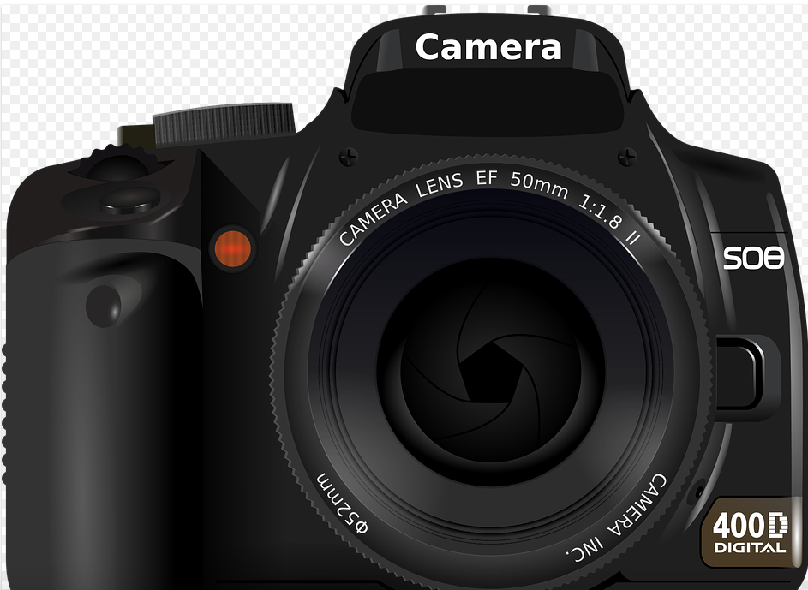
What is disruption?

Slide 7
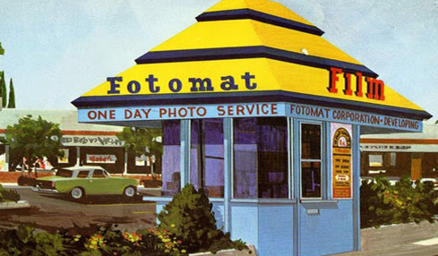
What is disruption?

Slide 8
What is disruption?

Slide 9
What is InsureTech?
InsureTech is disruption.

Slide 10
InsureTech:
Business component - think Kodak
Insurance regulatory component

Slide 11
Insurance regulation
Solvency
Discrimination

Slide 12
Insurance regulation/Solvency
IDD
Member states have a role in assessing “adequacy of the . . . the financial situation of the insurance, reinsurance or ancillary insurance intermediary.”
Insurance and reinsurance intermediaries must be insured.
US
NAIC Financial Regulation Standards/Accreditation
50 states, District of Columbia, Puerto Rico in harmony

Slide 13
Insurance regulation/Discrimination
Underwriting
Policyholder relations
Claims

Slide 14
Insurance regulation/Discrimination
Nuanced
Opaque
Auditing ease
Electronic records

Slide 15
Insurance regulation/Discrimination
IDD
Light treatment/focus on policyholder protection
Member States?
US
Light treatment
50 states and little law

Slide 16
Notes:
Struck the “missing in action” language.

Slide 17
Siri: What is the Future of InsureTech in EU and US Regulation?
Leo P. Martinez
Dean Emeritus & Albert Abramson Professor of Law Emeritus
University of California, Hastings College of the Law
8th Association Internationale de Droit des Assurances (AIDA)
Europe Conference, Lisbon
October 3, 2019

