Slide 1
Challenges in automating the contract review process and how semantic technology could help
Florian Köhler, Head Contracts P&C EMEA, Swiss Re
Susanna Tron, Analytics Knowledge Engineer, Swiss Re

Slide 2
Agenda
Contract Review at Swiss Re
Current approach and in-house technology
How Semantic Technology could help

Slide 3
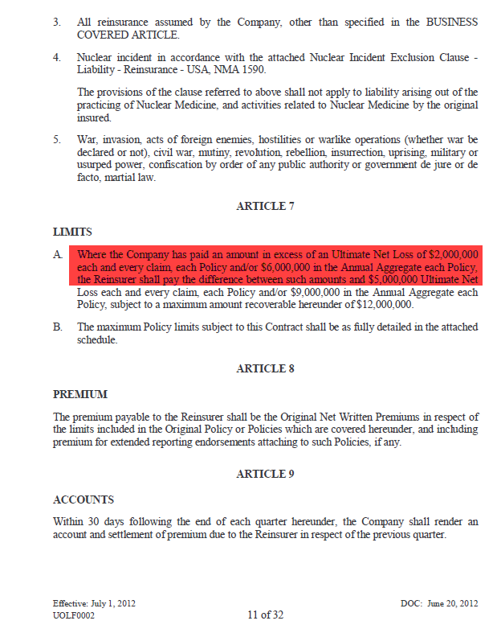
Goal and Mission Contract Review at Swiss Re
Goal:
Avoid signing contracts containing clauses resulting in unintended coverage or higher exposure.

Slide 4
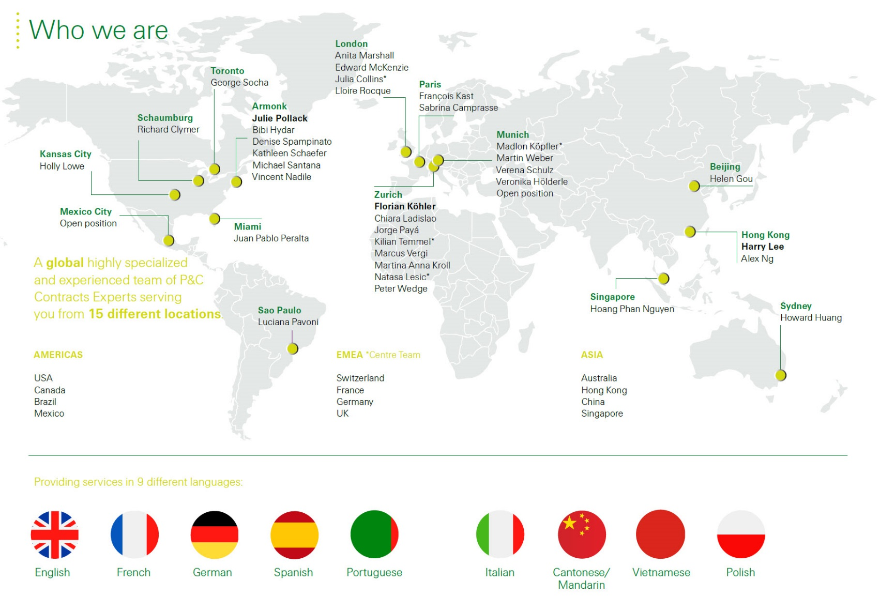
Who and Where We Are
Contract Review at Swiss Re
Our global function gives Swiss Re a competitive advantage by:
bringing together a multicultural team with international diversity
providing in-depth knowledge of local markets with our team in primary locations
offering multiple language skills
enabling one voice by having consistent principles
bringing diversity in management
supporting ease of doing business to leverage efficiencies
using state of the art technology to increase productivity, consistency and gain efficiencies

Slide 5
The Process
Contract Review at Swiss Re
Workflow Tool
Contract Review Tool
1
2
3
4
CONTRACT EXPERT
BROKER/
CLIENT
CLIENT MARKET/
UNDERWRITER
BUSINESS Support
Contracts Expert performs tool-supported efficiency and consistency check on treaty document
YES
BUSINESS SERVICES
NO
Business Support performs tool-supported document comparison
Scenario #1: Is this a new contract?
Scenario #2: Are there any material deviations and/or changes in the renewal contract?
Scenario #3: Was final wording materially changed by broker/client?

Slide 6
Contract Reviewing today Current Approach and In-house Technology
Powerful in-house tool
Based on a manually curated Clause Treasury
Multiple review and analysis functionalities
ca. 45’000 clauses
§§§
7 languages
Captures market view
Notes:
72% English
Other languages: French, German, Dutch, Italian, Portuguese, Spanish

Slide 7
Strength and Weaknesses of current Technology Current Approach and In-house Technology
Strengths
Captures market and company view
Treasury is manually curated by experts
Spots all differences with respect to treasury
Weaknesses
Doesn’t distinguish between type of differences
No understanding of meaning
Dependency on clause treasury

Slide 8
Semantic Intelligence for Contract Reviewing How Semantic Technology could help
Goal: Introduce NLU (Natural Language Understanding) techniques to
- Detect differences with high impact
- Flag toxic wordings
- Reduce dependency on clause treasury

Slide 9
Semantic Intelligence: What is semantics and why is it difficult for machines? How Semantic Technology could help
Semantics: a subfield of linguistics devoted to the study of meaning
Often also refers to the human ability to understand the meaning of a word or expression
“The company keeps lots of stock on hand.”
“Transactions on the stock market closed on the positive trajectory.”
“Agreement between XL Reinsurance America Inc. and Swiss Reinsurance Company Ltd.”
“Subject: CSS Versicherung AG - Personal Accident XL 2012 - Initial Loss Advice”
Notes:
homonym (and homograph) “stock”
1) stock on hand = inventory
2) stock market = equity market

Slide 10
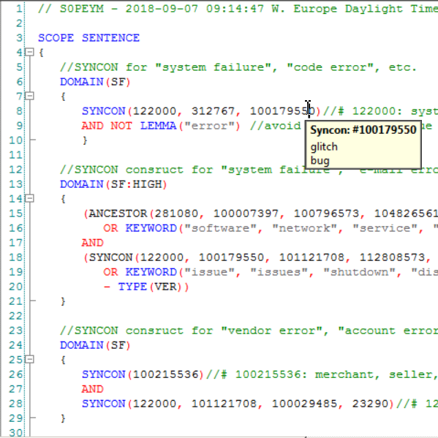
Semantic Rule-based systems for advanced Text Analysis How Semantic Technology could help
Advanced AI algorithms and knowledge graph, i.e. a rich lexical database
Complex and highly customised linguistic and/or business rules
Understanding meaning and context of language – “read the way people do”
Input
Linguistic Analysis
Linguistic Rules
Output
Pre-processing
Sentence Analysis
Semantic Analysis
Knowledge Graph
concepts, domain ontologies, companies, …
E.g. - Contracts, - Claims, - Submissions, …
E.g. - Pre-processing, - Entity extraction, - Classification
Notes:
Representation of semantic knowledge where concepts are connected through semantic relationships, e.g. hypo/hyperonymy , related terms, grammatical information, etc.

Slide 11
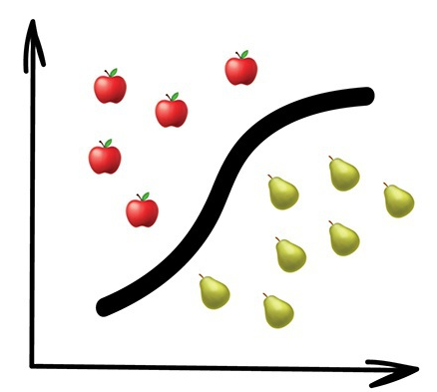
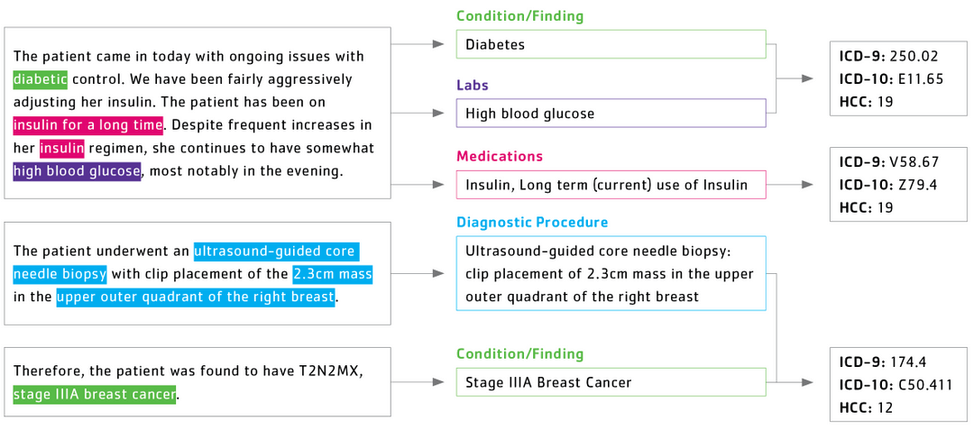
Machine-learning vs. rule-based How Semantic Technology could help
Machine-learning
learns from previous examples
good at generalising
uses statistics, not language or business knowledge
Rule-Based
encodes domain expertise
highly customisable and very precise
understands language and business domain
https://vas3k.com/blog/machine_learning/
https://www.talix.com/platform

Slide 12
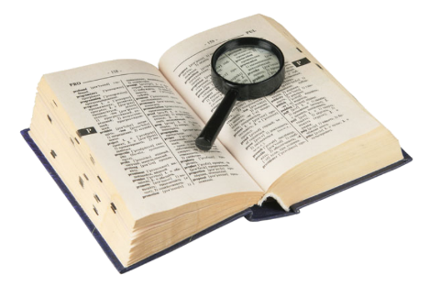
Contract Reviewing tomorrow: Semantic Similarity How Semantic Technology could help
Detect synonyms and related words
Define and implement legal similarity
Codify and apply business knowledge

Slide 13
Textual Similarity: matching symbols to symbols
Guy Carpenter & Company, is hereby recognized as the Intermediary negotiating this Agreement for all business hereunder.
XXXXX is hereby recognised as the intermediary negotiating this Contract for all business hereunder.
Textual Similarity: ~80%

Slide 14
Semantic Similarity: Aligning the meaning of words and expressions
Guy Carpenter & Company, is hereby recognized as the Intermediary negotiating this Agreement for all business hereunder.
XXXXX is hereby recognised as the intermediary negotiating this Contract for all business hereunder.
Broker Name
to recognise
Insurance Broker
to negotiate
Re. Contract
Re. business
placeholder Broker name
to recognise
Insurance Broker
to negotiate
Re. Contract
Re. business

Slide 15
Semantic Similarity: Aligning the meaning of words and expressions
Guy Carpenter & Company, is hereby recognized as the Intermediary negotiating this Agreement for all business hereunder.
XXXXX is hereby recognised as the intermediary negotiating this Contract for all business hereunder.
Semantic Similarity: 100%

Slide 17
Legal notice
©2019 Swiss Re. All rights reserved. You are not permitted to create any modifications or derivative works of this presentation or to use it for commercial or other public purposes without the prior written permission of Swiss Re.
The information and opinions contained in the presentation are provided as at the date of the presentation and are subject to change without notice. Although the information used was taken from reliable sources, Swiss Re does not accept any responsibility for the accuracy or comprehensiveness of the details given. All liability for the accuracy and completeness thereof or for any damage or loss resulting from the use of the information contained in this presentation is expressly excluded. Under no circumstances shall Swiss Re or its Group companies be liable for any financial or consequential loss relating to this presentation.

