Slide 1
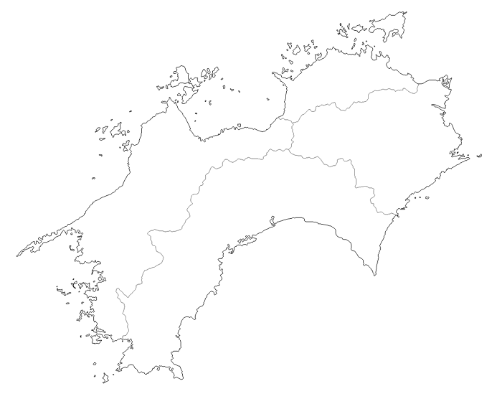
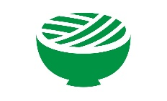
AIDA in Marrakech
April 23th, 2019
Legal Issues on Autonomous Ship in Japan
Prof. Tadao KOEZUKA
JSD(Keio Univ.), LLM in Insurance Law(UConn)
KAGAWA UNIVERSITY, Takamatsu, Japan
Visiting Attorney-at-Law, Kobayakawa Law Office
koezuka@jl.kagawa-u.ac.jp

Slide 2
Index:
“Legal Issues on Autonomous Ship in Japanese Laws”
Ⅰ. Introduction
Ⅱ. The concept of “Ships” in Acts of Japan.
１. The Levels of Autonomous Ship
２. The Concept of “Ships”ーIs “Autonomous Ship” included in it?
Ⅲ. Civil Responsibility
１. Rule of Modern LawーUnsurpassed Boundary between “Person” and
“Things”ー
２. Liability for transport object, third parties(outside contract), Liability under
employment relationships and Responsibility for removal of remnants
３. Difficulty in finding the cause of the accident
Ⅲ. Marine Insurance
１. Marine insurance type Marin Cargo Insurance, Ship Insurance, P&I
Insurance, Shipowners' liability insurance for passengers' personal accident
２. Investigation of the Cause of Marine Accidents
Ⅳ. Conclusions

Slide 3
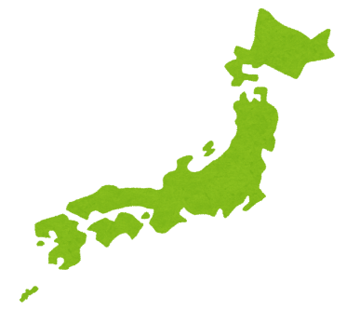
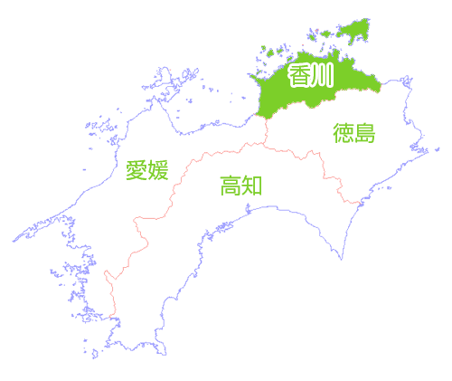
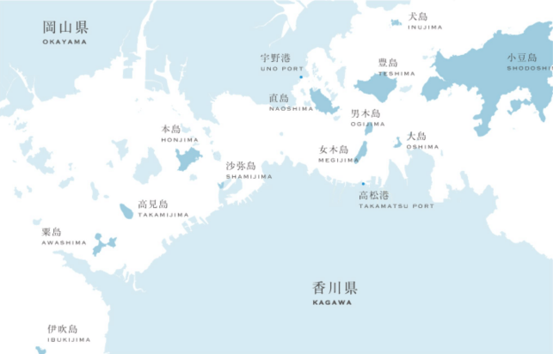
Ⅰ．Introduction
Shikoku Island
Japan
－Many ships are
sailing between
the many islands
of the Seto Inland
Sea every day.
－Because there are
few people who want
to be seafarers and lack
of manpower, it is
expected that Autonomous
Ships will be introduced
to society.
Takamatsu City
Kagawa Univ.
Kagawa Pref.

Slide 4
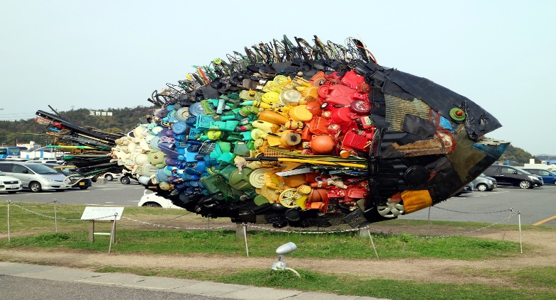
Ⅰ．Introduction
Setouchi Triennale 2019 from Apr. 26th 【Source】 https://setouchi-artfest.jp/en/
The Chichu Art Museum in Naoshima
Uno's Chinu in Uno Port
【Source】 https://www.e-tix.jp/chichu/en/
【Source】 http://tabino-snap.cocolog-nifty.com/blog/2016/04/post-df24.html

Slide 5
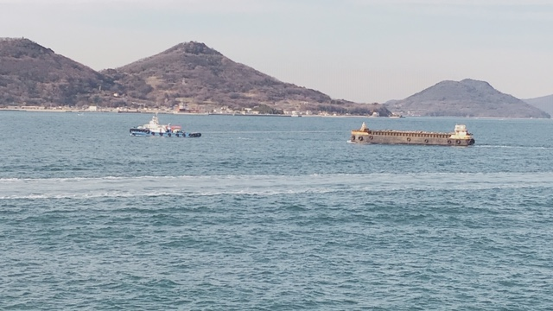
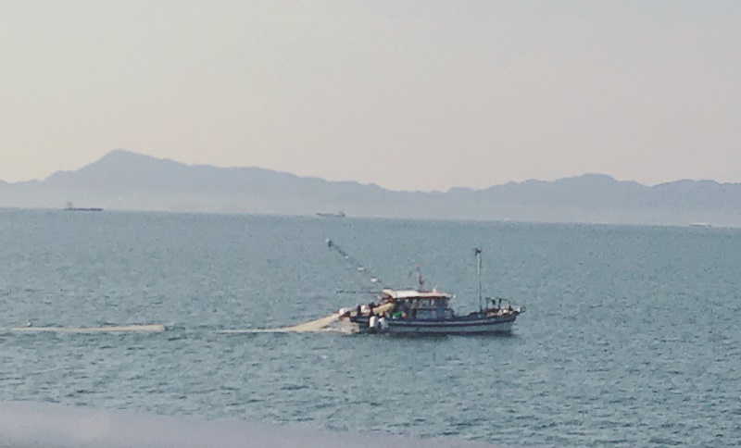
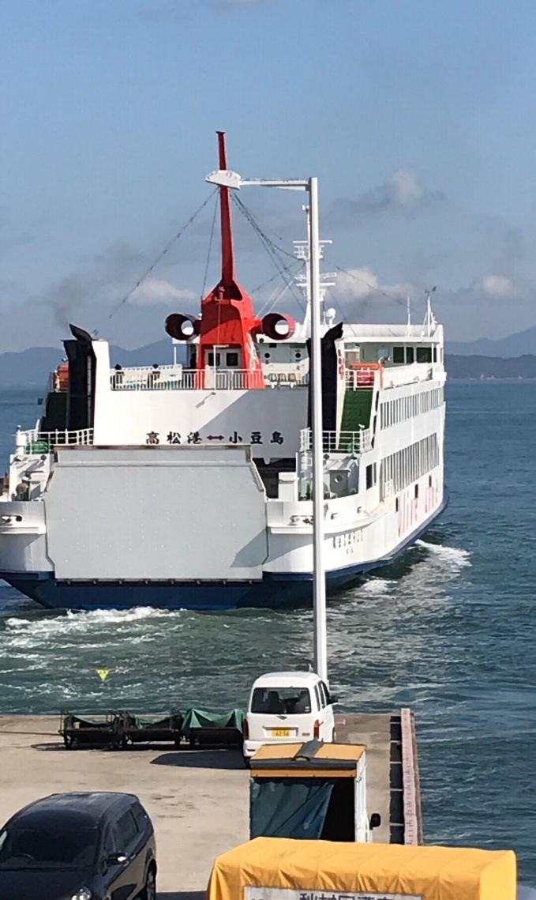
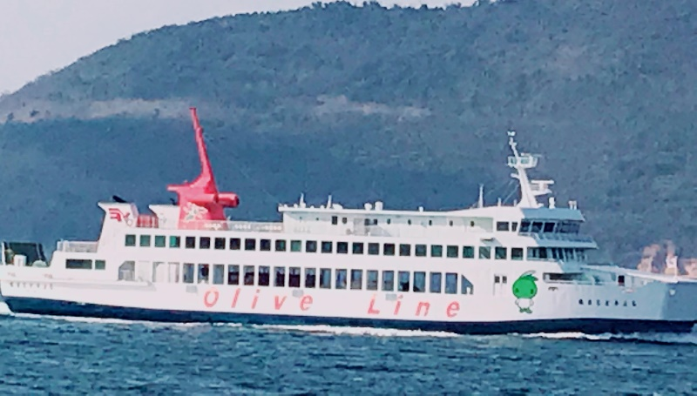
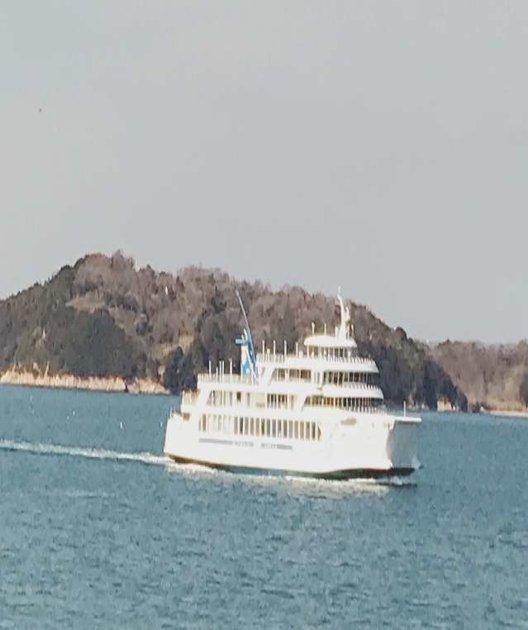
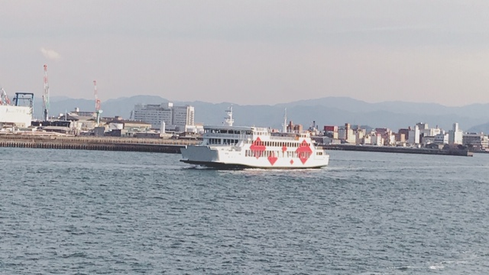
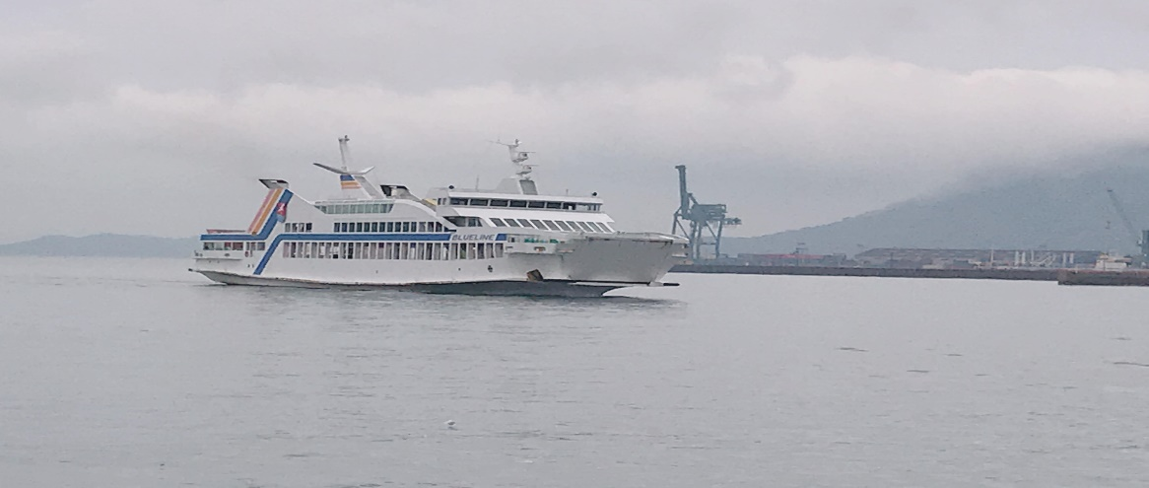
Ⅰ．Introduction

Slide 6
Ⅰ．Introduction
“Growth Strategy 2017（Initiatives and Programs）”, Cabinet decision,
Jun. 9, 2017
－In order to commercialize an automated operated ship by 2025,
Japan will set up an international standard for data transmission
of onboard equipment etc., next year.
－“(Shipment/Receipt) A package is shipped from a remote island of Shikoku to a friend living in Hokkaido. Thanks to the coordination of transportation which is supported by robot-ticks such as auto-operated ship, truck drive in convoy, unmanned auto-driving, and indivi dua l delivery by drone, the package was delivered safely, securely, speedily, and cheaply, despite being in the middle of winter.” p.12

Slide 7
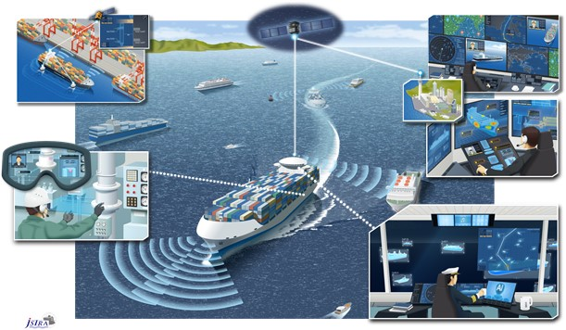
Ⅰ. Introduction
A Future Autonomous Ship
【Source】http://www.mlit.go.jp/report/press/kaiji07_hh_000109.html

Slide 8
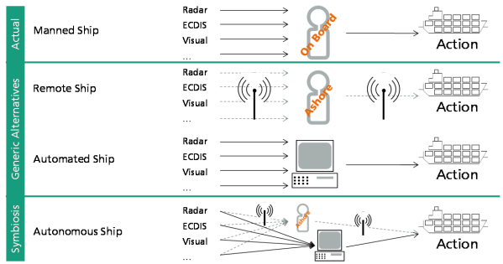
Ⅱ. The concept of “Ships” in Acts of Japan
１．The Levels of Autonomous Ship
From Manned Ship to Autonomous Ship
【Source】Rodseth and Burmeister,”Developments towards Unmanned Ship” MUNIN Project

Slide 9
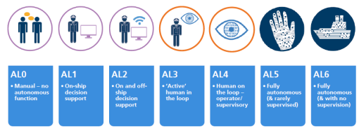
Ⅱ. The concept of “Ships” in Acts of Japan
１．The Levels of Autonomous Ship
Accessibility Levels; AL0~AL6 (Lloyd’s Register)
【Source】 Lloyd’s Register, “Revised update of LR‘s Cyber-enabled ships Ship Right procedure”（Dec. 06, 2017）, Transportation Policy Council in MLIT, “Mid-term report: Measures to be promoted in the short term to deepen the productivity revolution of the maritime industry” p.21(Mar.28, 2018) )[in Japanese]. https://www.lr.org/en/latest-news/early-adopters-and-innovators-in-connected-assets-on-ships/#.XLQT8vPOM7c.email

Slide 10
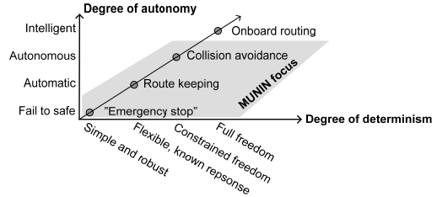
Ⅱ. The concept of “Ships” in Acts of Japan
１．The Levels of Autonomous Ship
Autonomy versus Determinism
【Source】Rodseth and Burmeister,”Developments towards Unmanned Ship” MUNIN Project

Slide 11
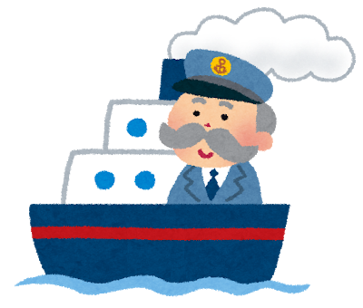
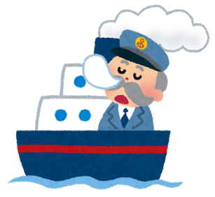
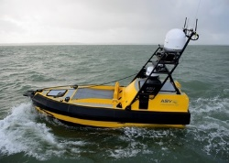
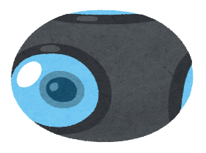
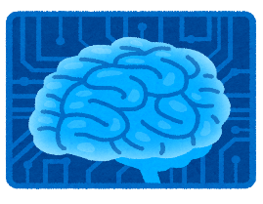
Ⅱ. The concept of “Ships” in Acts of Japan
２. The Concept of “Ships”ーIs “Autonomous Ship” included in it?
Manned Ship (Driver)
Cognition
Judgment
Operation
Autonomous Ship (AI)
？
equal
Cognition
Judgment
Operation
https://www.
toyo.co.jp

Slide 12
Ⅱ. The concept of “Ships” in Acts of Japan
２. The Concept of “Ships”ーIs “Autonomous Ship” included in it?
【Big Issue】 Whether an autonomous ship is included in the legal concept of a ship? The Japanese law on ships does not contain an unified definition of "ships".
－If an Autonomous Ship does not fall under the concept of “ship”,
the Autonomous Ship does not apply to the maritime conventions and
regulations.
(E.g.) If a Remote Control Ship is regarded as the same as a toy radio
control boat, the Remote Control Ship will be treated as a "toy" rather
than a "ship" in law.
－ Really, the size of Autonomous Ship is generally more than 5 tons,
like a general cargo ship.
－ It is not appropriate to evaluate an Autonomous Ship as the same as
a toy control boat.

Slide 13
Ⅱ. The concept of “Ships” in Acts of Japan
２. The Concept of “Ships”ーIs “Autonomous Ship” included in it?
The Acts on Ships, which are defined the concept of “Ship”, are enacted as follows:
［1］Commercial Code Art.68(1) （1899）;
ー The term "Ship" as used in this Act means one used in a voyage at sea for the purpose of conducting a commercial transaction.,
[2] Act on Preventing Collisions at Sea Art.3-1 (1892);
ー“Ship" refers to ships (・・・) used for water transportation.
[3] Act on Liability for Oil Pollution Damage Art. 2-(iv)-2（1975）;
ー“General Ship” means the ship for the carriage by sea of freight・・・, [4] Basic Act on Traffic Safety Measures (1970);
ー“Ship”: A ship or boat for navigation on water or in water.
But these definitions in the Acts are not unified.

Slide 14
Ⅱ. The concept of “Ships” in Acts of Japan
２. The Concept of “Ships”ーIs “Autonomous Ship” included in it?
Comparison of Autonomous Cars and Autonomous Ships
 | Autonomous Cars | Autonomous Ships
Drive・Operation | ・ One driver operates | ・ A plurality of persons, such as ship handling, engine maintenance, cargo monitoring, takeoffs, etc. share work. ・ A typical commercial vessel is a large-scale system operated by a crew, and also has the characteristics of a 24-hour plant.
Physical characteristics | ・ Several tons, high agility (rapid start, sudden stop, quick turn possible) | ・ Large ships are in the hundreds of thousands of tons, with low agility（rapid start, sudden stop, quick turn impossible）
Traveling and navigation environment | ・ Movement is relatively fast, always close to other vehicles. ・ There are many pedestrians and bicycles around the car（Mixed traffic） ・ There are many travel restrictions such as lanes and traffic lights. | ・ Movement is relatively slow and not nearly in close proximity to other ships. ・ There are mainly ships around the it, but there are also fishing nets and floats. ・ There are few movement restrictions except for some restrictions. ・ The state of isolation continues on the sea for a long time.

Slide 15
Ⅱ. The concept of “Ships” in Acts of Japan
２. The Concept of “Ships”ーIs “Autonomous Ship” included in it?
Continue・・・
 | Autonomous Cars | Autonomous Ships
Development trend | ・In order to drive safely under a high density mixed traffic environment, development and practical application of safe driving support technology such as collision damage reduction brakes will progress. ・ A technology for autonomous driving on public roads has been developed using a combination of 3D position information, GPS, etc., with technology for recognizing objects around the vehicle by sensors etc. | ・ Technology developments contributing to the improvement of safety and efficiency are progressing in each of the work areas such as navigation planning, ship maneuvering, hull / equipment management, and cargo management.
【Source】 Transportation Policy Council in MLIT, “Mid-term report: Measures to be promoted in the short term to deepen the productivity revolution of the maritime industry” p.18(Mar.28, 2018)[in Japanese].

Slide 16
Ⅱ. The concept of “Ships” in Acts of Japan
２. The Concept of “Ships”ーIs “Autonomous Ship” included in it?
－The Art.3-1 of the Act on Preventing Collisions at Sea (1892); “in ships, to be able to fully judge the surrounding situation and the possibility of collision with other ships, always keep an appropriate look-up by sight, hearing and all other means suitable for the situation at that time”.
⇒ It is not clear who always keep an appropriate look-up in this Article. This purpose of this Article is to avoid a collision with other ships. Since the purpose of this Article is to avoid collision with other ships, if the situation around the ship can be grasped, even if AI looks
out and even if a person looks out
overboard, there is no need for seafarer to
board and look over.

Slide 17
Ⅱ. The concept of “Ships” in Acts of Japan
２. The Concept of “Ships”ーIs “Autonomous Ship” included in it?
－But, the purpose of watching is to collect information on the
situation around the ship. Since the appropriate decision will
be made by the person making a decision from the information
collected, it is necessary for the person to make the final decision
even if the AI watches.
－The Art.39 of the Act on Preventing Collisions at Sea (1892);
the provisions of this Act do not excuse the responsibility of
“seafarers” for the consequences of neglecting to take the necessary precautions as ...
⇒ In Japan's current law, AI is not recognized as a legal entity
responsible for it, so it is understood that "seafarers" does not
include AI.

Slide 18
Ⅱ. The concept of “Ships” in Acts of Japan
２. The Concept of “Ships”ーIs “Autonomous Ship” included in it?
－There is no legal need for seafarers to be located on the ship, provided that AI or remote-control can avoid onboard risk and offboard risk. Therefore, Seafarers are not an essential factor in determining whether they are ships or not.
－Seafarers are not a component of “Ships”, but under the current law of Japan seafarers are required to avoid onboard risk and outboard risk.
⇒ I think that it is possible to define that Unmanned Ships are legally “Ships” by revising treaties and domestic laws.

Slide 19
Ⅲ． Civil Responsibility
１．Rule of Modern LawーUnsurpassed Boundary between “Person” and “Things”
Person cannot
control an AI .
Person can
Control a dog.
Cloud Computing
Cyber Physical System
Decision Making
香川PHR
データセンター
Control
Optimization
Optimization
Data Collecting
自然人（法人）
ＡＩ on Things
Things
Subject of rights
Intermediate form between
Person and Things
Object of rights

Slide 20
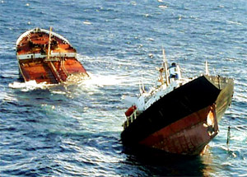
Ⅲ. Civil Responsibility
２. Liability for transport object, third parties(outside contract), Liability under employment relationships and Responsibility for removal of remnants
－Because seafarers can control manned ships, generally maritime accidents are often caused by seafarers' negligence.
－In the case of removal of
remnants, the owner of them
may be held liable.
【Source】https://www.spf.org/_opri/newsletter/2010
/242_2.html (The Sasakawa Peace Foundation)
― In employment
relationships, owners of ships are responsible for compensation
for seafarers' casualties.

Slide 21
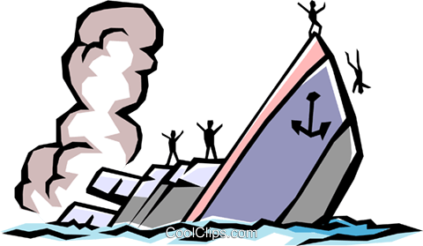
Ⅲ. Civil Responsibility
３. Difficulty in finding the cause of the accident
－An autonomous ship is equipped with an AI, and while communicating or remotely controlled, the autonomous ship navigates. At that time, if a cyber attack is received, there is a possibility that a marine accident may occur because the AI can not be controlled or the remote control can not be performed.
Dos attack

Slide 22
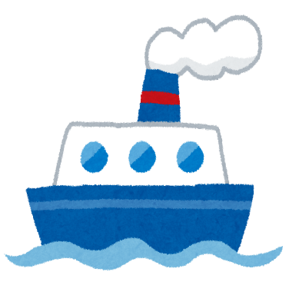
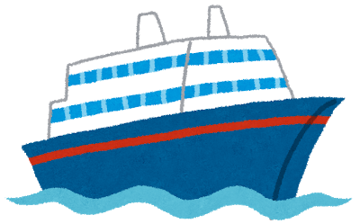
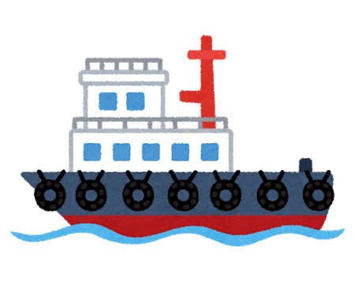
Ⅲ. Marine Insurance
１. Marine insurance type Marin Cargo Insurance, Ship Insurance, P&I Insurance, Shipowners' liability insurance for passengers' personal accident
－Marine insurance has various types of insurance.
－There are two types of marine insurance: first-party insurance
and third-party insurance.

Slide 23
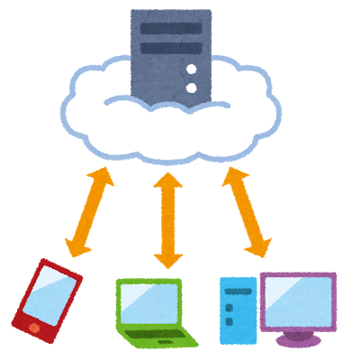
Ⅲ. Marine Insurance
２. Investigation of the Cause of Marine Accidents
－The autonomous ship operates while communicating with
the cloud computer.
－A virus may invade an autonomous ship-mounted
AI and cause a marine accident.
In this case, it becomes extremely
difficult to find out the cause of the
marine accident. It is difficult to
determine if the virus is the cause
of the accident, a defect in the
product, or the negligence of
the seafarers. Therefore, third-party insurance does not work
well because it is not immediately clear whether the insured is
liable for legal damages.

Slide 24
Ⅳ. Conclusions
The cause of the accident for research and development
should be distinguished from the cause of the accident for the
pursuit of civil liability and criminal liability.
2. It is difficult to investigate the cause of the sea accident in a short time and without increasing the economic cost, considering the possibility of cyber attack, except for a case where seafarer's mistake is the cause of the accident.
3. Liability insurance does not work because it is difficult to
determine whether the insured has incurred damages in an accident
that has the possibility of a cyber attack.
4. I think that first party insurance such as ship insurance should
be enhanced. However, it is necessary to sort out the exclusion
clause on a simple cyber attack, terrorism or war.

Slide 25
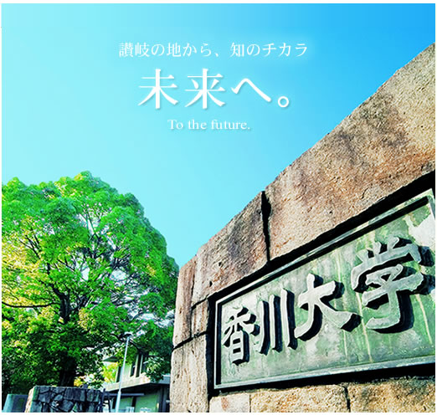
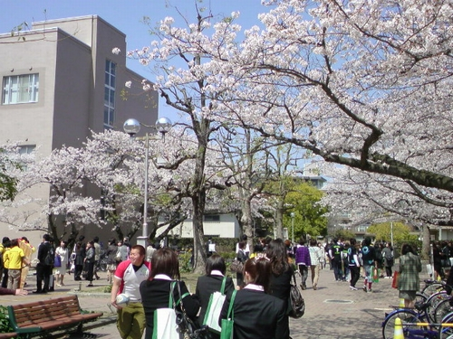
From Setouchi Inland Sea, Review Japan and World
Thank you for your Attention！
UDON Prefecture

